Slide 1
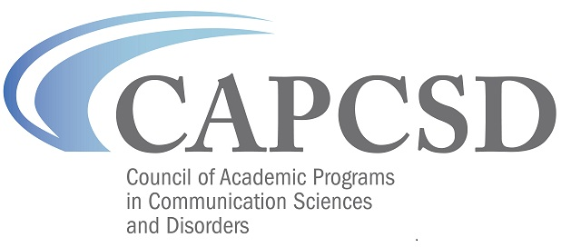
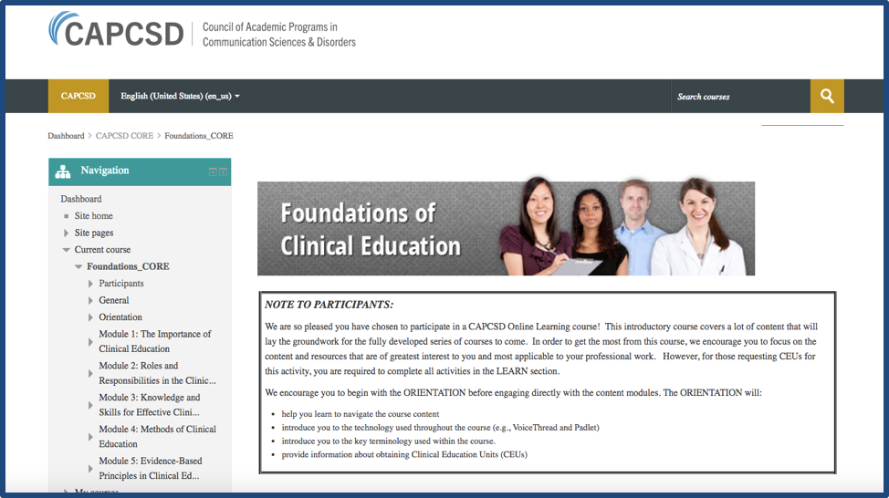
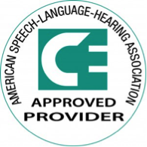
Clinical Education/Supervision eLearning Courses!
http://elearning.capcsd.org
Training in Clinical Education/Supervision Matters!
Your work as a highly skilled clinical educator/supervisor of graduate students in speech-language pathology is important to the success of our profession!
The Following Courses Have Been Developed:
Foundations of clinical education
Effective clinical educator –student relationships
Effective feedback
Coming Soon- Assessment of student performance
Starting January 1, 2020, ASHA will require that preceptors, clinical supervisors and Clinical Fellowship mentors have a minimum of two hours of professional development in the area of supervision, post-certification.
To help meet this need, Sacred Heart University, Southern Connecticut State University, and the University of Connecticut are pleased to offer all their clinical preceptors/educators/supervisors the opportunity to participate in the CAPCSD Clinical Education/Supervision eLearning Courses at no charge!
Each course has five (5) modules that may be completed independently of the others. Course modules contain readings, video tutorials and interactive learning activities that you may complete on your own schedule.
For course enrollment codes and more information about how to register, please contact:
AAA and ASHA CEUs are available at no charge for successful completion of each course module!

