Slide 1
The State of the Utah Valley Economy
Utah Valley Chamber 2018 Executive Summit
September 27, 2018
Juliette Tennert, Chief Economist

Slide 2
The State of the Utah Valley Economy IS STRONG

Slide 3
Near 1 in every 3 Utah jobs gained was in Utah County
Job Growth
August 2017 – August 2018
Source: Utah Department of Workforce Services

Slide 4
Utah can’t be #1 without Utah County
States with Most Robust Job Growth
August 2017 – August 2018
Source: Gardner Policy Institute analysis of Utah Department of Workforce Services and U.S. Bureau of Labor Statistics data

Slide 5
Innovation Economy, Construction, Health Care fueling growth
Job Growth by Industry
2017-2018
Source: Utah Department of Workforce Services

Slide 6
Over 1 in 4 new Utahns in Utah County
Population Growth
2010 - 2017
Sources: Gardner Policy Institute Utah Population Committee and U.S. Census Bureau

Slide 7
Utah can’t be #1 without Utah County
States with Most Robust Population Growth
2010 - 2017
Source: Gardner Policy Institute analysis of Gardner Policy Institute Utah Population Committee and U.S. Census Bureau

Slide 8
Over 50 percent of growth in 4 cities
Distribution of Population Growth in Utah County
2010 - 2017
Lehi city | 16.6% |  | Mapleton city | 1.9%
Saratoga Springs city | 13.1% |  | Payson city | 1.5%
Eagle Mountain city | 11.4% |  | Elk Ridge city | 1.5%
Orem city | 10.6% |  | Lindon city | 1.0%
Vineyard town | 6.8% |  | Alpine city | 0.9%
Pleasant Grove city | 5.9% |  | Cedar Hills city | 0.6%
Provo city | 5.4% |  | Unincorporated | 0.5%
Spanish Fork city | 5.2% |  | Draper city (pt.) | 0.4%
Springville city | 4.1% |  | Woodland Hills city | 0.2%
Highland city | 3.8% |  | Genola town | 0.2%
American Fork city | 3.3% |  | Goshen town | 0.0%
Santaquin city (pt.) | 2.8% |  | Cedar Fort town | 0.0%
Salem city | 2.0% |  | Fairfield town | 0.0%
Source: Gardner Policy Institute analysis of U.S. Census Bureau data

Slide 9
Economic migration relatively strong in Utah County
Net Migration Contribution to Population Growth
2010 - 2017
Sources: Gardner Policy Institute Utah Population Committee

Slide 10
“Whether by design or default, you are shaping your future”
Challenges and Opportunities for Utah County
(End of Business Cycle?)
Economic and Demographic Growth
Diversity – economic, age, culture
Transportation – air, land water
Critical land conservation
Affordable housing
Tax modernization
Sources: Eric Allenbaugh (quote), Kem C. Gardner Policy Institute

Slide 11
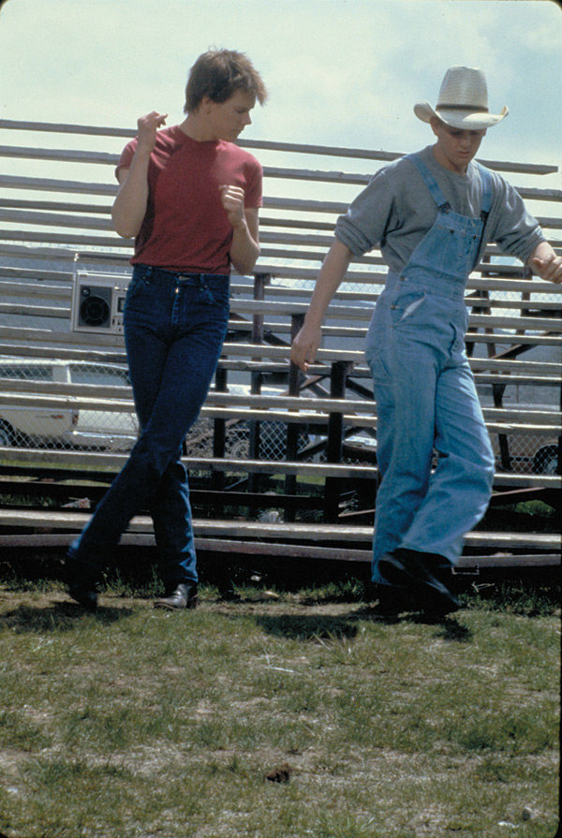
Thank you!
Juliette Tennert, Chief Economist
juliette.tennert@utah.edu
Kem C. Gardner Policy Institute
David Eccles School of Business | 411 E. South Temple Street Salt Lake City, UT 84111 | 801-585-5618 | gardner.utah.edu
Facebook.com/gardnerpolicyinstitute | Twitter.com/KemGardnerInst

