Slide 1
Welcome to ChamberMaster!
Over 2300 Associations Partner with ChamberMaster
ChamberMaster is a modern, cloud-based management platform that will help your organization reach new levels of service and create additional value for your members. ChamberMaster is proven technology, tracking membership data for over 1 million members across over 2200 organizations. Through our leading-edge technology, impressive value proposition, and true care for our customers we have become the leader in serving organizations with our ChamberMaster Member Management Platform.
Timely Software Updates: Because it’s web-based, there’s never anything to update or install and you will see new features for you and your members added nearly every single month!
Save Time and Money with ChamberMaster: Our web components simply plug into your website and save you the software development costs of having these features created on your own.
Eliminate dual entry time: One entry updates your website, accounting, and contact records. ChamberMaster Plus will allow you to upload your billing transactions with QuickBooks and automatically upload contacts to your groups in Constant Contact or MailChimp. We import your existing member database into MemberZone for a smooth transition.
Training and Support is included: Unlimited use of our online, instructor-led training courses, access to our 1-800 Technical Support department (7-7 CST), email support, videos and online user manuals.
Unlimited users: Setup as many users as needed. Each staff member will have their own login and password to track changes and set access levels.
Member Center: Each member has a login so they can update their online directory listing, contact information, submit Hot Deals, Job Postings, and Event requests, view their own chamber website statistics, view account balances, pay online and connect with other members.
Powerful Modules for your Website: Directory, Hot Deals, Member to Member Hot Deals, Job Postings, Events Calendar(s), MarketSpace, Contact Us Form, Information Request, Weather page, Member Login & Center, Member Map Listing, Member Application Form, RFP Form, Group Signup Form, Blog, Board and Committee listing page, eCommerce, Form Builder/Survey and News Releases all easily connected to your website and updated using ChamberMaster.

Slide 2
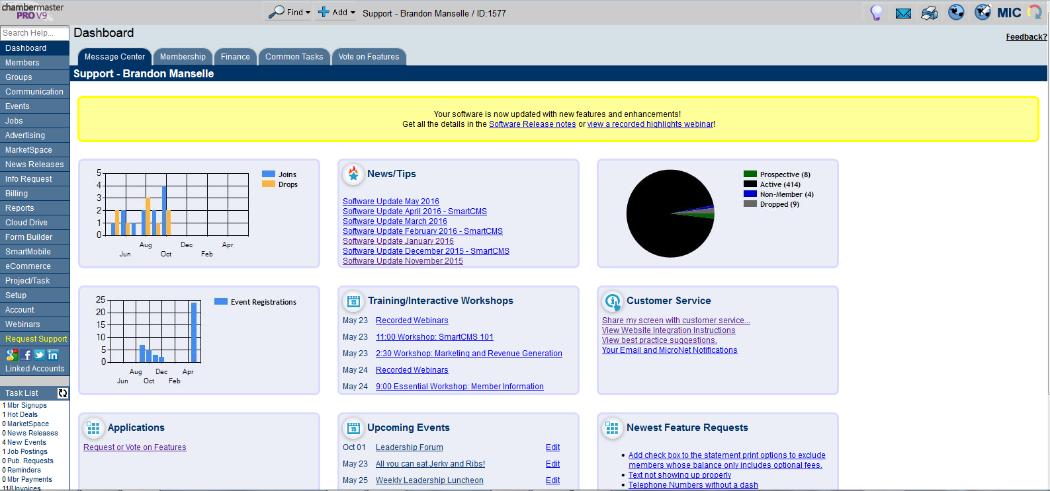
What does ChamberMaster Provide?
We provide the backend database solution for your Chamber staff allowing them to quickly and efficiently update member data!

Slide 3
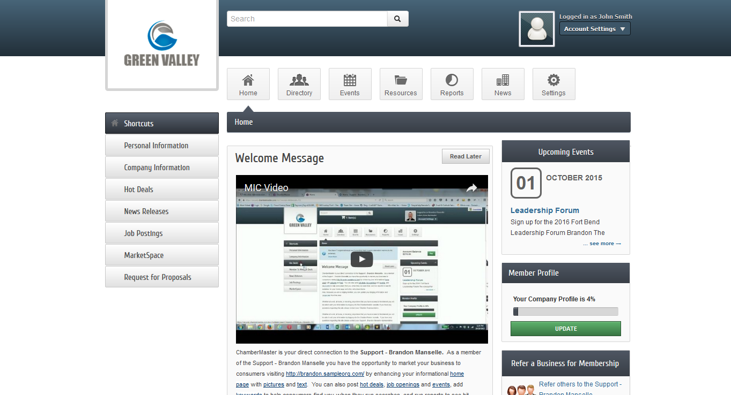
Member Benefits!
We also provide benefits and value to the Chamber’s members allowing them to login, engage and update content on their own in our Member Information Center!

Slide 4
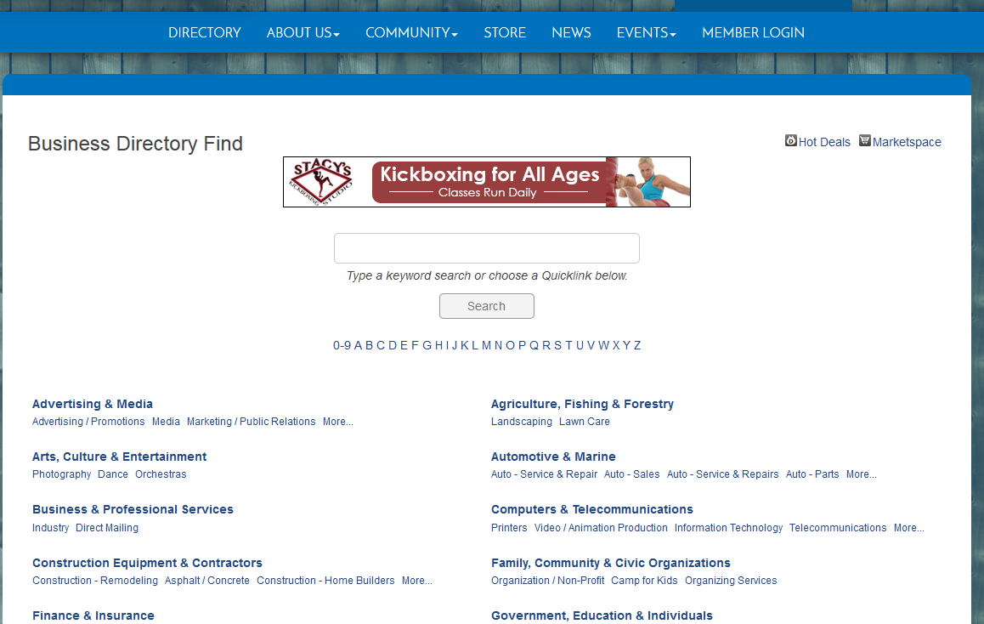
Website Solutions!
And lastly we can integrate or build Chamber’s an new, responsive website!

Slide 5
Check it out yourself!
Below are some quick videos on ChamberMaster and some of the benefits it provides to your Chamber and Chamber Members!
Staff reduces data entry time!
Member tools in the member information center!
5 minute demo of how it works!

