Slide 1
NSVFA Membership Renewal
Step by step guide to renewing your membership online.

Slide 2
Step 1
Go to NSVFA home page www.nsvfa.org

Slide 3
Step 2
At the very top of the screen on the right side click on the member login tab

Slide 4
Step 3
In the middle of the screen click on the button “Member Login Page”

Slide 5
Step 4
Enter your email and password
(Please note you must be a department Administrator to access all of your department’s information) If you are unable to login, contact the NSVFA office at 402-761-2211

Slide 6
Step 5
On new screen after signing in on the left side click on the tab “My INFO”

Slide 7
Step 6
The new screen will now display your information that we have on file in the software. By clicking on the “pencil” icon to the right of the listed fields you can update your information.

Slide 8
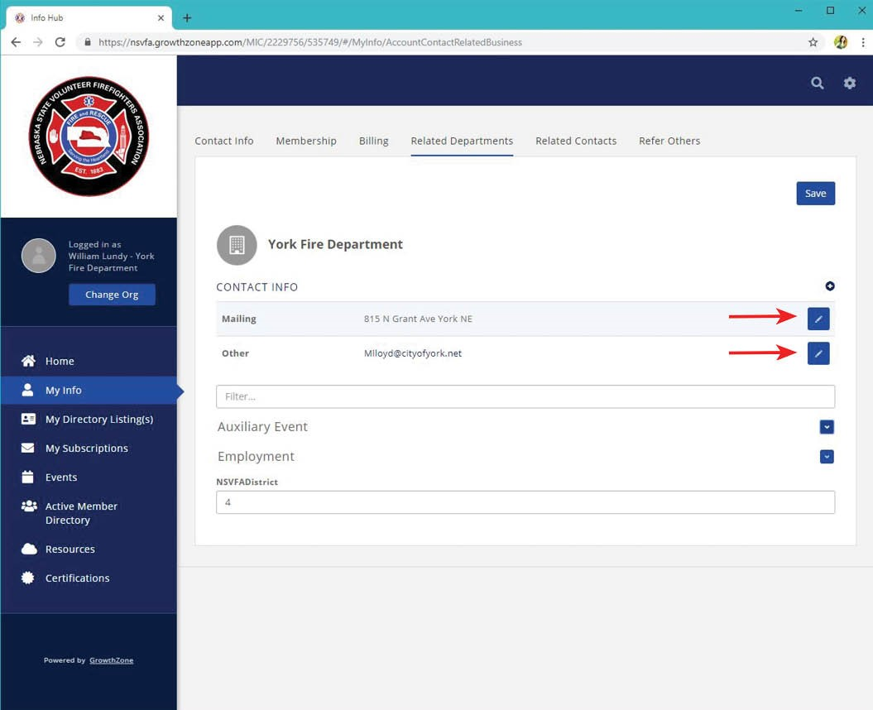
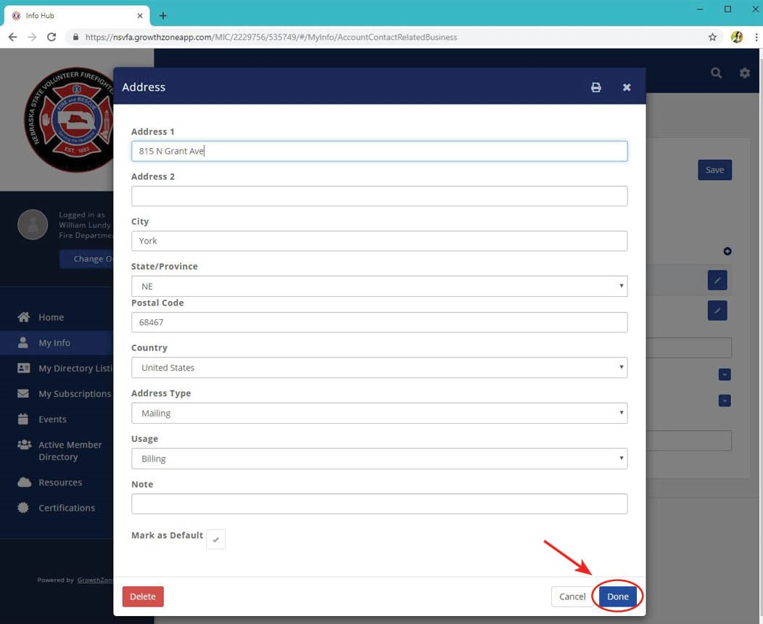
Step 7
Please confirm your department’s mailing address by clicking on the “Related Departments” tab. This will open a new screen showing the mailing address of your department and department email we have in the system. To update any of this data click on the pencil icon on the right-hand side of the box of the information you want to update. Once you have updated the information click on the “Done” bottom at the bottom right hand of the screen.

Slide 9
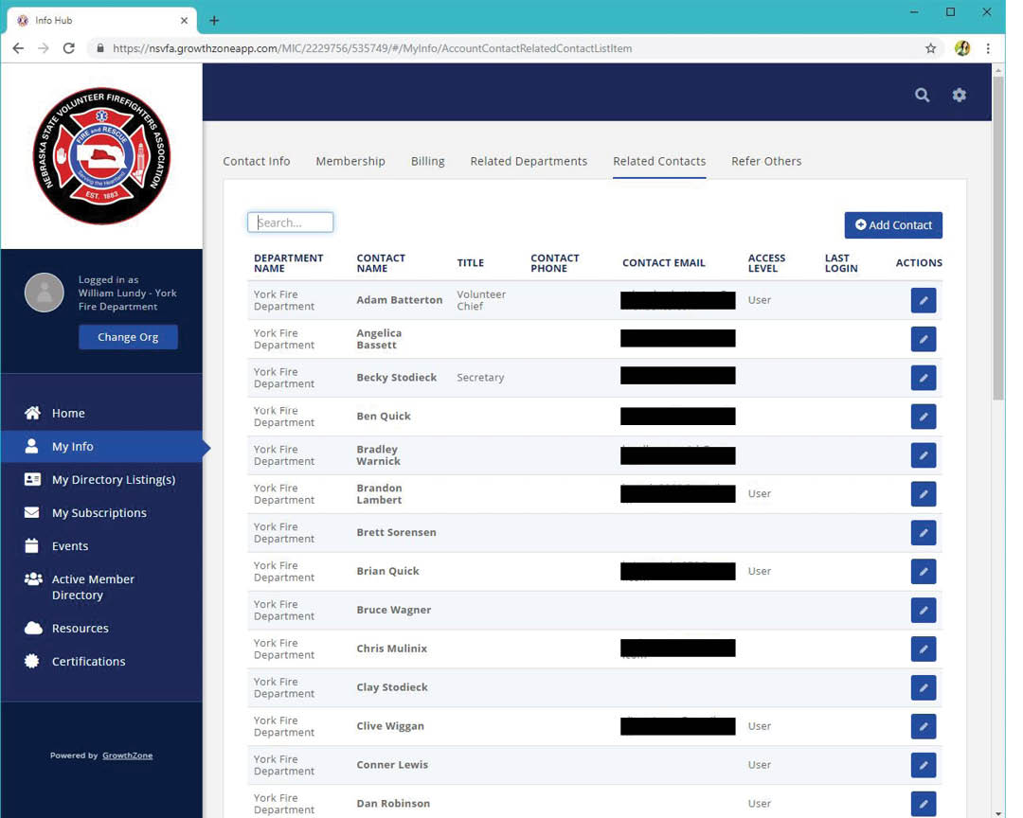
Step 8
To display your department information in the tool bar, click on “Related Contacts.” This now displays everyone that is in the system. Please note you are not listed since your information was first displayed after logging in.
Please note under the column listed as “TITLE” it may display “NP Only” which means newspaper only.

Slide 10
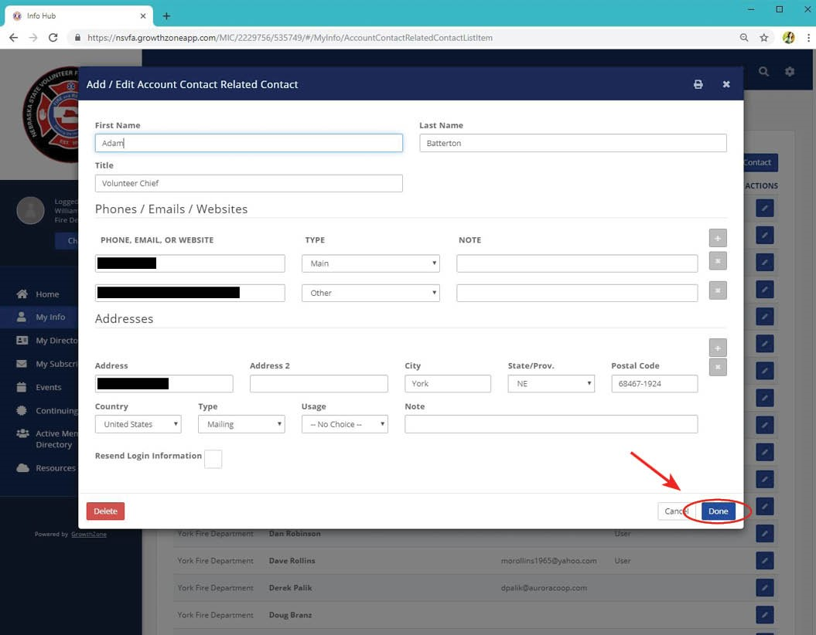
Step 9
By Clicking on the “pencil” icon to the right of their name will display all current information we have stored in the software for that person. To update any member information just click in the appropriate box and type the new information. Once all information is updated please click on the “Done” button in the bottom right corner of the form to save the update.
Once the system saves the update it will return you to the main screen.

Slide 11
Step 10
To delete a member once again click on the “pencil” icon to the right of that person’s name and at the bottom left of the form is a “Delete” button click on the button delete that person from your membership.

Slide 12
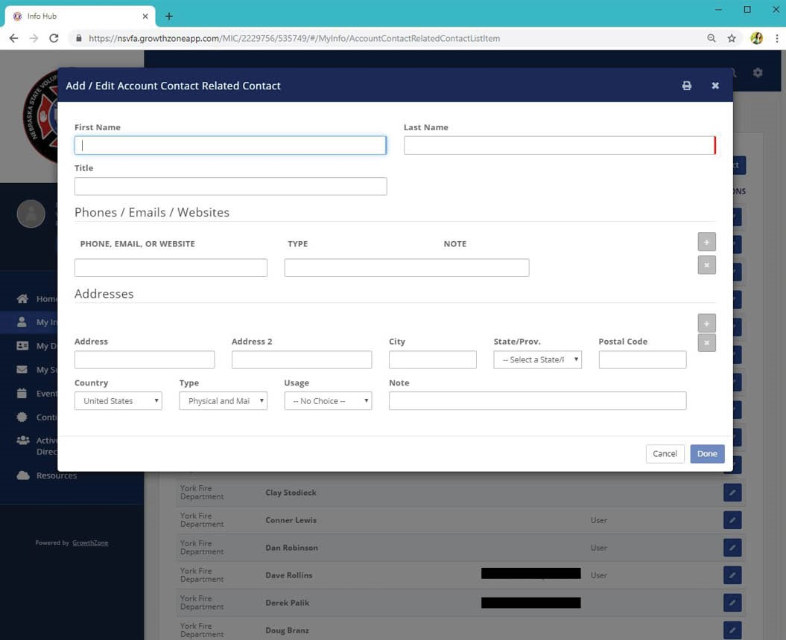
Step 11
To add a new member, go to the “Related Contacts” page at the very top right of the screen, click on the “Add Contact” button. This action will open a new blank form to add the new member or new newspaper subscription.
Complete the boxes for First and Last Name. In the box labeled Title, this is where you will enter their position (Chief, Secretary, Treasurer, NP ONLY, etc.) In the box labeled phone, Email or web site enter the telephone number associated with the new contact. In the TYPE box once, a number is entered you can select from a various number of options to identify what type of phone this may be. Example Cell, Home or Work.
To add the new members email address once you finish the telephone number click on the “+” sign to the right of the note box and this will insert a new line to allow you to add the new persons Email address. Once again in the TYPE box you can select a number of different options for the type of Email, Other, Personal, Work.
To delete any line, click on the “X” to the right of the line being displayed
In the address area of the form please complete the address information. This should be the new persons mailing address and not their physical address. Please ensure the address is correct to insure delivery of the Nebraska Firefighter Newspaper. The TYPE and USUAGE boxes can be left blank. Click on the “Done” bottom at the bottom right side of the screen to save your update. Continue adding new members until all new members have been added to the database.
Don’ forget to add “NP ONLY” to the title field of those who are newspaper only members

Slide 13
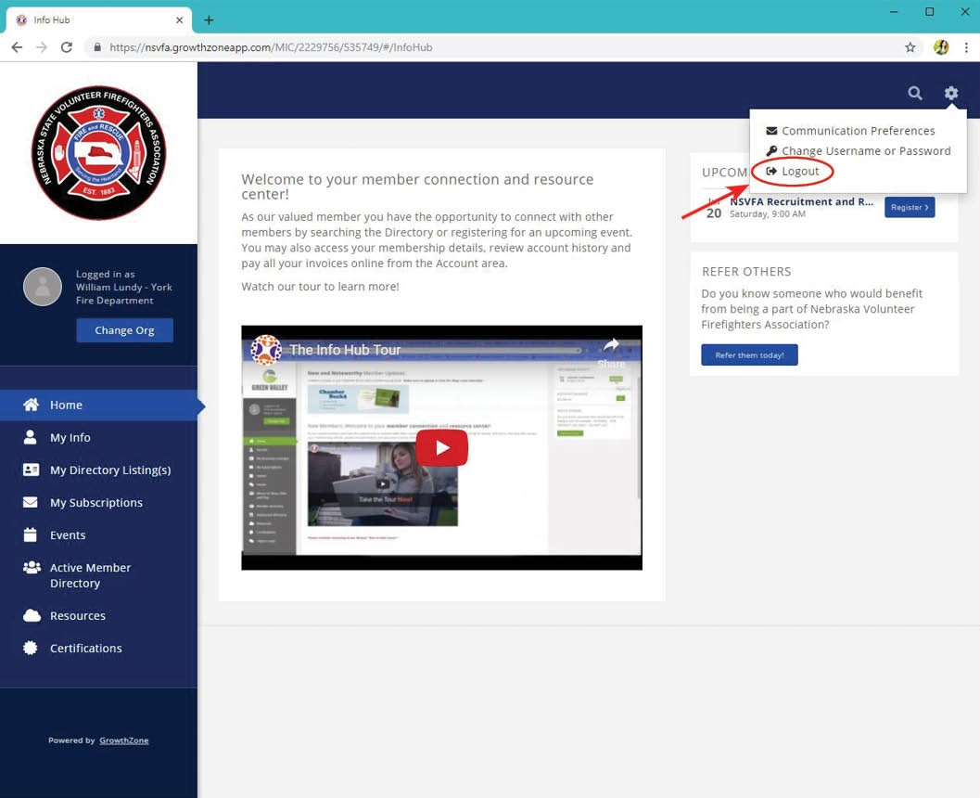
Step 12
To log out of the system in the upper right hand corner of the screen click on the “Gear” icon and from the dropdown menu select “Logout”.

Slide 14
Step 13
Once you have updated all of your information concerning your department please email the NSVFA office at staff@nsvfa.org indicating that your membership is updated and ready to be processed. Because of current limitations to the software we need you to indicate in your email the following information:
Members that want to join the Nebraska Fire Chief’s Association
Step 14
The NSVFA office will review your membership, and then generate an invoice to your department that will be sent via email and can then be paid online. Once payment is received the NSVFA office will generate new membership certificate and membership cards to be mailed to your department.

