Slide 1
DISCLAIMER
By Downloading these products I agree to the Copyright & Liability below:
Products are electronically transferred upon your acceptance to abide by the terms and conditions when you register with www.managementstudyguide.com.
Copyright Statement
This material is for a single user and may be presented to others in form of Slide Show, provided the slide masters, copyright, Logo, and other proprietary notices must also be kept intact. This product may not be re-sold, distributed electronically, reproduced electronically, stored in a database or retrieval system, except by written permission from the publisher. Any infraction or infringement will be prosecuted to the full extent of the law.
Image Credit
All Images used in this presentation are from 123rf.com and are protected by the above mentioned copyright statement.
Start Course
Start Course by viewing the presentation in “Slide Show“ mode. Please click on “Slide Show” on the top and then click on “From Beginning”.

Slide 2
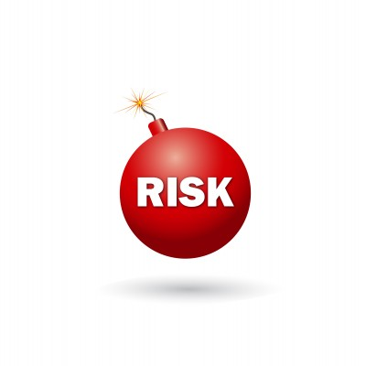
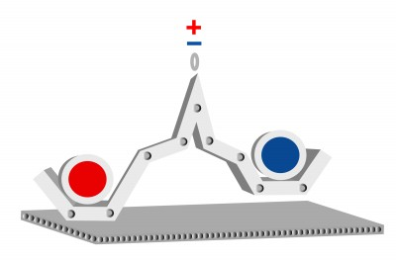
Enterprise Risk Management

Slide 3
Contents
Enterprise Risk Management - Fundamentals
Importance of risk appetite
The 4Ts of hazard response
Risk control techniques
Control of selected hazard risk
Managing uncertainty
Risk governance
Insurance and risk transfer
Evaluation of control environment
Activities of internal audit function
Risk assurance techniques
Reporting on risk management
Corporate Social Responsibility
Future of Risk Management

Slide 4
Introduction
Let us see Governance and risk management in manufacturing company
Tell me about this company
XYZ is a manufacturing company and it actually transformed its crisis into an opportunity to enhance its Enterprise Risk Management practices for value creation.
XYZ company
How old is this company?
This manufacturing company has been in operations for past 20 years and has grown from a small domestic company into a complex global organization.
XYZ company

Slide 5
Introduction
What was the issue?
A significant financial restatement led the Board of Executives to take a hard look at company’s governance, risk management and compliance functions
XYZ company
What results did the management team end up with?
The results they gathered showed that the Enterprise Risk Management (ERM) functions or practices were insufficient to support its current business
XYZ company

Slide 6
Introduction
Now, what they are likely to do? Do they implement ERM programs?
For an aggressive five-year growth plan, company leaders set out to transform the company into a Risk Intelligent Enterprise by implementing sustainable ERM programs
XYZ company
So what are the benefits?
ERM will help management to have a more consistent view of risks throughout the business and also to take important strategic decisions
XYZ company

Slide 7
Introduction
How did they start?
The company began by laying the foundation for the ERM program and developed corporate level risk objectives. The company evaluated and prioritized its risk exposures and mitigation efforts in order to understand where to focus its future investments
XYZ company

Slide 8
Introduction
What were the next steps?
With the help of external assistance, the company:
Established a steering committee of representative, corporate leaders to oversee and monitor the implementation of ERM
Established ERM charter
Developed common risk definitions
Developed the company’s risk assessment criteria
Identified and prioritized key enterprise risks
Developed a prioritized list of top 20 risks to the company based on impact, vulnerability and speed of onset
Identified important interrelationships among risks
XYZ company

Slide 9
Introduction
CEO’s message: “Our ERM program will be a strategic asset for the company in executing our aggressive global plans for growth"
The end result
Let us learn about Enterprise Risk Management in detail
Executives and the board are now confident that they understand the company’s current major risk areas and the priority that each should receive in its ERM efforts. The company is now defining ERM roles and responsibilities and developing a plan for implementing and communicating the program throughout its global business

Slide 10
Contents
Enterprise Risk Management - Fundamentals
Importance of risk appetite
The 4Ts of hazard response
Risk control techniques
Control of selected hazard risk
Managing uncertainty
Risk governance
Insurance and risk transfer
Evaluation of control environment
Activities of internal audit function
Risk assurance techniques
Reporting on risk management
Corporate Social Responsibility
Future of Risk Management

Slide 11
What is Enterprise Risk Management?
“ERM is the ongoing proactive process of adopting a holistic approach across the enterprise towards all the uncertainties which may affect either positively or negatively the achievement of its key purposes and objectives, leading to action for achieving greater business robustness and flexibility, efficient risk taking and an appropriate risk-reward balance”

Slide 12
ERM vs. Traditional Risk Management
Strategic application
Risks considered
Performance metrics
ERM approach is closely connected to business decisions of an organization. Since its application is for the entire organization, it supersedes any departmental or functional autonomy to encourage review and organization’s value-based objectives
ERM is concerned with managing all sort of risks which affect the organization’s ability to meet its objectives. It allows the organization to stay focused on certain important areas
ERM emphasizes results-based performance measurement throughout the organization. Results indicate whether the application of a particular risk management strategy has helped the organization to achieve its business goal

Slide 13
Why implement ERM?
ERM helps an organization manage its risks to protect and enhance enterprise value in 3 ways:-
Click any of the circles to know in detail
Establish sustainable competitive advantage
Optimize the cost of managing risk
Improve business performance

Slide 14
Why implement ERM?
Establish sustainable competitive advantage :
Enterprise Risk Management aligns and links the various views of an organization and helps the organization to successfully respond to a new environment. It pays attention to all sources of organizational value and does not concentrate on physical and financial ones
Go back

Slide 15
Why implement ERM?
Optimize the cost of managing risk:
The organization is able to analyse the level of risk it can take. The management avoids redundant activities, acceptance of risk and transfer decisions
Go back

Slide 16
Why implement ERM?
Improve business performance
ERM assists the management with reducing unacceptable performance variability by
Anticipating the impact of major events, and
Making responses to avoid those events from happening and/or manage the impact on the organization if they happen
Go back

Slide 17
5 steps to implementing ERM
5 steps to implementing ERM
Advance the risk management capabilities for other key risks
Advance those risk management capabilities for priority risks
Conduct a Enterprise Risk assessment
Clearly state the ERM vision and value proposition around your priority risks
Evaluate the capability of the existing ERM infrastructure

Slide 18
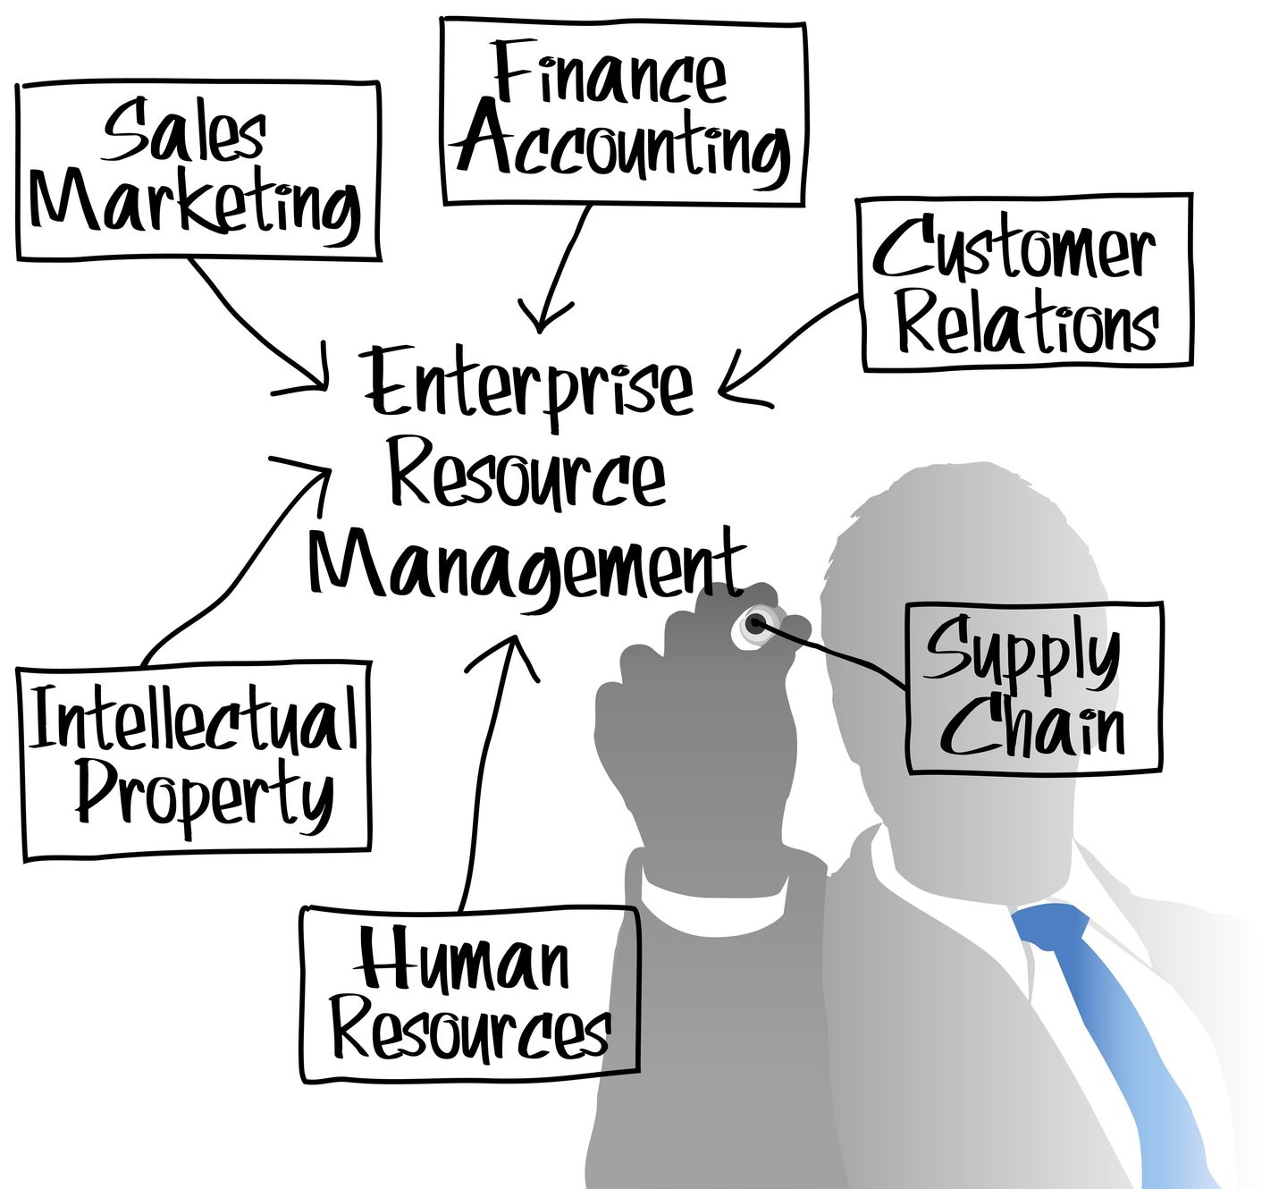
ERM-wide approach
ERM-wide approach looks at the risks which each and every department of an organization will face from its various operations. ERM manages those risks which hinder the achievement of objectives

Slide 19
Benefits of ERM
Marketplace
Financial
ERM
Reputational
Infrastructure
Click here to see each one in detail

Slide 20
Benefits of ERM
Financial
Infrastructure
Reputational
Marketplace
Reduced cost of funding and capital
Better control of CapEx approvals
Increased profitability for organization
Accurate financial risk reporting
Enhanced corporate governance

Slide 21
Benefits of ERM
Financial
Infrastructure
Reputational
Marketplace
Efficiency and competitive advantage
Achievement of the state of no disruption
Improved supplier and staff morale
Targeted risk and cost reduction
Reduced operating cost

Slide 22
Benefits of ERM
Financial
Infrastructure
Reputational
Marketplace
Regulators satisfied
Improved utilization of company brand
Enhanced shareholder value
Good reputation and publicity
Improved perception of organization

Slide 23
Benefits of ERM
Financial
Infrastructure
Reputational
Marketplace
Commercial opportunities maximized
Better marketplace presence
Increased customer spend
Higher rate of business successes
Lower rate of business disaster

Slide 24
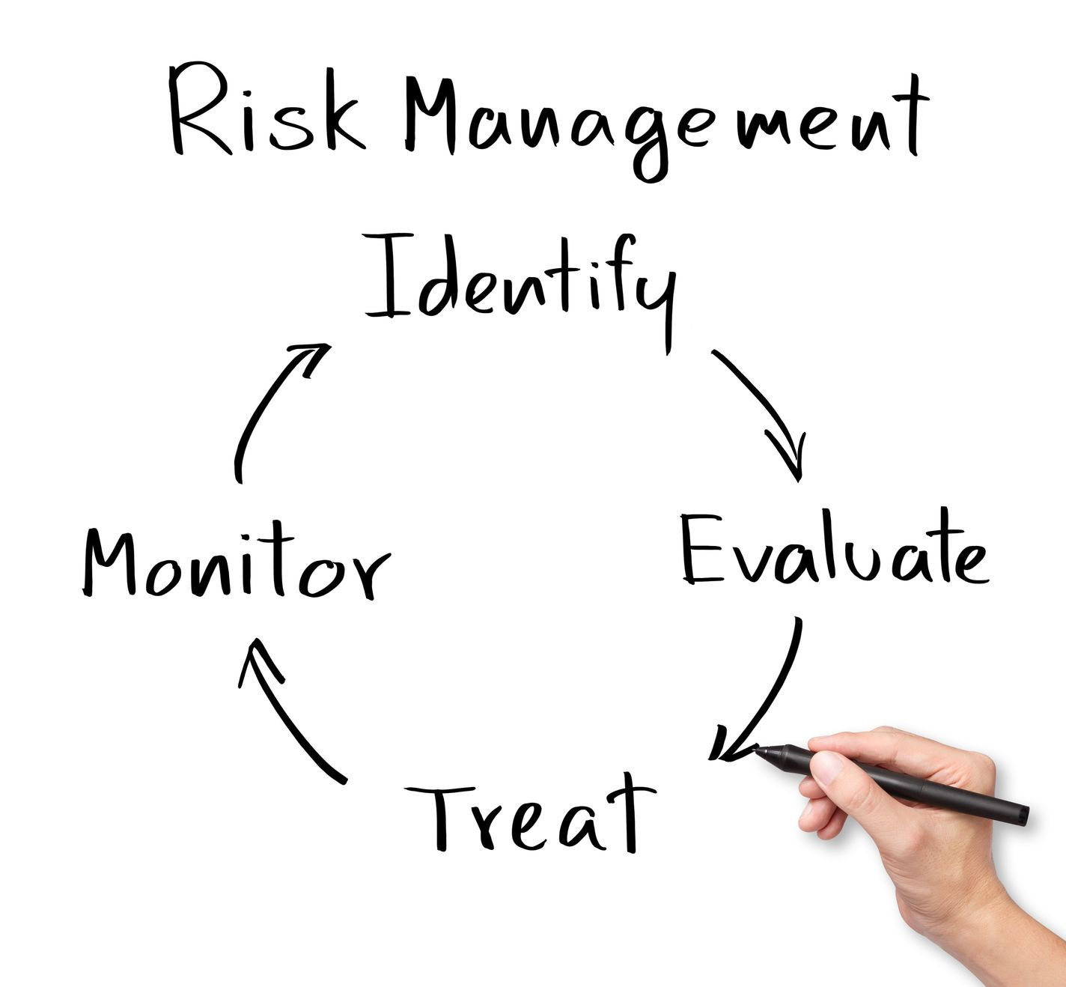
ERM and business continuity
ERM is related to business continuity management. Risk assessment which is a part of the risk management process and the business impact analysis which acts as a foundation for business continuity planning are closely related. Risk management identifies the risks separately that could impact the organization’s goals

Slide 25
Contents
Enterprise Risk Management - Fundamentals
Importance of risk appetite
The 4Ts of hazard response
Risk control techniques
Control of selected hazard risk
Managing uncertainty
Risk governance
Insurance and risk transfer
Evaluation of control environment
Activities of internal audit function
Risk assurance techniques
Reporting on risk management
Corporate Social Responsibility
Future of Risk Management

Slide 26
Risk capacity
Risk capacity refers to the ability or capacity of the enterprise to take risk. It is not the same as the cumulative total of all the individual values at risk associated with the risk faced by the organization. This cumulative total is the risk exposure of the organization

Slide 27
Risk appetite
Risk appetite refers to the value of the company’s resources which the management is willing to put at risk. Unfortunately most organizations have not calculated the value that they should risk. They don’t even calculate the actual value of resources which are at risk

Slide 28
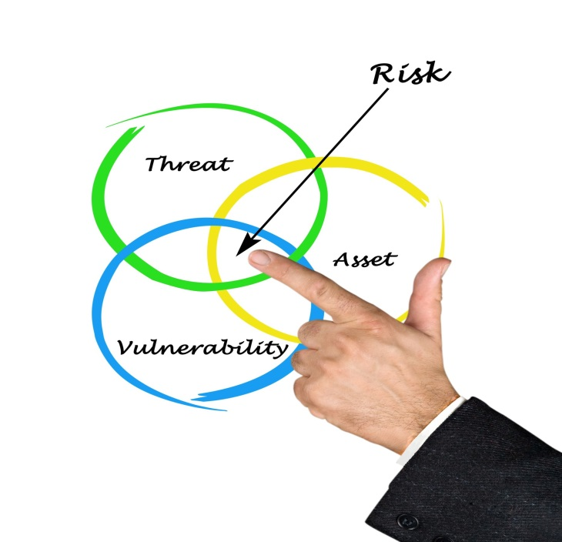
Nature of risk appetite
Disruptions can come to the organization through various forms of risks. These risks are associated with cost – cost of incidents that don’t occur, cost of loss preventions and cost containment activities, which also includes cost of insurance

Slide 29
MCQs
A manufacturing firm did not analyze the value of resources that it is going to put at risk. This firm did not even have exact data on actual resources which are at risk. This situation can be known and studied by
Option 1:
Risk Appetite
Option 2:
Risk Governance
Click on any one of the options for the correct answer
Option 3:
Business continuity
Option 4:
Risk capacity

Slide 30
MCQs
Yes you are right!
Click here Continue . . .

Slide 31
MCQs
That’s not quite right
The answer is: Risk appetite
Click here Continue . . .

Slide 32
Contents
Enterprise Risk Management - Fundamentals
Importance of risk appetite
The 4Ts of hazard response
Risk control techniques
Control of selected hazard risk
Managing uncertainty
Risk governance
Insurance and risk transfer
Evaluation of control environment
Activities of internal audit function
Risk assurance techniques
Reporting on risk management
Corporate Social Responsibility
Future of Risk Management

Slide 33
The 4Ts
T
T
T
T
Treat
Terminate
Tolerate
Transfer
Click here to see each one in detail

Slide 34
The 4Ts
T
Tolerate
The exposure is tolerable and no further action can be taken. There are certain limitations and you cannot do anything about that risk. The cost involved in taking action will not be proportionate to the benefits gained

Slide 35
The 4Ts
T
Treat
More number of risks are encountered by the organization in this way. When the organization is continuing with certain activity and if there is any risk, action is taken to confine the risk to an acceptable level

Slide 36
The 4Ts
T
Transfer
“Transfer” refers to the transfer of risk to a third party by paying something. This can be done by conventional insurance. This option is best suited for mitigating financial risks or risks of assets

Slide 37
The 4Ts
T
Terminate
There are a few risks which can be treated to certain acceptable levels by terminating the activity. When compared to the private sector such termination of activity are limited in the government sector

Slide 38
Key dependencies and significant risks
Firm risk
Example dependencies
Example of a significant risk
Availability of cash
Insufficient cash available from parent company
Proper allocation of funds
Inadequate profit because of incorrect capital expenditure decisions
Financial
Internal control
Frauds occur because of inadequate internal control
Liabilities under control
Higher than expected liabilities arise in the pension fund

Slide 39
Key dependencies and significant risks
Firm risk
Example dependencies
Example of a significant risk
People
Failure to achieve/maintain health and safety standards
Plant & equipment
Damage to key location caused by insurance
Infrastructure
IT
IT systems not available because of virus or hacker activity
Communication & transport
Transport networks closed because of severe weather conditions

Slide 40
Key dependencies and significant risks
Firm risk
Example dependencies
Example of a significant risk
Brand
Product recall causes damage to product image and brand
Public opinion
Lost sales or revenue because of change in public taste
Reputational
Regulation
Regulator enforcement action causes loss of public confidence
CSR
Allegation of unethical product-sourcing causes loses of sales

Slide 41
Key dependencies and significant risks
Firm risk
Example dependencies
Example of a significant risk
Economic health
Decline in world or national economy reduces consumer spending
Product development
Changes in technology reduce product appeal and sales
Market place
Competitor behavior
Competitor substantially reduces prices to win market share.

Slide 42
Risk acceptance
An organization needs to tolerate its risk which has crossed its comfort zone and risk appetite.

Slide 43
Risk reduction
When the potential loss which is associated with a risk is low, the organization will be willing to treat the risk

Slide 44
Risk transfer
Organization will like to transfer the risks when the probability of risk materializing is less but the potential is high. Insurance is a well established mechanism for transferring the financial consequences of losses arising out of hazard risks

Slide 45
Risk avoid
When both the likelihood of risk and potential impact are high, the organization can consider avoiding or eliminating the risk

Slide 46
Contents
Enterprise Risk Management - Fundamentals
Importance of risk appetite
The 4Ts of hazard response
Risk control techniques
Control of selected hazard risk
Managing uncertainty
Risk governance
Insurance and risk transfer
Evaluation of control environment
Activities of internal audit function
Risk assurance techniques
Reporting on risk management
Corporate Social Responsibility
Future of Risk Management

Slide 47
Types of control
Preventive
Corrective
Directive
Detective
Click here to see each one in detail

Slide 48
Types of control
Preventive
These controls are designed to limit the possibility of an undesirable outcome being realized
Corrective
Directive
Detective

Slide 49
Types of control
These controls are designed to limit the scope of loss and reduce any undesirable outcomes that have been realized
Preventive
Corrective
Directive
Detective

Slide 50
Types of control
These controls are designed to ensure that a particular outcome is achieved
Preventive
Corrective
Directive
Detective

Slide 51
Types of control
Preventive
These controls are designed to identify the occasions of undesirable outcomes having been realized
Corrective
Directive
Detective

Slide 52
Contents
Enterprise Risk Management - Fundamentals
Importance of risk appetite
The 4Ts of hazard response
Risk control techniques
Control of selected hazard risk
Managing uncertainty
Risk governance
Insurance and risk transfer
Evaluation of control environment
Activities of internal audit function
Risk assurance techniques
Reporting on risk management
Corporate Social Responsibility
Future of Risk Management

Slide 53
Control of financial risk
Fraud
“Fraud” is one of the key financial risks faced by all the organizations. Fraud is committed by employees, customers or distributors/ suppliers. The organization itself can commit fraud by falsely reporting the results of the organization

Slide 54
Minimizing fraud
Improve recruitments process
Reduce the number of assets worth stealing
Improve detection of fraud
Reduce the motive for fraud
Increase level of supervision
Improve record keeping

Slide 55
Control of infrastructure risk
Health and safety at work
There are various health and safety risks faced by organizations. These can be: a case filed by an injured employee, prosecution by a regulatory authority and disruption in business caused by accidents and certain dangerous occurrences. Organizations have applied various health and safety tools and they are following various techniques to manage the risk. The involvement of health and safety specialists is vital for successful risk management initiatives
Click here to see few health and safety risks

Slide 56
Health and safety risks
Dangerous machinery
1
Pressure system
2
Electrical safety
3
Hazardous substances
4
Radiation
5
Fire safety
6
Stress at work
7
Vehicles and driving risks
8
Slips, trips and falls
9

Slide 57
Causes of fire at work
҉
҉
҉
Hot work
Machinery
Smoking material
҉
҉
҉
Flammable liquids
Bad house keeping
Arson

Slide 58
IT security
If the computer system fails, it will disturb the entire process of the business in an organization. Loss of certain important data can be a serious problem for an organization. This loss can occur because of hardware problems, software problems, human error or electrical failure

Slide 59
◌
◌
◌
Consequences of IT failure
◌
◌
◌
Loss of business/customers
Loss of goodwill
Cash-flow problem
Reduced quality of service
Loss of data
Financial loss

Slide 60
Employee engagement and termination
Legislative and regulatory compliance
Recruitment, retention and skills availability
HR risks
Pension arrangement
There are more risks when employing new staff and the utilization of human resources within an organization. These are:-
Performance management
Absence management
Health and safety

Slide 61
Control of reputational risks
“Brand name” can be considered as an important, valuable asset of an organization. Therefore it is important to avoid any sort of damage to the brand and to the organization

Slide 62
Causes for brand damage
Changes in government policy
Changes in market place
New entrants into the market place
Price and specification competition
Inappropriate franchise behavior
Fake goods

Slide 63
Environment
There are a set of rules for those organizations which produce industrial waste. These rules detail the organization about how the waste should be treated and what arrangements should be made for discarding it
There are also issues for those commercial organizations which do not produce industrial waste or by products. The main concern for these organizations is to minimize the commercial waste that they produce

Slide 64
Control of market place
Technology developments
It is important for the organization to meet customers’ demands and expectations. The changes in technology makes this task challenging for the companies. The organization which supplies goods that are technology based face continuous challenges

Slide 65
Regulatory risks
Regulatory risk is one of the most difficult risks faced by an organization. Compliances may appear simple and clear but there are certain complexities associated with the changes to regulations and different regulatory requirements in different countries

Slide 66
MCQs
A software company declared annual profits at the end of a financial year, but the results displayed does not match with the external audit reports. By this we can understand that
Option 1:
Inaccurate auditing is done
Option 2:
Organization committed fraud
Click on any one of the options for the correct answer
Option 3:
Organization facing financial risks
Option 4:
Organization is under recession

Slide 67
MCQs
Yes you are right!
Click here Continue . . .

Slide 68
MCQs
That’s not quite right
The answer is: Organization committed fraud
Click here Continue . . .

Slide 69
Contents
Enterprise Risk Management - Fundamentals
Importance of risk appetite
The 4Ts of hazard response
Risk control techniques
Control of selected hazard risk
Managing uncertainty
Risk governance
Insurance and risk transfer
Evaluation of control environment
Activities of internal audit function
Risk assurance techniques
Reporting on risk management
Corporate Social Responsibility
Future of Risk Management

Slide 70
What is uncertainty?
Uncertainty means incomplete knowledge, i.e., a shortfall of knowledge or information about:-
1
2
3
4
5
What kinds of outcome may occur?
The factors which may influence future outcomes
The extent to which known and unknown factors will influence outcomes
The likelihood of various outcomes
The impacts which those outcomes, if they occur, would have on the organization

Slide 71
Kinds of uncertainty
Click here to see each one in detail
Event uncertainty
Variability uncertainty
Assumptions uncertainty
Systemic uncertainty

Slide 72
Kinds of uncertainty
Event uncertainty
Variability uncertainty
The occurrences which are good or bad and which may or may not materialize
Assumptions uncertainty
Systemic uncertainty

Slide 73
Kinds of uncertainty
Event uncertainty
Variability uncertainty
Events that are expected to happen up to a certain extent and cannot be accurate
Assumptions uncertainty
Systemic uncertainty

Slide 74
Kinds of uncertainty
Event uncertainty
The assumptions which are made about certain happenings may happen or may not happen. Certain sources of uncertainty are dependent on other sources.
Variability uncertainty
Assumptions uncertainty
Systemic uncertainty

Slide 75
Kinds of uncertainty
Event uncertainty
Relationships, which are usually uncertain by itself, between different sources of uncertainty, including “knock-on effects”
Variability uncertainty
Assumptions uncertainty
Systemic uncertainty

Slide 76
Approach to uncertainty management
Being proactive is one of the most important and best ways to manage uncertainty. In uncertain areas where we don’t have knowledge, we have to enhance ourselves. In other areas of uncertainty we have to slightly change the business strategy to make business more flexible and achieve its objectives

Slide 77
Steps in uncertainty management
Assess the extent to which all our knowledge may be “fuzzy”
Go to Step 1, focus on key information which you find relevant to the business
3
5
1
2
4
6
7
Assess what we already know
Assess those things that we don’t know and get further information
Find out the additional areas of information which will be useful and relevant for the business
Find out the remaining uncertainties and those residual uncertainties should be given consideration to make business more flexible and strong
Always try to devote time and resources searching for new things and gaining knowledge

Slide 78
10 Ways to reduce uncertainty
1
Definition and acquisition of data which are known to be required
2
Research, including a study of similar situations, present or past, in the same or other organizations
3
Consultations with experts, including specialists in visualizing possible world futures
4
Brainstorming and workshops
5
Concept mapping for the organization as a whole to identify key risk areas

Slide 79
10 Ways to reduce uncertainty
6
Pattern recognition as events occur
7
Consultations with stakeholders affected third parties, about their views on the business and on likely future developments
8
Making a deeper analysis of the business variability and its underlying causes
9
Model building, scenario analysis and stress testing
10
Financial restructuring

Slide 80
New knowledge
We find some limitations in developing our knowledge and we have to try to make the best use of it. Uncertainty can be reduced after gaining more knowledge and information
We find some limitations in developing our knowledge and we have to try to make the best use of it. Uncertainty can be reduced after gaining more knowledge and information
.

Slide 81
New thinking
1
Focus on managing or responding to change
2
Follow a holistic approach to risk management, covering strategic, project and operational risks and the extra corporate dimension which links them all together

Slide 82
New thinking
3
Adopt a positive approach which focuses on opportunities and seeks the upsides as well as downsides of threats
4
Be highly flexible in our thinking, behavior, organization, processes and systems

Slide 83
New thinking
5
Seek to make the business as robust as possible to withstand threats which are at present unknown (or of unprecedented force)
6
Ensure that there is a sufficiently wide and creative base of knowledge focusing on future possible changes and on the steps which need to be taken in advance to provide the best chance of managing them successfully

Slide 84
MCQs
For top management team in a company, lack of proper information or incomplete knowledge about their organization or departments will mainly lead to:
Option 1:
Inefficient risk management
Option 2:
Limited growth of the company
Click on any one of the options for the correct answer
Option 3:
Inefficient control
Option 4:
Uncertainty

Slide 85
MCQs
Yes you are right!
Click here Continue . . .

Slide 86
MCQs
That’s not quite right
The answer is: Uncertainty
Click here Continue . . .

Slide 87
Contents
Enterprise Risk Management - Fundamentals
Importance of risk appetite
The 4Ts of hazard response
Risk control techniques
Control of selected hazard risk
Managing uncertainty
Risk governance
Insurance and risk transfer
Evaluation of control environment
Activities of internal audit function
Risk assurance techniques
Reporting on risk management
Corporate Social Responsibility
Future of Risk Management

Slide 88
Why risk governance matters?
The main reason for failure of certain organizations is lack of proper risk governance systems in place. A good risk governance system is vital to control risk and to ensure whether these systems are adequate and being operated properly

Slide 89
Controlling staff risks
There should be an appropriate system to reduce the staff risk as it is one of the greatest sources of downside risk in an organization. One of the important aspects of risk governance is to ensure that people working in an organization have proper ethics and good attitude towards risk. There should be a good remuneration to reward them which will automatically bring success to the organization in the medium and long term

Slide 90
System of checks and balances
There should be proper checks and balances to ensure that no individual takes excessive risk on behalf of the organization. All the employees including the CEO should be aware of their limits and authority and should act within these limits

Slide 91
Policies and procedures
It is essential to put in place appropriate processes and procedures to ensure that there is adequate monitoring of changes in the risk profile, to gain positive assurance about the extent to which all risks are being properly managed, to monitor how the ERM system is improving, and to identify further actions which may be desirable

Slide 92
Audit of risk management process
The audit result must be submitted to the Board and should contain the following:-
The progress which has been made towards achieving a suitable risk aware culture and communications system throughout the business
Progress on the risk training of managers and other staff
The effectiveness of risk-related communication with suppliers and customers
The documentation of risks and responses, including evidences
The effectiveness of reporting systems - risk occurrences, risk indicators, data accuracy, etc.
The extent to which the Central Risk Function has discharged its tasks
Regulatory compliance
The effectiveness of the mechanism for categorizing certain risks as strategic, so that they receive special attention
The amount of time which the Board itself has devoted to ERM

Slide 93
Contents
Enterprise Risk Management - Fundamentals
Importance of risk appetite
The 4Ts of hazard response
Risk control techniques
Control of selected hazard risk
Managing uncertainty
Risk governance
Insurance and risk transfer
Evaluation of control environment
Activities of internal audit function
Risk assurance techniques
Reporting on risk management
Corporate Social Responsibility
Future of Risk Management

Slide 94
Importance of Insurance
The important principle of insurance is that the insurance companies are contracted to pay a certain sum of money in the event of defined circumstances arising or when defined events occur
Insurance contracts can require the insurance companies to pay for losses suffered directly by the insured. This is first party insurance
Here are few lines on importance of insurance
Other types of insurance contract the insurance companies to pay compensation to other parties if they have been injured or suffer losses because of the activities of the insured
This is third-party insurance.

Slide 95
Advantages
Insurance can provide access to specialist services as part of insurance premium e.g., advice on loss control
Insurance can provide benefits to insured, because the loss may be greater than the insurance premium
Insurance can reduce uncertainty regarding hazard events that may occur
An advantage of insurance is that it provides indemnity against an unexpected loss

Slide 96
Disadvantages
There may be disputes regarding the extent of the cover that has been purchased and the exact terms and conditions of the insurance contract
The delays often experienced in obtaining settlement of an insurance claim

Slide 97
Reasons for buying insurance
Legal and contractual obligations
Balance sheet/profit and loss protection
Employee benefit/ protection of employee assets

Slide 98
Aspects to be considered
When booking at the purchase of insurance cover, the organization will need to consider the following 6 aspects:-
Cost
Coverage
Compliance
Capacity
Claims
Capability

Slide 99
Contents
Enterprise Risk Management - Fundamentals
Importance of risk appetite
The 4Ts of hazard response
Risk control techniques
Control of selected hazard risk
Managing uncertainty
Risk governance
Insurance and risk transfer
Evaluation of control environment
Activities of internal audit function
Risk assurance techniques
Reporting on risk management
Corporate Social Responsibility
Future of Risk Management

Slide 100
Nature of internal control
Internal control occupies an important position in management of risks
Internal control is related to the process and methods to be followed by the organization to see that it meets its objectives
Internal controls can be defined as actions taken by the management to plan and organize certain activities which help the organization in achieving its goals

Slide 101
Designing effective internal controls–the arrangement
Maintenance of reliable system
Timely preparation of reliable information
Optimum use of
resources
Safeguarding
of assets
Preventing and detecting
fraud and error

Slide 102
Purpose of internal control
The primary purpose of internal control activities is to help the organization achieve its objectives. Typically, internal controls have the following purposes
Safeguard and protect the assets of the organization
Ensure the keeping of accurate records
Promote operational effectiveness and efficiency
Adhere to policies and procedures, including control procedures
Enhance reliability of internal and external reporting
Ensure compliance with laws and regulations
Safeguard the interests of stakeholders/shareholders

Slide 103
Control environment
The Canadian Institute of Chartered Accountants (CICA) created a means to measure the quality of the control environment within an organization. It is referred as CoCo, which means, criteria of control framework.
The frame work:
Purpose
A Sense of direction
what are we for you?
Commitment
A Sense of identity and values
Do we want to do good job?
Click here to see each one in detail
Control environment
Action
Monitoring and hearing
A Sense of evolution
What progress? What next?
Capability
A sense of competence
What action do we need to take?

Slide 104
Components of the CoCo framework
Purpose
Objectives should be established and communicated
Policies should be established, communicated and practiced
Plans should include measurable performance targets and indicators
∞
∞
∞
∞
∞
∞
Significant internal and external risks should be identified and assessed
Plans should be established and communicated

Slide 105
Components of the CoCo framework
Commitment
Shared ethical values should be established, communicated and practiced
Mutual trust should be fostered to support the flow of information
HR policies should be consistent with ethical values
Authority, responsibility and accountability should be clearly defined

Slide 106
Components of the CoCo framework
Capability
People should have the necessary knowledge, skills and tools
Communication processes should support the values of the organization
Sufficient and relevant information should be identified and communicated
Decisions and actions within the organization should be co-ordinated
Control activities should be designed as an integral part of the organization

Slide 107
Components of the CoCo framework
Monitoring and learning
Environment should be monitored to
re-evaluate controls
Assumptions behind objectives should be periodically challenged
Procedures should be established to ensure appropriate actions occur
Performance should be monitored against the targets
Information needs and related information systems should be reassessed
Management should periodically assess the effectiveness of control

Slide 108
Leadership
Planning
Customer focus
People focus
Evaluating the control environment
Process management
Partnership
Business performance
Continuous improvement

Slide 109
Contents
Enterprise Risk Management - Fundamentals
Importance of risk appetite
The 4Ts of hazard response
Risk control techniques
Control of selected hazard risk
Managing uncertainty
Risk governance
Insurance and risk transfer
Evaluation of control environment
Activities of internal audit function
Risk assurance techniques
Reporting on risk management
Corporate Social Responsibility
Future of Risk Management

Slide 110
Scope of internal audit
Internal control refers to the policies and procedures to be followed by the organization to meet its objectives. These activities are to be evaluated by a department called “internal audit department”. The functions of internal audit may be outsourced to external accountancy firms in a few cases

Slide 111
Presentation of financial data
The presentation of financial data relies on five basic financial statement assertions which are related to:
Existence of the information
Presentation and disclosure
Completeness of the financial data
Valuation and allocation
Rights and obligations

Slide 112
Role of internal audit in ERM
Core internal audit roles in regard to ERM
Legitimate internal audit roles with safeguards
Roles internal audit should not undertake
Click here to see each one in detail

Slide 113
Role of internal audit in ERM
Core internal audit roles in regard to ERM:
Reviewing the management of key risks
Evaluating the reporting of key risks
Evaluating risk management process
Giving assurance that risks are correctly evaluated
Giving assurance on the risk management processes

Slide 114
Role of internal audit in ERM
Legitimate internal audit roles with safeguards:
Facilitating identification and evaluation of risks
Coaching management in responding to risks
Coordinating ERM activities
Consolidated reporting of risks
Maintaining and developing ERM framework
Championing establishment of ERM
Developing ERM strategy for board approval

Slide 115
Role of internal audit in ERM
Roles internal audit should not undertake:
Setting the risk appetite
Imposing risk management processes
Management assurance on risks
Taking decisions on risk responses
Implementing risk responses on management’s behalf
Accountability for risk management

Slide 116
Management responsibilities
Internal audit activities
Risk management support
Management responsibilities
Click here to see each one in detail

Slide 117
Allocation of responsibilities
Internal audit activities:
Giving assurance on risk management processes
Giving assurance that risks are correctly evaluated
Evaluating risk management processes
Evaluating the reporting of key risks
Reviewing the management of key risks
Internal audit activities
Risk management support
Management responsibilities

Slide 118
Allocation of responsibilities
Risk management support:
Facilitating identification and evaluation of risks
Coaching management in responding to risks
Coordinating ERM activities
Consolidated reporting on risks
Maintaining and develop ERM framework
Championing establishment of ERM
Developing ERM strategy for board approval
Internal audit activities
Risk management support
Management responsibilities

Slide 119
Allocation of responsibilities
Management responsibilities:
Setting the risk appetite
Imposing risk management processes
Management assurance on risks
Taking decisions on risk responses
Implementing risk responses on behalf of management
Accountability for risk management
Internal audit activities
Risk management support
Management responsibilities

Slide 120
Contents
Enterprise Risk Management - Fundamentals
Importance of risk appetite
The 4Ts of hazard response
Risk control techniques
Control of selected hazard risk
Managing uncertainty
Risk governance
Insurance and risk transfer
Evaluation of control environment
Activities of internal audit function
Risk assurance techniques
Reporting on risk management
Corporate Social Responsibility
Future of Risk Management

Slide 121
Responsibilities of the audit committee
External audit
Internal audit
Financial reporting
Click here to see each one in detail
Regulatory reports

Slide 122
Responsibilities of the audit committee
External audit
Internal audit
Financial reporting
Regulatory reports
Recommend the appointment and re-appointment of external auditors
Review the performance and cost-effectiveness of the external auditors
Review the qualification, expertise and independence of external auditors
Review and discuss any reports from the external auditors

Slide 123
Responsibilities of the audit committee
External audit
Internal audit
Financial reporting
Regulatory reports
Review internal audit and its relationship with external auditors
Review and assess the annual internal audit plan
Review promptly all reports from the internal auditors
Review management response to the findings of internal auditors
Review activities, resources and operational effectiveness of internal audit

Slide 124
Responsibilities of the audit committee
External audit
Internal audit
Financial reporting
Regulatory reports
Review the annual, half-year and quarterly financial results
Review the disclosure made by the chief executive and group finance director during the certification process for the annual report

Slide 125
Responsibilities of the audit committee
External audit
Internal audit
Financial reporting
Regulatory reports
Review arrangements for producing the audited accounts
Monitor and review the standards of risk management and internal control
Annually review the adequacy of the risk management processes
Receive reports on litigation regarding financial commitments and other liabilities

Slide 126
Role of risk management
The responsibilities of risk management and internal control are set by the risk management policy. The roles of risk management is broad and includes providing assurance, supporting decision making, achieving compliance and improving the efficiency of operations, projects and strategy

Slide 127
Role of risk management
When allocating risk management responsibilities, consideration should be given in respect of each of the significant risks faced by the organization:
Determining strategy
Designing controls
Auditing compliance

Slide 128
Risk assurance
Assurance will be required in relation to the risk management activities themselves. The following points should be kept in mind while reviewing and monitoring activities:
Review of the level of success in achieving business objectives
Delivery of risk assurance across this whole range of activities
Review of the standards of risks control in force
•
•
•
•
•
•
Review of the process as it operates the organization
Review of level of success in reducing risk exposures
Review of how a high-risk strategy, project or operation was successful

Slide 129
Risk assurance
When a company plans to borrow more money from the bank, it may be asked to demonstrate how the board obtained assurance that the management of significant risks is satisfactory. The sources of assurance available might include:-
Evaluation of the risk culture of the organization
Quality of audit reports produced by internal audit
Quality of reports produced by the various departments
Overall business success of individual departments

Slide 130
Benefits of risk assurance
Builds confidence with stake holders
Provides reassurance to sponsors
Allows more secure delegation of authority
Provides reassurance to financiers
Encourages the risk culture within the organization
Demonstrates good practice to regulators
Reduces the chances of damage to reputation
Prevents financial and other surprises

Slide 131
Contents
Enterprise Risk Management - Fundamentals
Importance of risk appetite
The 4Ts of hazard response
Risk control techniques
Control of selected hazard risk
Managing uncertainty
Risk governance
Insurance and risk transfer
Evaluation of control environment
Activities of internal audit function
Risk assurance techniques
Reporting on risk management
Corporate Social Responsibility
Future of Risk Management

Slide 132
Risk documentation
There is a high number of risk management documentation which is connected to the risk management activities. The types of risk management documentation are:-
Risk management administration
Risk Documentation
Risk response and improvement plan
Event reports and recommendation
Risk performance and certification reports

Slide 133
Importance of records
Reduces the time spent by staff looking for information
Facilitates the effective sharing of information
Reduces the unnecessary duplication of information
Identifies how long-term records need to be kept
Supports risk management and business continuity process

Slide 134
Designing a risk register
Risk register refers to the document which is kept for recording risk management processes for the risks identified. There are a few disadvantages like these risk registers would become a static record of risk status and the data recorded will not be used in a dynamic way

Slide 135
Charities risk reporting
Risk reporting by charities is made compulsory in all the countries. Like other listed companies and government departments, charities should have risk management procedures with them

Slide 136
Government risk reporting principles
Openness and transparency
Involvement
Proportionality
Evidence
Responsibility

Slide 137
Government risk reporting principles
Openness and transparency
Government will be open and transparent about its understanding of the nature of risks to the public and about the process it is following in handling them

Slide 138
Government risk reporting principles
Involvement
Government will seek wide involvement of those concerned in the decision process

Slide 139
Government risk reporting principles
Proportionately
Government will act proportionately and consistently in dealing with risks to the public

Slide 140
Government risk reporting principles
Evidence
Government will seek to base decisions on all relevant evidence

Slide 141
Government risk reporting principles
Responsibility
Government will seek to allocate responsibility for managing risks to those best placed to control them

Slide 142
Contents
Enterprise Risk Management - Fundamentals
Importance of risk appetite
The 4Ts of hazard response
Risk control techniques
Control of selected hazard risk
Managing uncertainty
Risk governance
Insurance and risk transfer
Evaluation of control environment
Activities of internal audit function
Risk assurance techniques
Reporting on risk management
Corporate Social Responsibility
Future of Risk Management

Slide 143
Corporate Social Responsibility
If there is good corporate social responsibility standards in an organization, it will increase the reputation and enhance the stakeholder value. On the other hand, incidents, events and losses which are related to poor corporate social responsibility will spoil the image and reputation of the organization and will pull down the stakeholder value
CONDUCT
OUR PEOPLE
COPORATE RESPONSIBILITY
ENVIRONMENT
SOCIETY

Slide 144
CSR and risk management
The agendas of both risk management and corporate social responsibility management are broad and interlinked. The risk assessment workshops conducted throughout the world consider CSR and social, ethical and environmental considerations within the topics that are evaluated

Slide 145
Issues covered by CSR
Health and safety
Products/ services
Employees
CSR
Community
Customers
Suppliers
Environment

Slide 146
CSR and reputational risk
CSR is considered as a reputational issue by most of the organizations. They view the component parts of CSR as hazard risk. There are more probabilities that public views will be ahead of the thinking within many organizations

Slide 147
CSR and stakeholder expectation
The environmental pressure groups are considered as valid stakeholders. These groups have good influence to bear on
the activities of the organization
MARKETPLACE
WORKPLACE
Corporate Social Responsibility
ENVIRONMENT
COMMUNITY
IMPACT ON STAKEHOLDERS

Slide 148
Ethical trading
Good ethical behavior is considered important in all businesses. Failure to comply with these ethical standards are considered as major business risk. Bribes and other forms of dishonest and illegal activities have strong consequences for corporate responsibility and future profits

Slide 149
Reasons for reputational damage
False allegation against competitors
ˠ
ˠ
Excessive payment to political parties
Failure to comply with rules and regulations
ˠ
Unethical alliance with competitors
Tax evasion
ˠ
ˠ

Slide 150
Contents
Enterprise Risk Management - Fundamentals
Importance of risk appetite
The 4Ts of hazard response
Risk control techniques
Control of selected hazard risk
Managing uncertainty
Risk governance
Insurance and risk transfer
Evaluation of control environment
Activities of internal audit function
Risk assurance techniques
Reporting on risk management
Corporate Social Responsibility
Future of Risk Management

Slide 151
Steps to successful risk management
Hey! Do you know the idea behind successful risk management?
Let us see some ways to achieve successful risk management
CLICK HERE!
In order to improve the risk management performance of an organization, a risk management initiative is required. This will depend on the size, complexity and nature of the organization. There is no single approach to implementing risk management in an organization
Yes! Here it is!

Slide 152
Achieving successful risk management
Undertake a management review of all risk management activities and ensure that maximum benefits continue to be delivered
Sponsorship of the project by a board or executive committee member
Sponsorship
Develop a shared perception of risk within the organization
Manage-ment review and benefits
Shared
Perception
Successful Risk Management
Determine the risk appetite of the organization and description about contribution towards corporate governance
Appetite and governance
Define the role of the risk manager as facilitator
Role

Slide 153
Factors influencing the approach
External influences including corporate governance
Senior management influence within department
1
2
Now identify the main risk in your company
CLICK HERE! To write down
4
3
Origin of the risk management department
Nature of the business, its products and culture

Slide 154
Risk in your company
Identify what you think is the most important risk related issue your company faces. Choose it intuitively before proceeding with the presentations, based on your current understanding of risk. Describe your issues below
Your Answer here:
Let us complete couple of small exercises on the following pages
CLICK HERE!

Slide 155
Exercise 1
An employee of Global Solutions, who works in the financial department just outside the center of the resort usually drives his BMW to work. The risks of driving (mainly, injury, or liability in the event of an accident) could be transferred, eliminated, or mostly mitigated if she were to do the following:-
Take a shuttle bus from a nearby hotel instead
2. Move to within walking distance of the office
3. Trade in her BMW for a newer Volvo with more advanced safety and navigation features
4. If allowed, telecommute from a home office
Move on to the next slide to know the question
CLICK HERE!

Slide 156
Exercise 1
On the lines below, identify how each of these alternatives transfers, eliminates, and/or mitigates the risk for this commuter.
Shuttle bus Your answer:
2. Move to within walking distance of the office Your answer:
3. Newer Volvo Your answer:
Telecommute: Your Answer
After you complete these answers, compare them in next slide
CLICK HERE!

Slide 157
Exercise 1
Take a shuttle bus from a nearby hotel instead
Avoid any risk of liability and mitigate the risk by riding in a larger, safer vehicle
Move to within walking distance of the office
Avoid both risk of liability and risk of injury in an auto accident
Trade his car in for a newer Volvo that has more advanced safety and navigation features
Mitigate the risk of liability for an accident on snowy or silk roads and reduce the change of injury in an accident
If allowed, get an internet connection and work at home
Eliminate commuting risks

Slide 158
Exercise 2: Can you Identify the risk?
For each of the risks listed below, place a check (✓) in the appropriate column(s) to indicate which type of risk it represents | Operational risk | Strategic risk
Manufacturing breakdown
Information system failure
Theft and fraud
Product failure
Outsourcing
Supplier risk
Lack of vision
Lack of innovation
Political risk
Ethical risk
After you have completed, compare your answers in next slide
CLICK HERE!

Slide 159
Answers
For each of the risks listed below, place a check (✓) in the appropriate column(s) to indicate which type of risk it represents | Operational risk | Strategic risk
Manufacturing breakdown
Information system failure
Theft and fraud
Product failure
Outsourcing
Supplier risk
Lack of vision
Lack of innovation
Political risk
Ethical risk

Slide 160
Summary
Enterprise Risk Management: Key learnings from this module
More effective strategic and operational planning.
Planned risk-taking and the proactive management of risks.
Greater confidence in decision making and achieving operational and strategic objectives.
You will have greater confidence with stakeholders.
Enhanced capital raising and risk-based capital efficiency.
Dealing effectively with disruptions and losses, minimizing financial impact on the organization.
Avoid surprises and be able to do forward planning..
Evidence of a structured / formalized approach in decision making.

