Slide 1
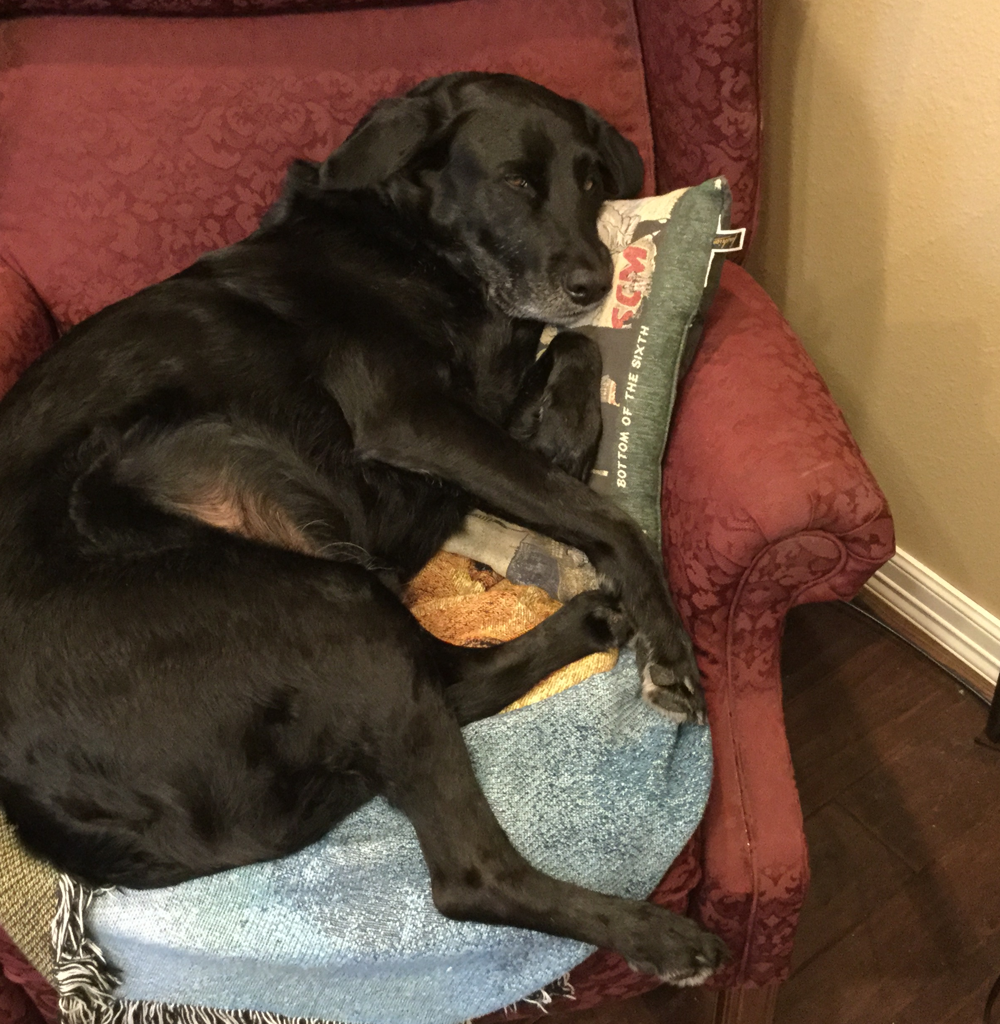
How to inactivate Alvin A. Stutler
He already looks inactive.

Slide 2
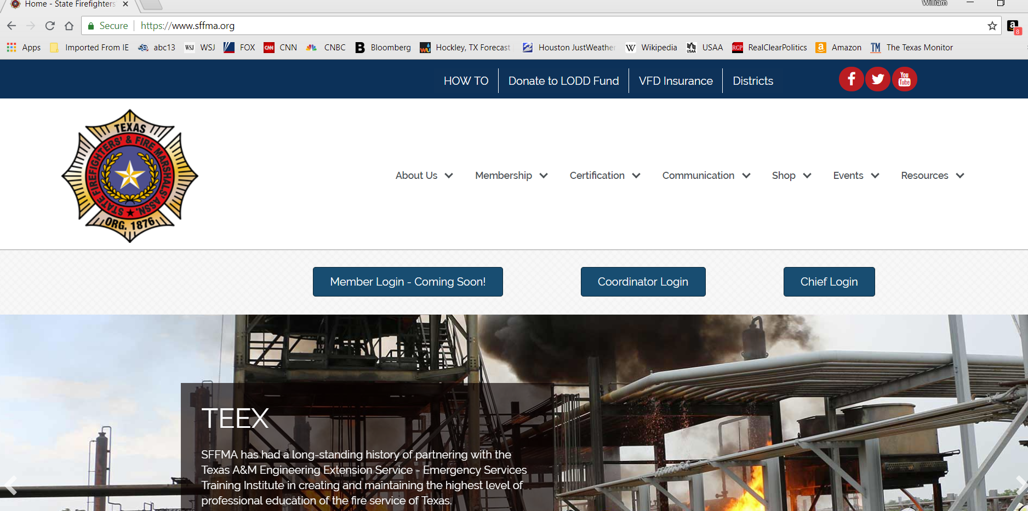
Click

Slide 3
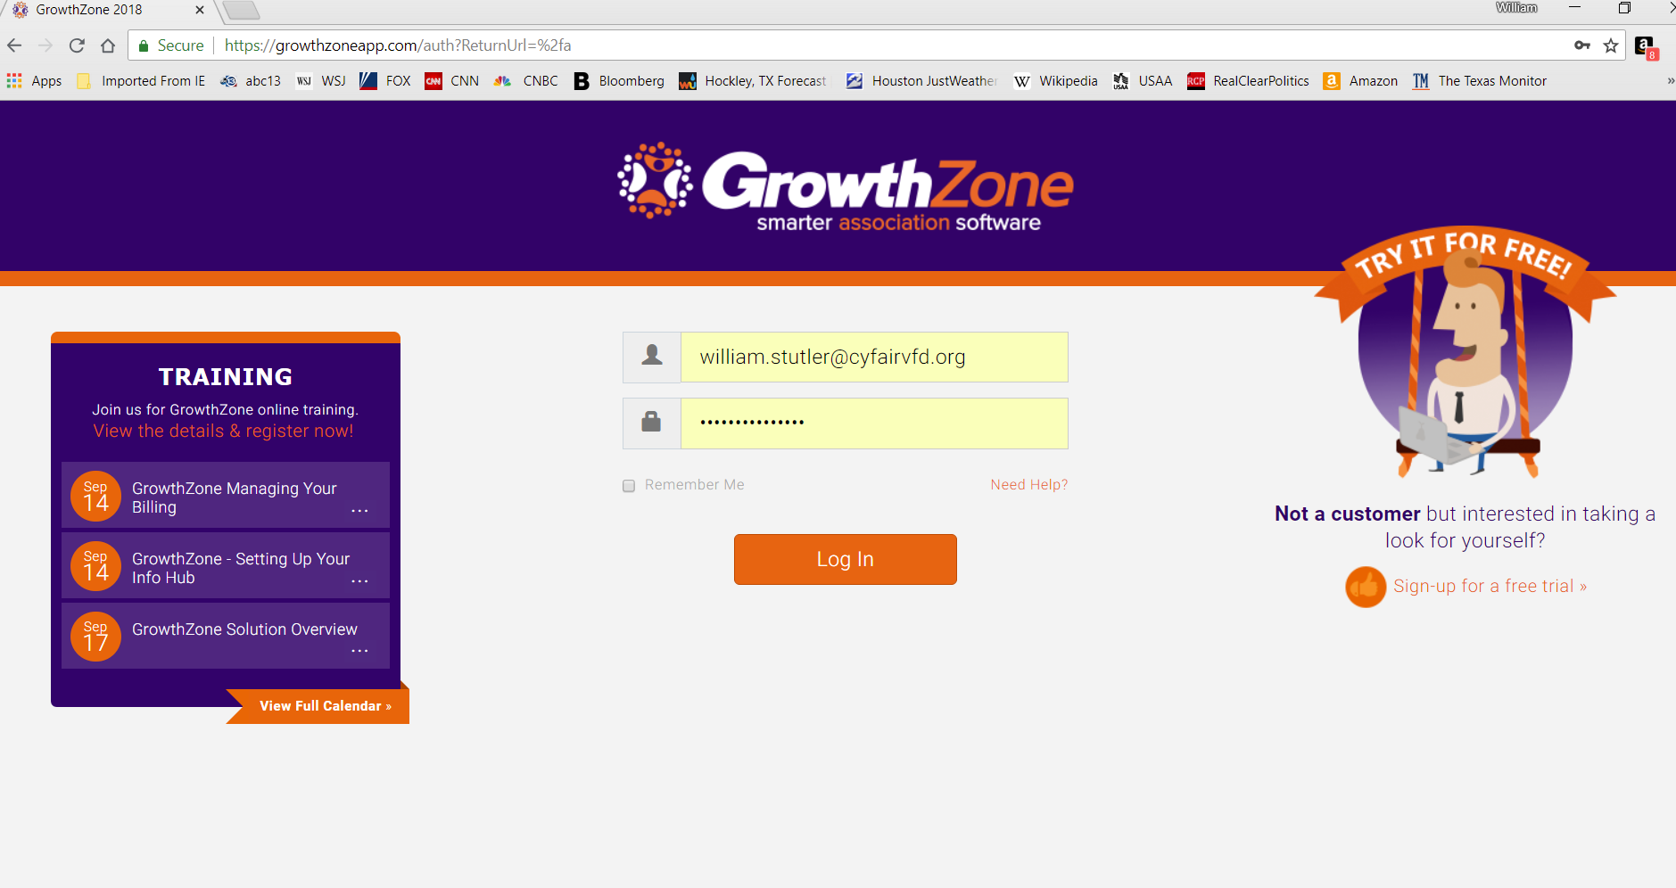
Click

Slide 4
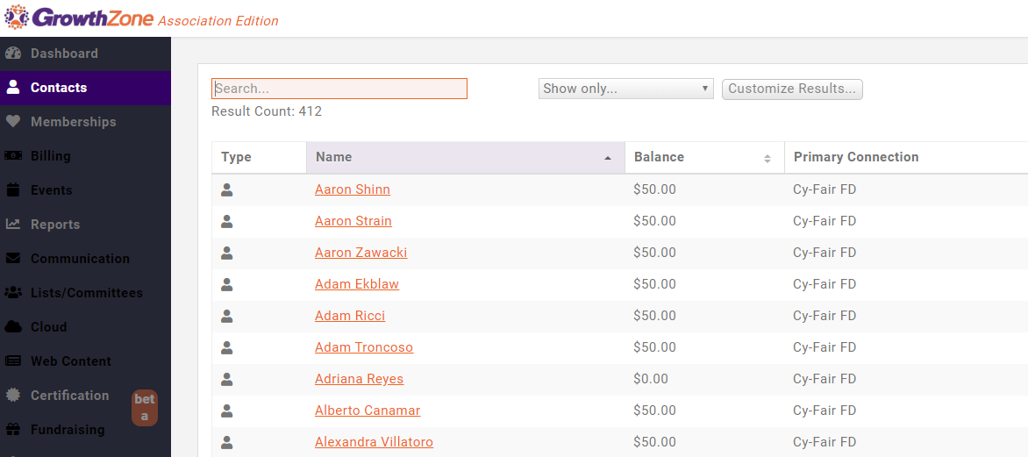

Slide 5
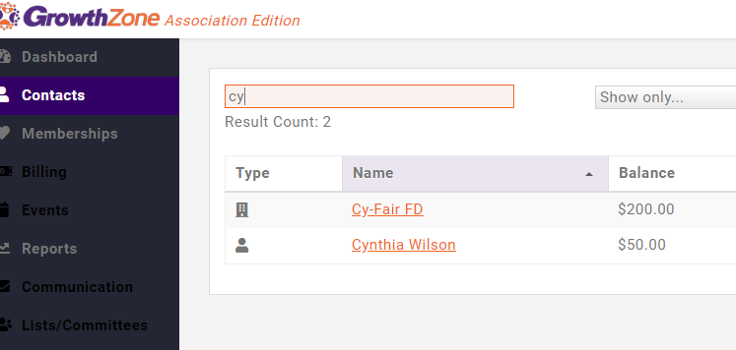
Click

Slide 6
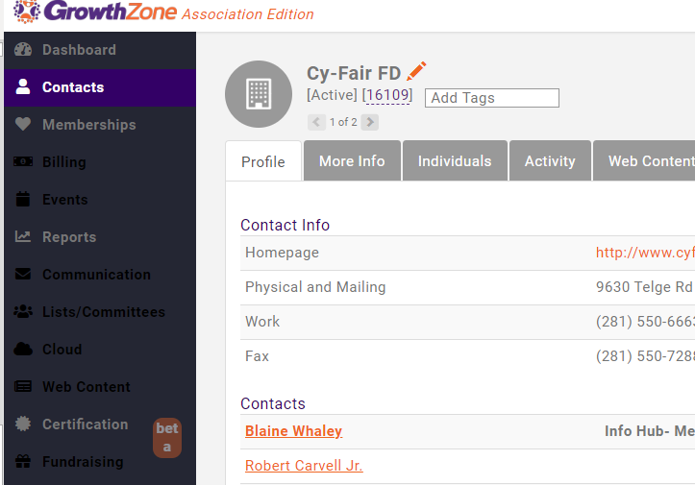
Click

Slide 7
Search
Then select the angled pencil

Slide 8
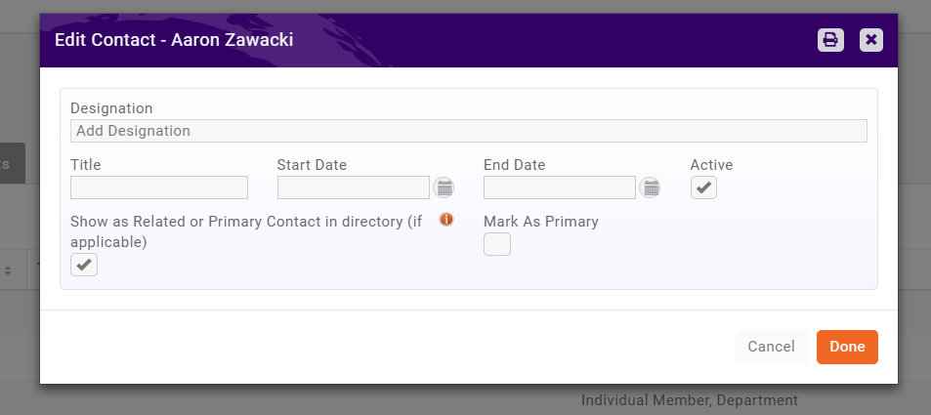
Uncheck the Active Box

Slide 9
This Member is now inactive and ONLY Kevin can reactivate him.

Slide 10
Done!

