Slide 1
Download your roster into Excel
Version 8.0
12/13/2018

Slide 2
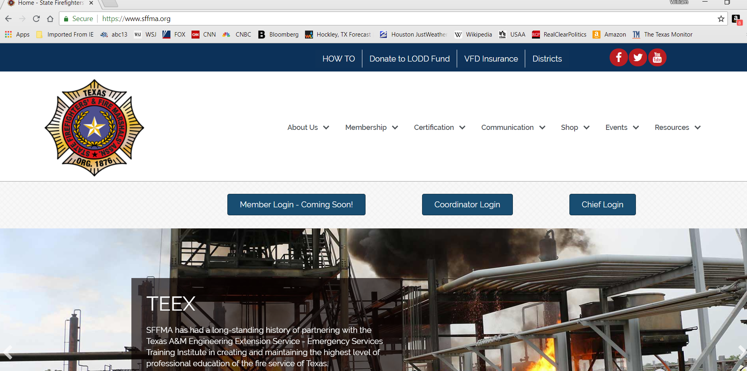
Click

Slide 3
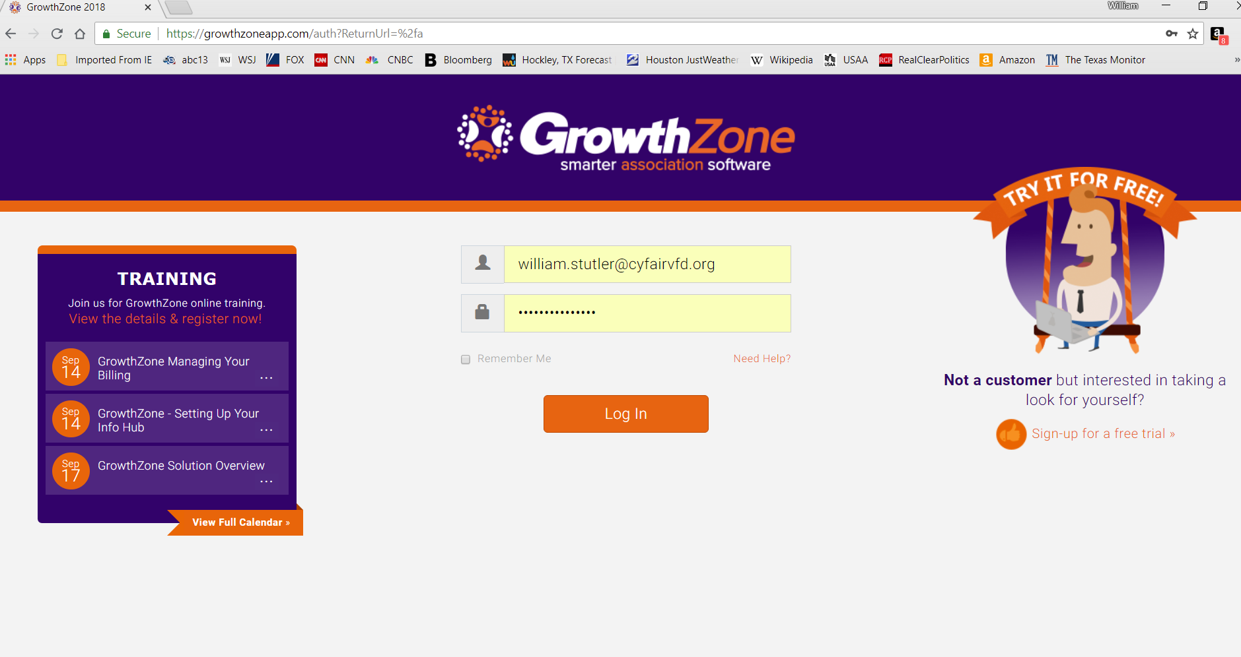
Click

Slide 4
Click

Slide 5
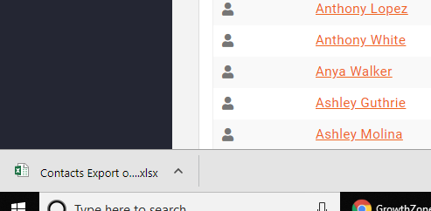
Click on the file in the lower left corner of the web page

Slide 6
Click

Slide 7
Done!

