Slide 1
Connect. Collaborate. Contribute.
Adapted from N. Hernandez, The Research Commons Collaboratory: The Research Commons Tools To-Date. July 14, 2017.
The Research Commons Story at The Ohio State University Libraries
Alison Armstrong
Associate Director, Research and Education

Slide 2
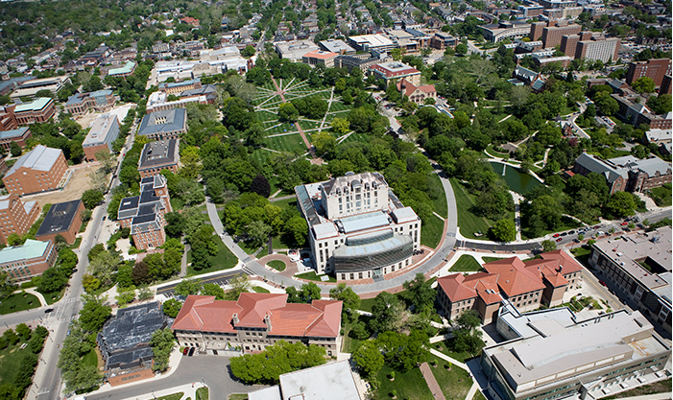
UNIVERSITY LIBRARIES
About Ohio State
Top-20 public university
58,000 students
15 Colleges
Land grant institution
200 undergraduate majors and 250 master’s, doctoral, and professional degrees
13 OSUL locations
UNIVERSITY LIBRARIES

Slide 3
What is the Research Commons?
UNIVERSITY LIBRARIES
A place where researchers can connect with each other and with services that support and enable their work
A campus hub for collaborative and interdisciplinary research across all fields, with a special focus on Data Management & Visualization, Digital Humanities, and Geographic Information Systems (GIS)
3

Slide 4
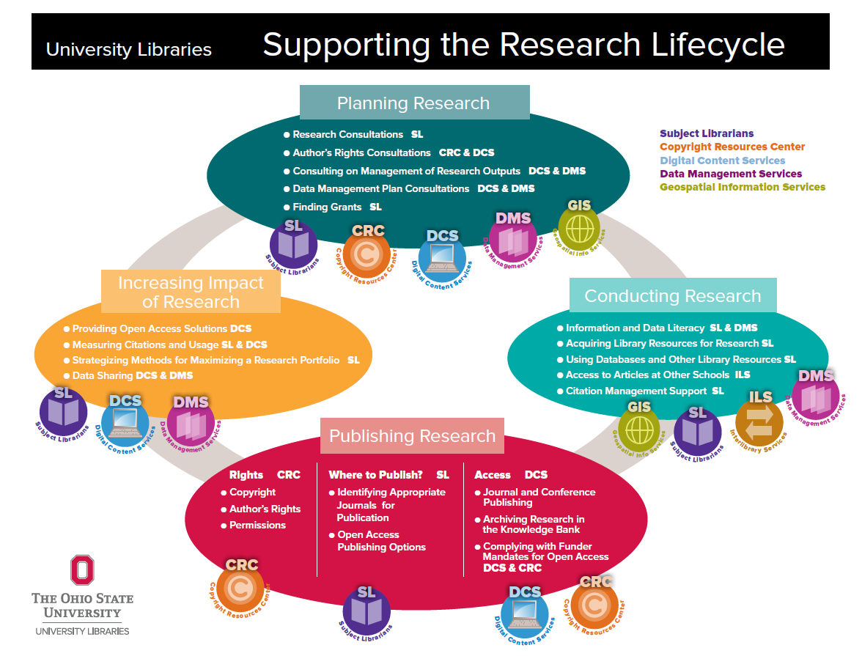
Defining the Research Commons
UNIVERSITY LIBRARIES
As a Network
As a Space
As a Place

Slide 5
UNIVERSITY LIBRARIES
UNIVERSITY LIBRARIES
5

Slide 6
UNIVERSITY LIBRARIES
Research Commons Timeline
2015
Success Measures and Assessment
February 2017
Application Developer Hired
November 2016 RC
Concierge hired
2012
White Paper (C. Gibson)
2013
RC Task Force Report
2015
Construction Begins
Techniques
Research Impact Librarian Started
DMS
Outreach/ Education Specialist Hired
2012
Graduate Student Listening Sessions
2013
RC Partners Advisory Committee Created
2014
Data Mngmt. Services Librarian Hired
2014
RC
Manager & GIS
Specialist Hired
2014
Workshops Begin Autumn Semester
2014
Work with Marketing Class
2015
RC
Assistant Hired & Student Staff Trained
2015
RC IT
Specialist Hired
January 2016
Research Commons Opens
March 2015
Use Cases for Technology
June 2017 Data Visualization Specialist Hired
August 2016 DH Librarian Hired
Digital Humanities Use Cases
6

Slide 7
Research Commons Team
UNIVERSITY LIBRARIES
Meris Mandernach, Head of Research Services
Josh Sadvari, Program Manager, GIS Specialist
Leigh Bonds, Digital Humanities Librarian
Lee-Arng Chang, Data Visualization Specialist
Nancy Courtney, Research Impact Librarian
Inal Elbeyli, Application Developer
Rico Garabis, IT Specialist
Nicole Hernandez, Program Assistant
Amanda Rinehart, Data Management Services Librarian
Sharon Sadvari, DMS Outreach/Education Specialist
7

Slide 8
Partners
UNIVERSITY LIBRARIES
Internal External
Copyright Resources Center
Publishing and Repository Services
Thompson Reference
Subject Librarians
Office of Responsible Research Practices
Office of Research
The Writing Center
ODEE
Office of Undergraduate Research and Creative Inquiry
Industry Liaison Office
Ohio Super Computer
8

Slide 9
Consultations
UNIVERSITY LIBRARIES
Beginning Current
CRC
PRS
The Writing Center
Data Management Services
IRB
Funding Opportunities
CRC
PRS
Data Management Services
GIS
Research Impact
Industry Liaison Office
IRB
Funding Opportunities
Ohio Super Computer
IACUC
Research Methodology Center
9

Slide 10
The Research Commons
UNIVERSITY LIBRARIES

Slide 11
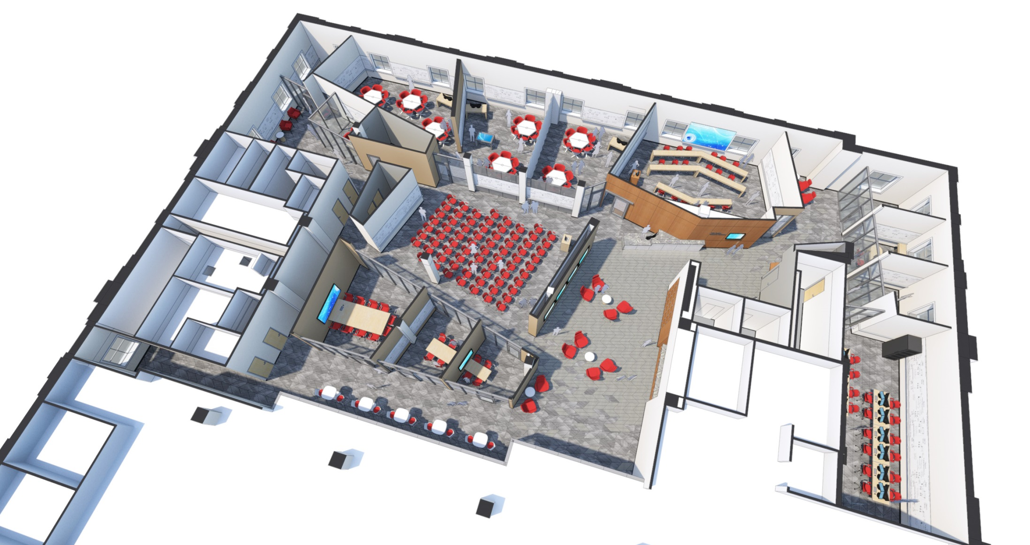
UNIVERSITY LIBRARIES
The Research Commons
UNIVERSITY LIBRARIES

Slide 12
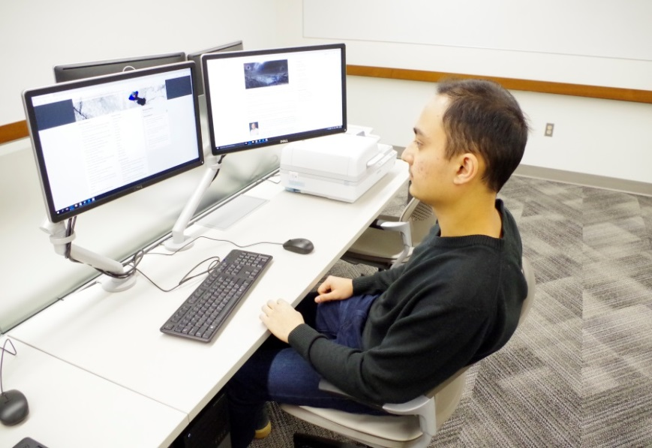
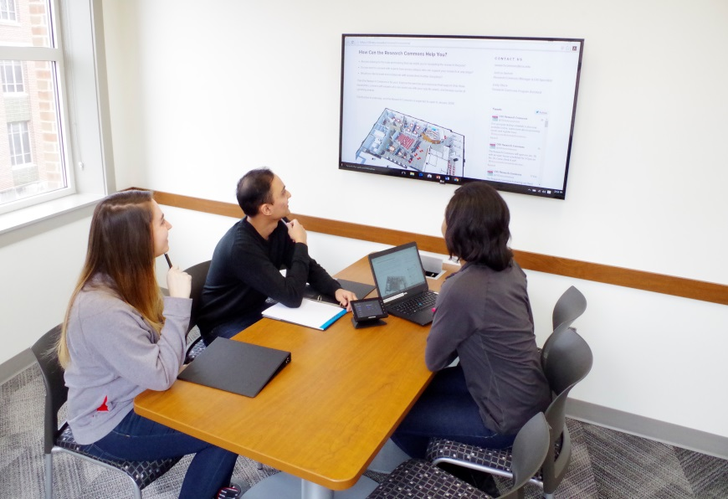
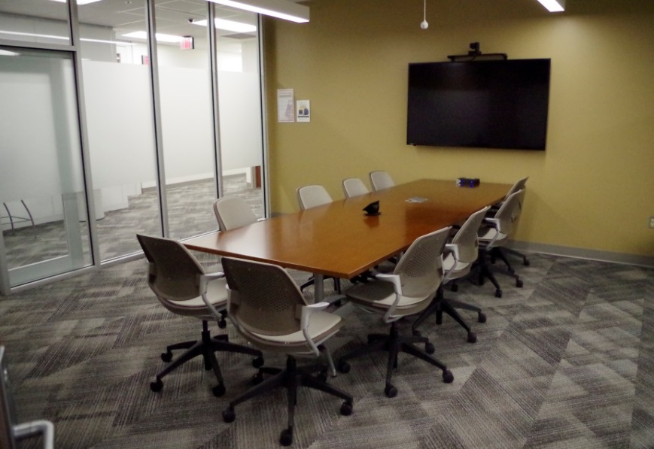
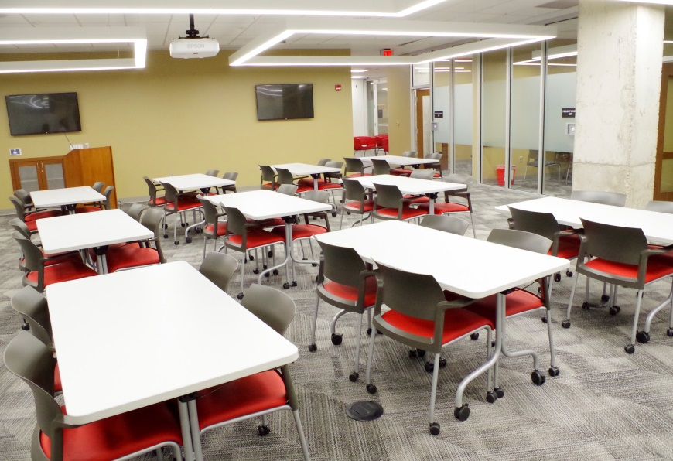
UNIVERSITY LIBRARIES

Slide 13
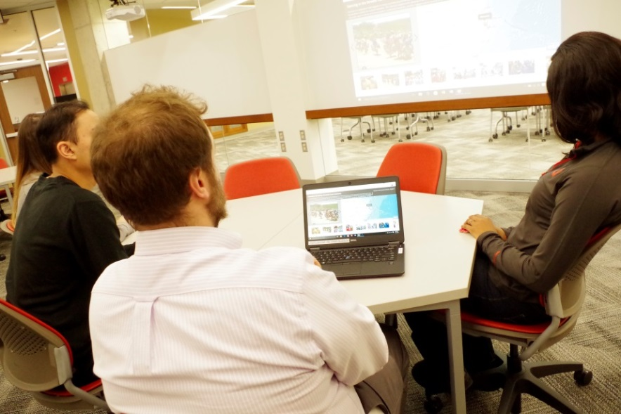
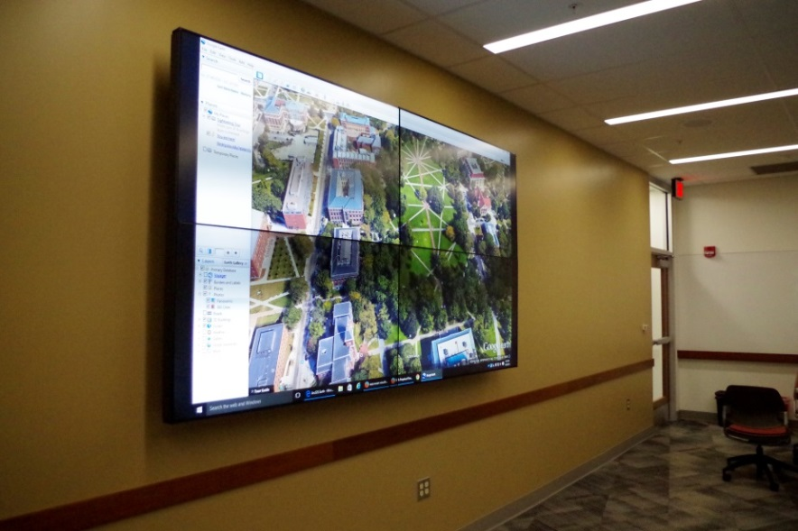
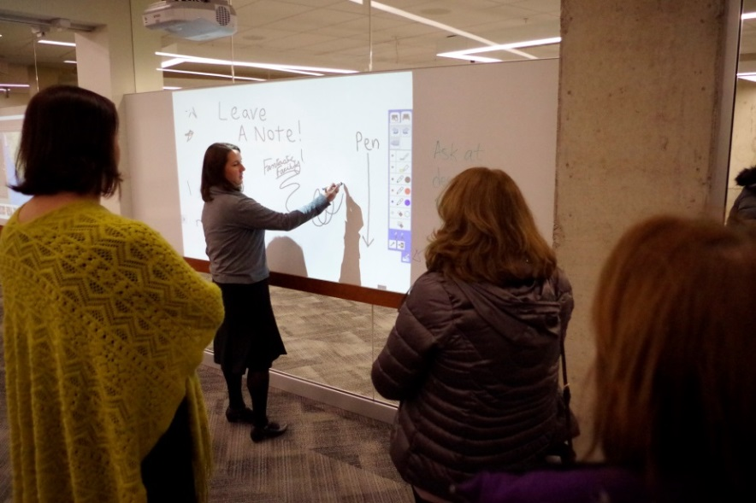
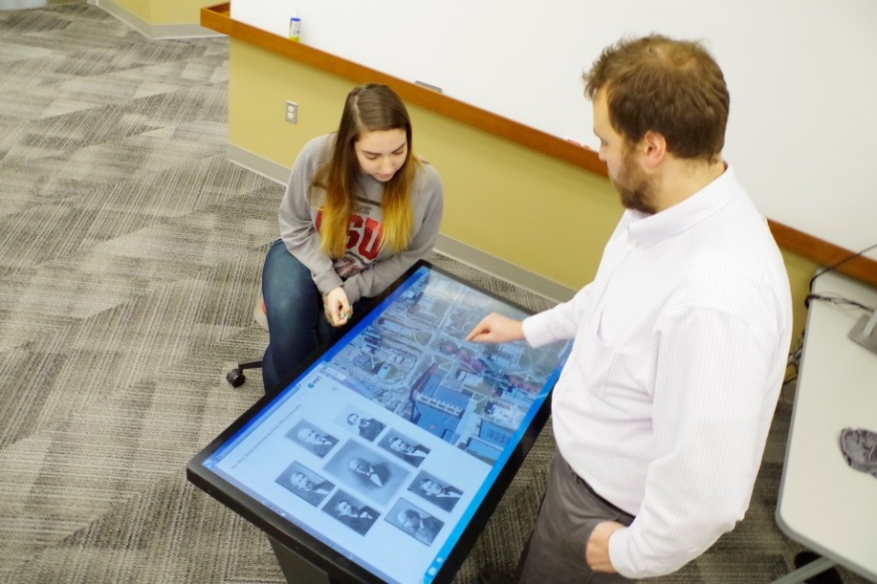
UNIVERSITY LIBRARIES

Slide 14
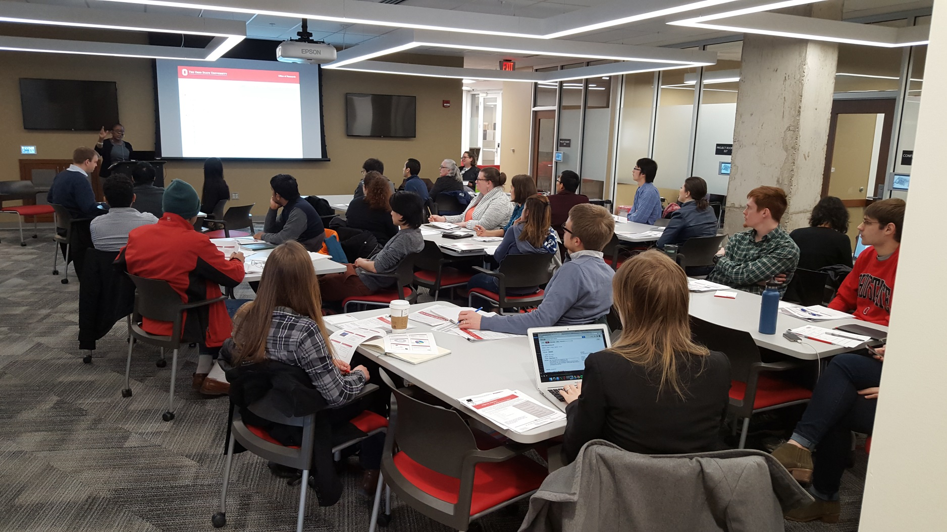
UNIVERSITY LIBRARIES

Slide 15
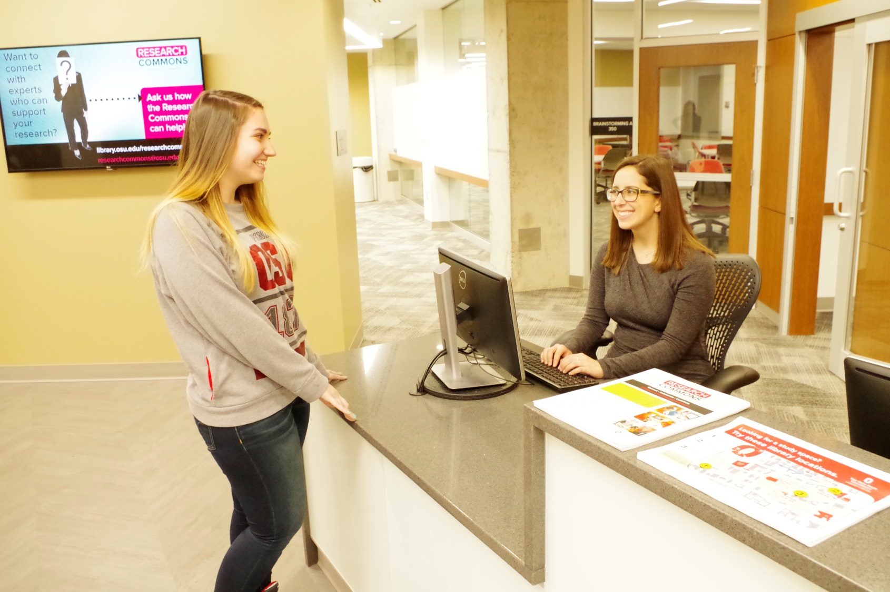
UNIVERSITY LIBRARIES

Slide 16
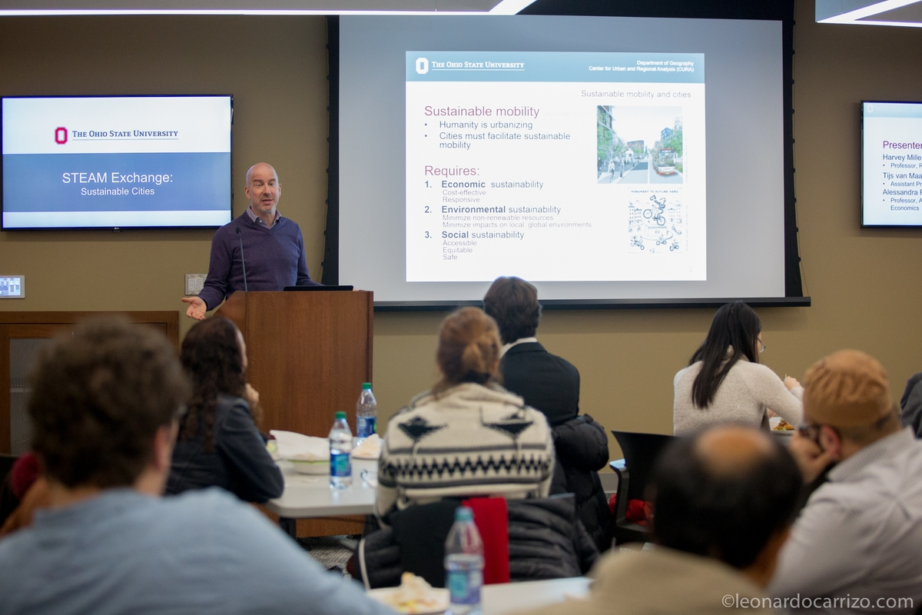
UNIVERSITY LIBRARIES

Slide 17
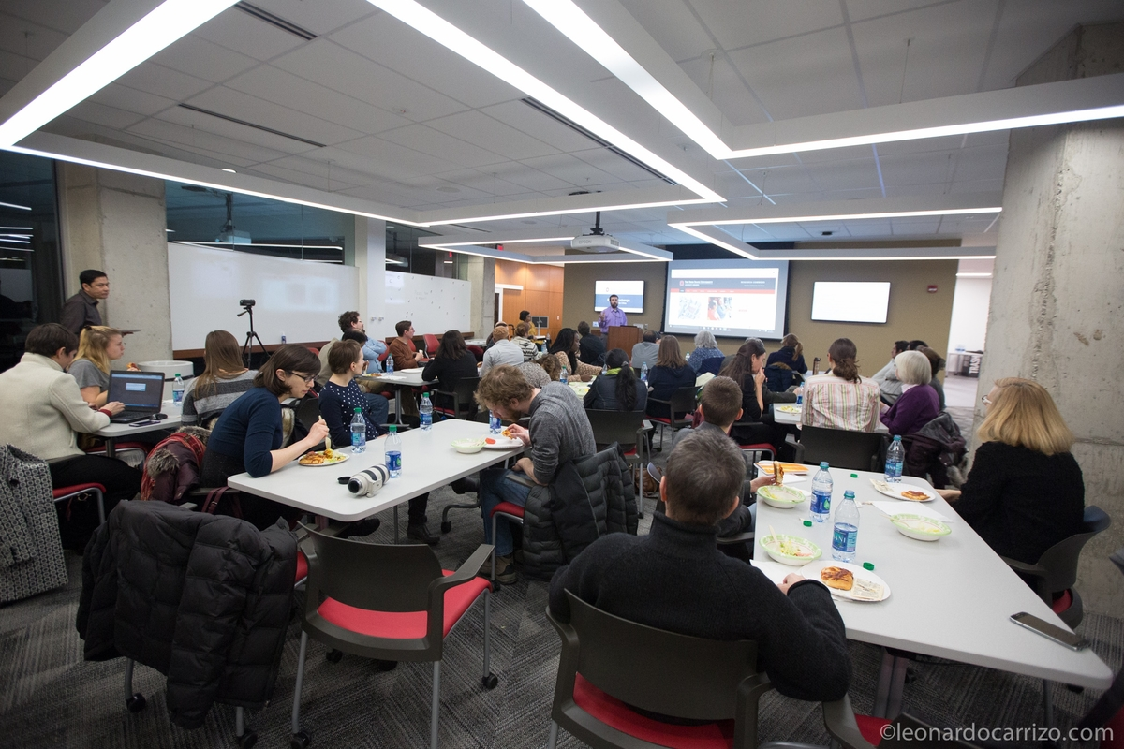
UNIVERSITY LIBRARIES

Slide 18
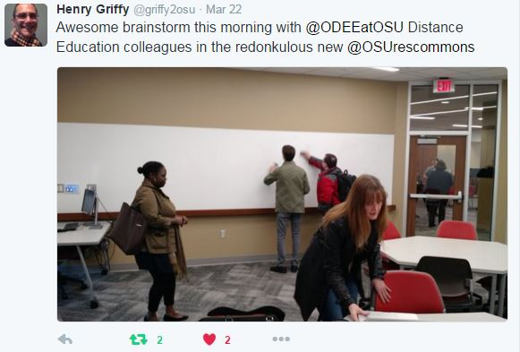
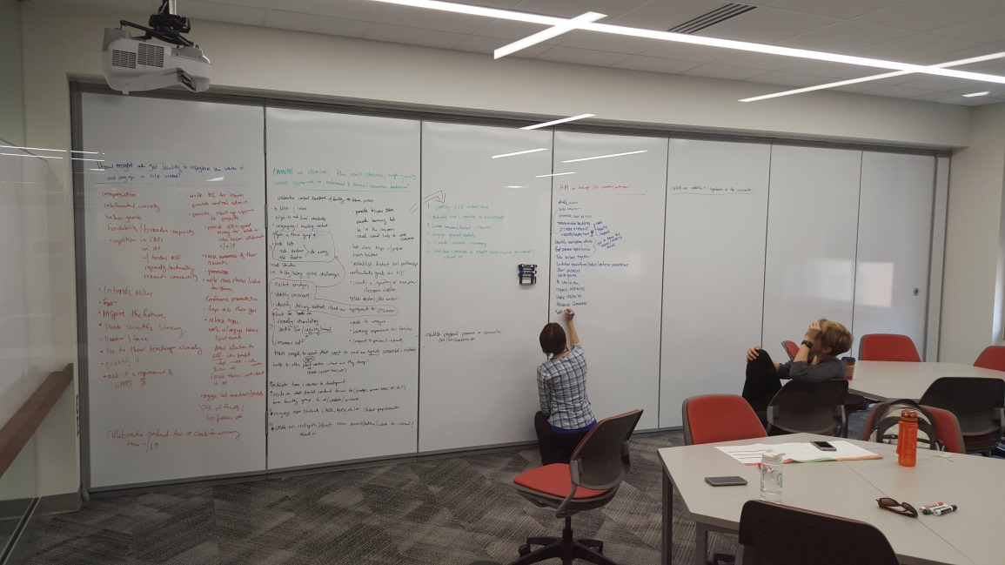
UNIVERSITY LIBRARIES

Slide 19
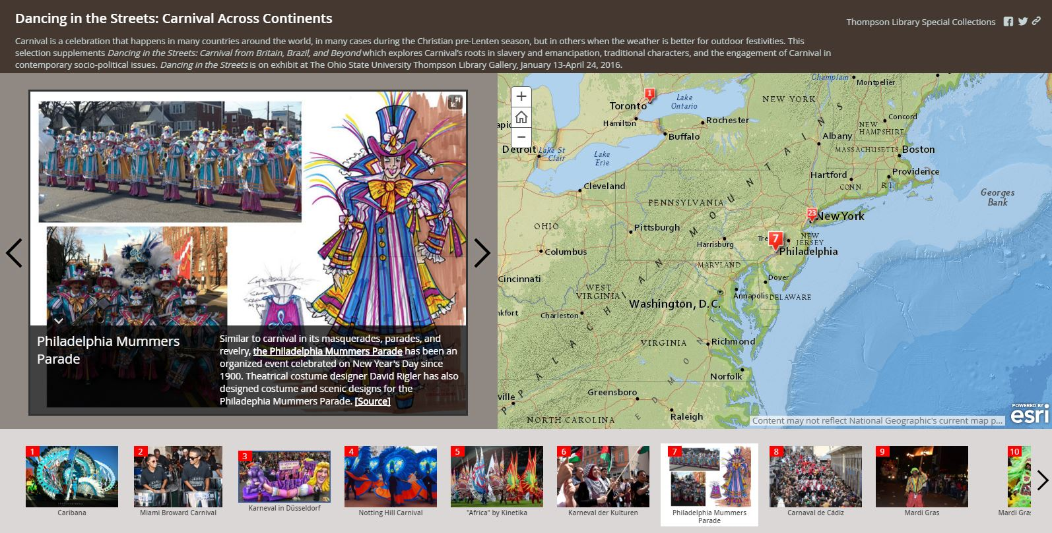
UNIVERSITY LIBRARIES

Slide 20
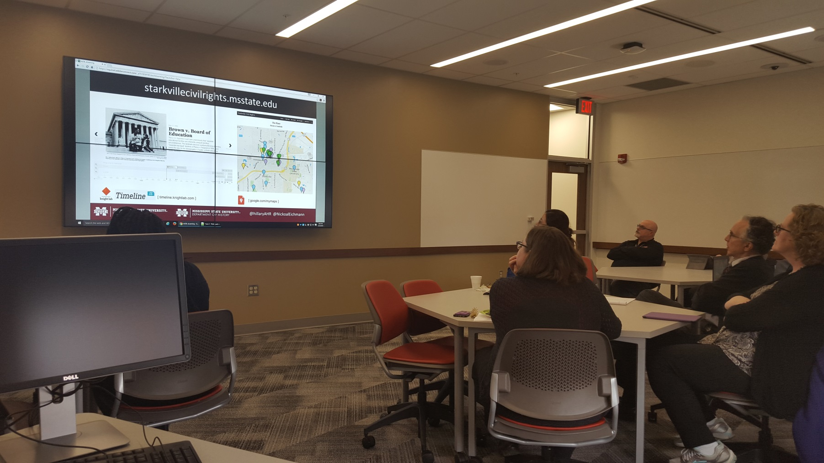
UNIVERSITY LIBRARIES

Slide 21
UNIVERSITY LIBRARIES

Slide 22
Thank you!
UNIVERSITY LIBRARIES
Alison Armstrong Associate Director for Research and Education
The Ohio State University
University Libraries
305G Thompson Library | 1858 Neil Avenue, Columbus, OH 43210
614-292-6206 office
armstrong.684@osu.edu

