Slide 1
Rejoining the information access landscape
TERRY REESE
HEAD OF DIGITAL INITIATIVES
THE OHIO STATE UNIVERSITY LIBRARIES
Notes:
This might be a kind of a quirky title for talk on how technology has impacted the library community. It may seem even a little more out of place, given the fantastic talks that we will hear today as part of this panel. Libraries are doing really interesting, and important things. Both public and academic libraries serve as important incubators within their respective communities – opening up opportunities and providing safe spaces to explore, create, and grow. I believe that. Growing up, in a small town of less than 800 in Oregon, it was the public library and the librarians that instilled in me an interest in the world beyond our little town. They opened up a world beyond Coos Bay, Oregon – a world that was bigger and more interesting. It is where I first was introduced to a computer (at 9), the notion of programming. And that changed my life. I’ve been programming now since I was 12...it effects my research, may work, and my service to the profession. Libraries change lives and make their communities more vibrant.
But I’m also at a large academic library – and this is an environment that is very different from a public library. Academic libraries not only serve as spaces for their communities, but they have acted as the guardians of the cultural record and the engine for scientific and philosophical discovery. They have been the trusted source of information for generations who work hand in hand with researchers to curate and create new knowledge. And it is this role that I’m interested in discussing, because this is the role that I believe we have largely abdicated as technology and information became commodity products. Today, the library community is just one small part of the larger information access landscape, and as a community, libraries find themselves at the edges of this community….both in terms of how we interact with it, and how our own researchers view and interact with us.
I’d like to talk a little about that – about the opportunities I’m seeing for libraries to rejoin the larger information access landscape, and what that will mean for the communities that they serve.

Slide 2
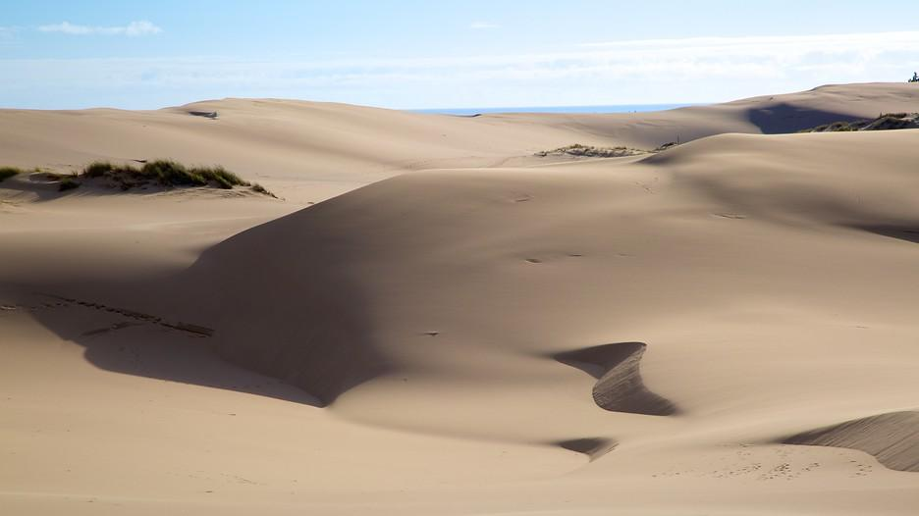
Notes:
I spent most of my life in Oregon, having only lived here in Ohio for the past 4 years – so this is my point of reference when I visualize a lot of things.
This is a picture of the Oregon Dunes. Between the Oregon and the Coast, Oregon has a long set of dunes that stretch the length of the state. The Dunes are an interesting ecosystem, because they are always shifting. Hills can appear and disappear almost overnight, and the are a good representation of how I’ve come to view our information ecosystem. Like the dunes, the information landscape is made up of lots of organizations, and the impact and importance of those organizations seems to shift with time.

Slide 3
Notes:
However, individually, these organizations are unique, with significant value. This is a picture from sand from the Dune under a microscope. When we look at the information landscape from a distance, we see a Dune, but up close, we see just how unique each individual part of the landscape really is. For libraries, this uniqueness is manifested in our distinctive collections, archives, our own research, etc. Like sand, our organizations look different because the communities that we serve are different. However, as cool as each individual grain of sand may be – it is only one small part of the much larger whole – and on its own, it's just a grain of sand.
This is how I think about libraries. I work at Ohio State University. It’s a big place and we have a lot of researchers. We also have a large community of researchers. I believe on any given day, the # of students and faculty on campus would make it the second or third largest city in Oregon (for some perspective). And even as large as we are – we can’t be large enough to meet the needs of our communities. And partly, that’s because the expertise and materials needed to meet those needs live at other large, organizations. For OSUL to be successful and meet the needs of its users – it needs to be a part of this larger information landscape.

Slide 4
Notes:
However, how we become a vital part of that information landscape is very different today, than it was yesterday. In the not too distant past, we leveraged tools like OCLC to make that happen. While most folks tend to focus on OCLC’s large, shared bibliographic database – it’s most valuable asset has always been it’s holdings database. For years, this is how individual libraries have become stronger together. In a sense, OCLC was the network that we connected our pipes to, and the most valuable commodity that we shared with one and another, was our metadata regarding our collections and an agreement to share our information with other people.

Slide 5
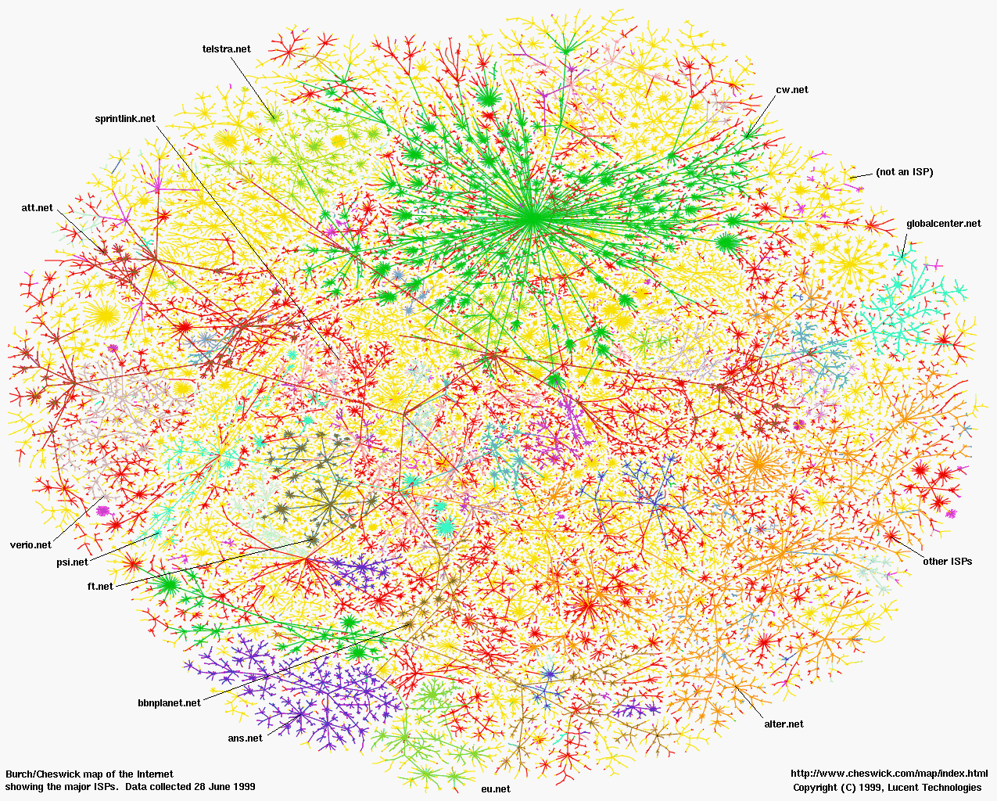
Notes:
Today, these pipes look very different. The internet and our connected world have forever changed what it means for libraries to be part of the information ecosystem. And this has had a significant impact in terms of how we view our collections and intellectual content, how we interact and allow other people to interact with our data, and even our conception of a what a library is today.

Slide 6
3 things
At this point in our history, there is no such thing as a digital library (or digital collections for that matter)
Libraries must embrace, support, create open data (and systems) or will become largely more irrelevant to their communities
The same way physical libraries are platforms for their users; the libraries must have a digital platform, a mechanism that enables non-carbon-based users to interact with its information, easily and seamlessly

Slide 7
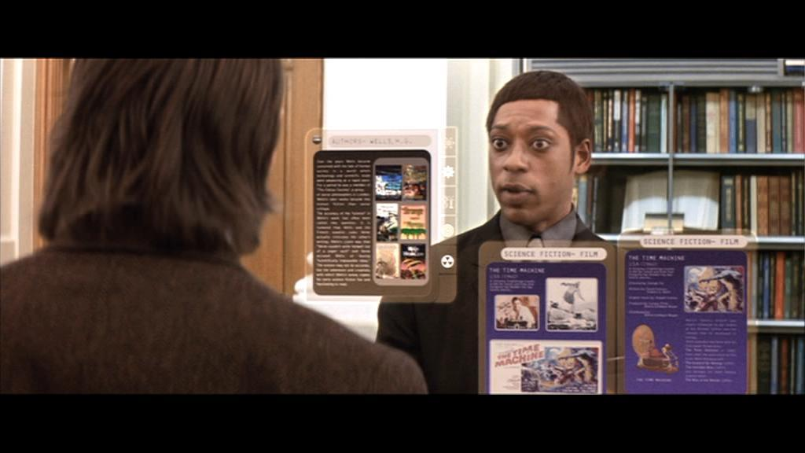
Notes:
This is a picture from one of my favorite books and one of my favorite bad movies. You might recognize it (or more likely, won’t)…but it’s a scene from the 2002 adaptation of H.G. Wells’s the Time Machine.
In this scene, our hero is jumping forward in time to try and figure out why he can’t change the past. And in jumping forward, he stumbles upon the NY Public Library, where – it has been completely digitized. The Librarian AI acts as the interface to the Libraries materials, and is connected to the whole of the world's knowledge.
So, Ok, I don’t expect to be replaced by a holograph anytime in the near future; but this scene always sticks out to me because it illustrates our users vision of what a library is (even somewhat today), and that is this notion that a library is digital.
The problem is, as a community, I’m not sure that we agree…and I think that due to the language that we use. Digital library, digital initiatives, digital preservation, digital collections – these are things that set them up as not normal, or not the default. When we say preservation in the library, we don’t say analog preservation, because books are still the default. When we stay that we are building collections – we don’t qualify that remark, because the physical collections are still the default. Even in a large academic institution, where we license lots of electronic materials – these materials are treated as leased items and not really part of the collections…analog is still the default in the language that we use, and it's reflected in how we spend our money, build our buildings, and develop our strategic plans.
And it needs to change…Today, a libraries digital collections, systems, and infrastructure are as much of a core part of what we do, as any other part of the institution. And to not recognize that is a disservice to your users and communities. In fact, to not recognize that is one of the fastest ways to become largely irrelevant to your user community – or to become simply a place for users. And being a community place isn’t necessarily a bad thing – we need community spaces – but research shows us that by and large, human interact is changing due to the way in which we have become connected through technology. I see it with my own kids – who plan time to connect virtually, rather than in physical spaces. And we see it in our research. I work in the semantic webspace, I collaborate with researchers around the world – I’ve never met some of the colleagues I work with the most – outside of Skype or Google hangouts. Even the notion of community space is largely becoming virtual, and where does the library fit into that world.
When I think about how we position initiatives at OSUL, these are the kinds of things that I’m worried about and thinking about. We still use legacy language to describe what we do – and that hurts us. We still largely see our digital work as important, but extra, though that is changing. And we are still largely trying to create physical spaces to bring people together, without investing in the virtual meeting spaces that I believe will be how researchers and students interact in the future. Obviously, even at an organization as large as OSU, we could be doing a lot more and better.

Slide 8
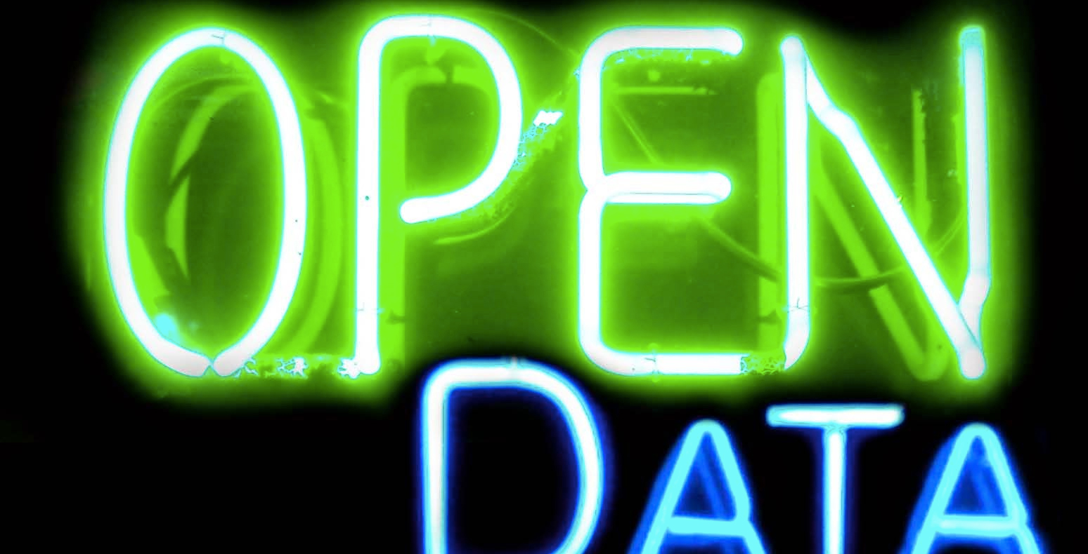

Slide 9
Notes:
Within the library, this seems to be accepted as an axiom. That data, in its most purest form, should be free and available to everyone. As a community, we’ve put tremendous capital behind this notion when it comes to advocating for free and open scholarly communications, for access to scholarly articles and research, to promoting open science and open data. Librarians are helping to lead discussions related to open textbooks, and open learning. We make statements that free and open data are the bedrocks of an informed and healthy democracy.
As librarians, we love open data…until we don’t
We’ve created this awesome thing called OhioLINK. We started OCLC, and then shared it with everyone else. We have companies like Zephera partnering and pushing libraries here in Ohio and beyond to “linkify” their data to make it more friendly and available to the web.
But does any of that actually make our data, or systems, more open. Generally, I’d say no. Finding stuff or making content easier to find is definitely important, but it doesn’t make your data open, and this is a really important distinction, because humanities research and the dream of linked data in the Libraries largely depend on it.
It’s time that Libraries begin evaluating our own systems and data polities against the same criteria that we want to use when we evaluate our data partners. So what do I mean.
Well, if a researcher comes to your library and says that they would like to data mine all the full text for your institutional repository – could you give them the data? Technically, this might be difficult, but honestly, how many could say that local policy or a knee jerk “copyright” response might end the discussion. I can tell you that would likely be the case at Ohio State (I’ve asked).
Can individuals download your library catalog? Can you post your catalog online in XML for anyone to download? The answer is sure, but the reality is that most libraries are still afraid that OCLC might come after them. I can tell you that’s the case at Ohio State (again, I’ve asked).
How easy is it for libraries to utilize local control vocabularies that you may develop?
Can you tell me what your data policies are related to information that you share or data that you capture? Can I, as a user, find that information out? Can I, as a researcher, have access to the library’s anonymous search logs?
Does your library have API? Is it documented, can researchers use it?

Slide 10
“It seems to me that we’ve spent enough time on closing down our information systems while attempting to broaden our influence through the production and delivery of innovative library programs and services. When we support the development and use of closed systems we’re failing our communities.”
--Cecily Walker, LITA Forum 2016 Keynote
Notes:
Let’s start here. Libraries are at the forefront in open education and open learning. We are developing new services, and finding ways to build new partnerships. We are doing our best work for the users that we can see, for the needs that we can identify and answer right now.
It’s the users that we don’t see, and the opportunities lost where we are failing right now. I’m asked all the time, how can libraries make themselves ready for linked data. My answer…open your data and think of the Library as a platform, and your data as a its service.
Quote taken from Code4Lib 2017 Keynote, Christine Harlow

Slide 11
Open your own systems
Start to think of the library, and it’s systems as a coherent platform, and open them
Understand the data you collect, house, and make available, and provide clear usage information that is both human and machine readable
Share your data, and the information about your data, widely

Slide 12
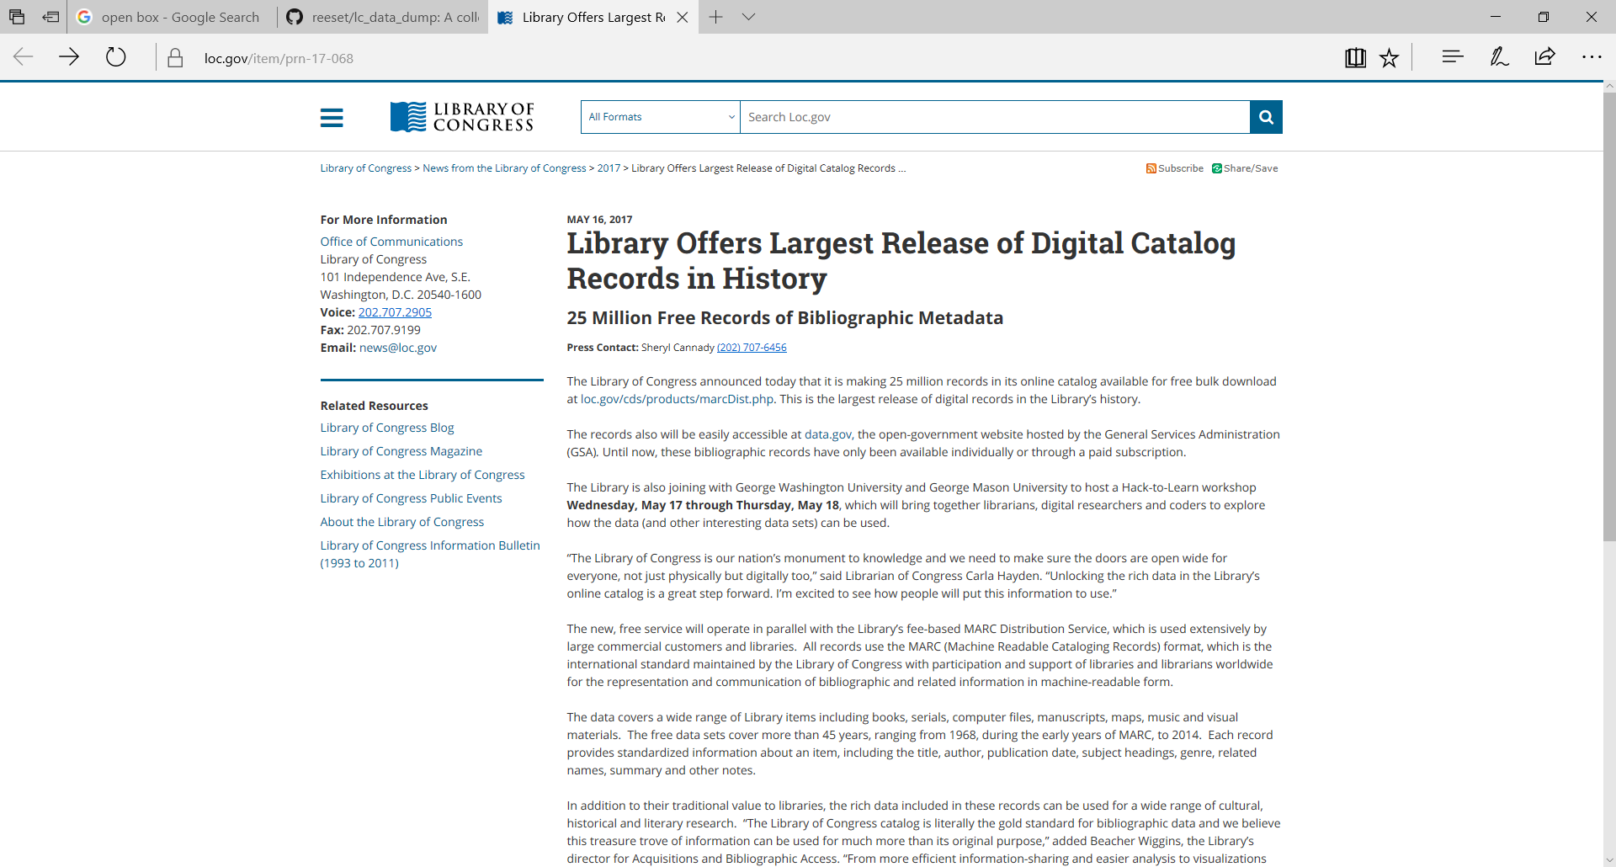

Slide 13
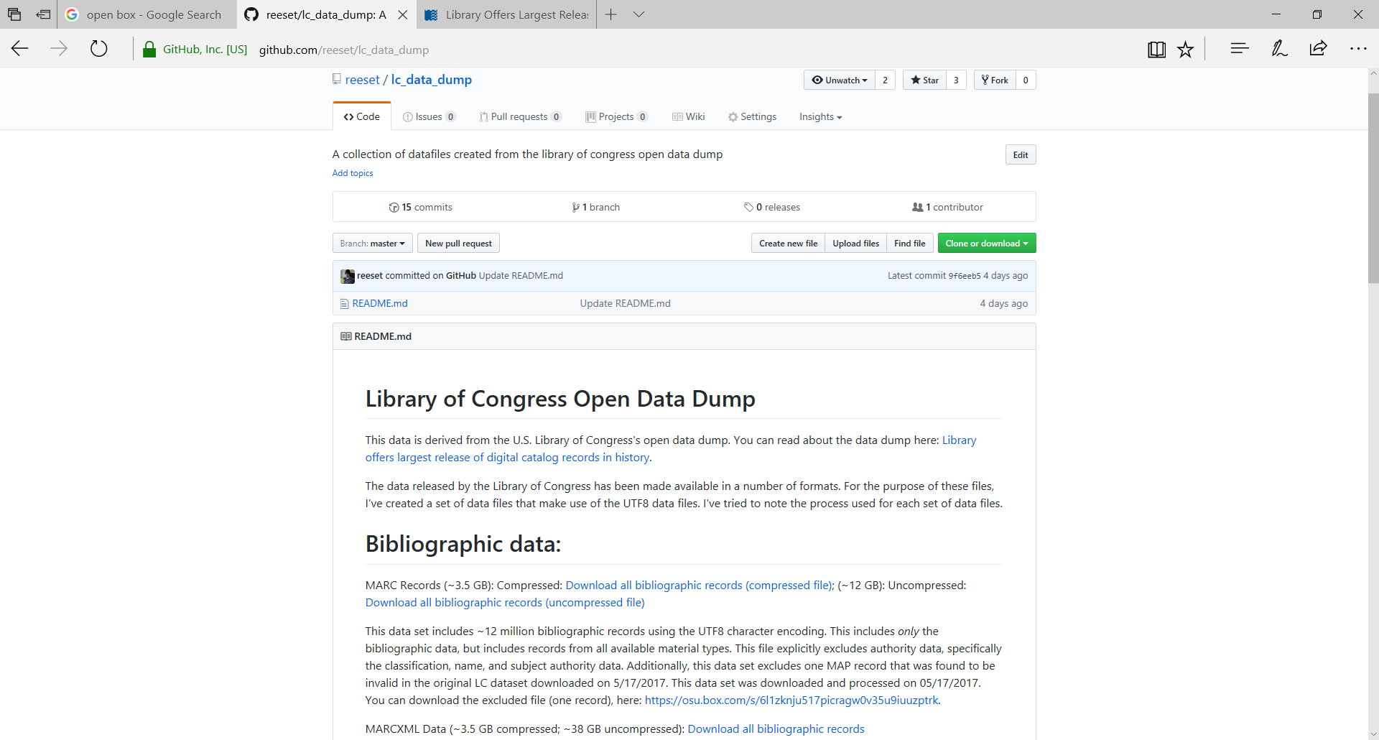

Slide 14
Don’t forget about your non-human users
BE A NETWORK PIPE
As Libraries, we need to rethink our own systems and how we share, create, and allow other systems to interact with us. We need to develop our digital infrastructure as a platform, not a set of loosely organized systems
We serve data and participate in building the semantic infrastructure
We provide APIs and documentation
We promiscuously share our data, freely, and openly.
Notes:
The semantic web is how information communities are sharing their data right now. And to participate in this space, your systems need to be open and self describing. And this is hard, because it means bringing mean to what can (and is) the libraries very messy, and siloed information technology infrastructure. But, I’d argue (and this is especially true for academic libraries), you want to serve your researchers and answer the kinds of questions I noted above, you must take on. Not doing so, regulates users primarily to physical spaces and curated access to materials. And both libraries and the even special collections that we house are not special enough to sustain this kind of model.

Slide 15
