Slide 1
When private meets public:
Data, ethics, and librarians
September 8, 2017
Amanda K Rinehart
Data Management Services Librarian, Ohio State University

Slide 2
Research Data Management at OSU Libraries: First Four Years
Education Focus
Workshops, OSU Libraries Research Commons
Data organization basics
DMPTool (470 plans to date!)
Events in colleges, departments, classes
Consultations, office hours
Notes:
Update this slide with current numbers

Slide 3
Top Consultation Concerns
How to organize data
How to share data
Writing a data management plan
How to collect data
Data ethics or legal issues
Notes:
Dinessa

Slide 4
ALA Ethics Statement
“We protect each library user's right to privacy and confidentiality with respect to information sought or received and resources consulted, borrowed, acquired or transmitted”
American Library Association Code of Ethics, http://www.ala.org/tools/ethics
Notes:
Dinessa

Slide 5
Data ethics/legal issues
Confidentiality
Consent
Copyright
DATA Use Agreements
FERPA
HIPAA
Institutional Review Board
Personally Identifiable Information
Privacy
Responsible Conduct of Research
Sharing
Transparency

Slide 6
Examples
Notes:
Dinessa

Slide 7
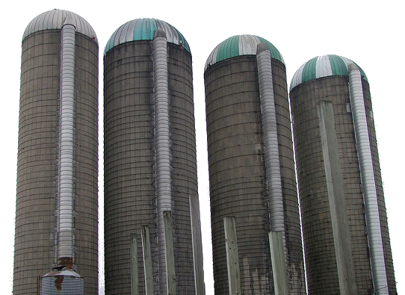
Data Ag Coalition
Problem: Farming data
- is in silos
- sometimes proprietary
- hard for farmers to analyze
Agri-businesses want the data
for product improvement,
but farmers want to retain control
Notes:
Dinessa

Slide 8
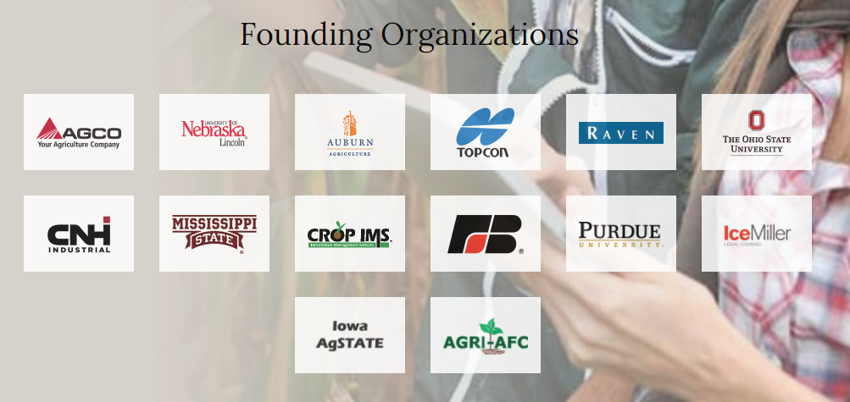
Data Ag Coalition
Solution: Put the farmers in charge of how the data is pooled and shared! Membership models with granular levels of control. (http://agdatacoalition.org)
Notes:
Dinessa

Slide 9
Data ethics/legal issues
Confidentiality
Consent
Copyright
Data Use Agreements
FERPA
HIPAA
Institutional Review Board
Personally Identifiable Information
Privacy
Responsible Conduct of Research
Sharing
Transparency

Slide 10
Raising Awareness
Public Affairs first year doctoral student seminar case studies
1. Facebook experiment – Is it OK to manipulate people?
2. OKCupid – Is public access consent for any activity?
3. Ask Retraction Watch – is it OK to deliberately skip citing datasets?
4. Student analytics - Big Brother or predictive support?
http://go.osu.edu/dataEthicsCases
Notes:
Dinessa

Slide 11
Data ethics/legal issues
Confidentiality
Consent
Copyright
DATA Use Agreements
FERPA
HIPAA
Institutional Review Board
Personally Identifiable Information
Privacy
Responsible Conduct of Research
Sharing
Transparency

Slide 12
Worried? Ask these questions:
Does this option do less harm than other options?
Would I want this publicized?
Can I defend this choice?
If I were the subject, would I be OK with it?
What do my colleagues say about this?
What does my professional association or ethics committee say?
What does the ethics officer or legal counsel say?
DiBiase, D, C. Goranson, F. Harvey, and D. Wright (2009). The GIS Professional Ethics Project: Practical Ethics Education for GIS Pros. Proceedings of the 24th International Cartography Conference. Santiago, Chile, 15-21 November.

Slide 13
Partnerships
Responsible Conduct of Research Trainers
Office of Compliance
Institutional Review Board
Legal counsel
Ethics researchers
Rinehart, A. (2016), Finding the Connection: Research Data Management and the Office of Research. Bul. Am. Soc. Info. Sci. Tech., 43: 28–30. doi:10.1002/bul2.2016.1720430107
Notes:
Dinessa

Slide 14
Amanda Rinehart
rinehart.64@osu.edu
Data Management Services Librarian
614-292-3336
490F 18th Ave Library

Slide 15
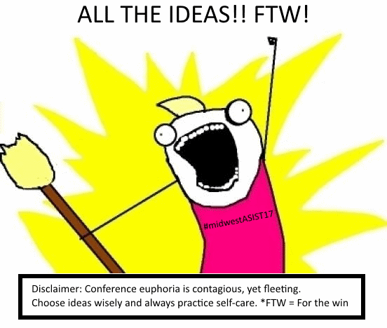

Slide 16
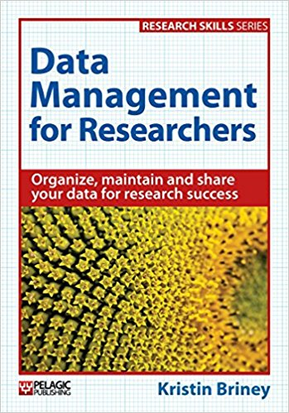
Interested in learning more?
Barbrow, S., Brush, D., & Goldman, J. (May 01, 2017). Research data management and services: Resources for novice data librarians. College and Research Libraries News, 78, 5, 274-278. Retrieved from: http://crln.acrl.org/index.php/crlnews/article/view/16660/18115
#datalibs

