Slide 1
Mobile Web at UConn Libraries
Dave Bretthauer
University of Connecticut Libraries
NEASIS&T: Going Mobile: Library Websites, Services, and Apps on Mobile Devices
April 23, 2012

Slide 2
About Uconn & Libraries
Reorganized in 2009, per new Academic Plan
Emphasis on meeting user needs by group
Undergraduate
Graduate
Faculty
Public
Planning Team manages a process for Strategic Goals (“SPGs”), including potentially significant funding
UConn Brand managed by University Communications

Slide 3
About Me
Member of Digital Programs Team
Websites/Web Presence
Local & BLC Digitization
Application Development since September 2010
Institutional Repository
Second Gen Digital Library System—Fedora Commons
Librarian, not an Applications Developer
Not part of IT
Emphasize usability & incremental improvement
Manage and/or support 24 websites:
First generation individual digital collections
Project and service websites
Application websites
Individual Library websites
Some not UConn-branded

Slide 4
UConn Libraries Website
Redesign rolled out in January 2009
10,000+ HTML pages
~3,000 ColdFusion pages
Managed with Dreamweaver, sort of
No Content Management System yet
Sparse documentation
No mobile presence
Google Analytics on many pages
De-emphasizing WebVoyage Catalog Interface

Slide 5
SPG Proposal, March 2010
Need: To provide access to library information resources to users with mobile devices, any time, any place.
Goal: To develop a mobile web strategy for the Libraries, identifying services and the hardware, software, staffing, training, and other resources required, and piloting a mobile web presence that provides those identified services.
Matched to specific organizational goals & strategies
Intended audiences
Undergraduate Students
Graduate Students
Faculty/Researchers
University Staff
Library Staff
Community Users
Budgeted Expenses
8GB iPod Touch: $258.00
Library Anywhere by LibraryThing: 1 year subscription: $2,200.00

Slide 6
Other Resources Leveraged
Informal Student Survey
Undergraduate Education Team’s Technology Survey
Training
CSS
Javascript & Advanced Javascript
Conferences:
CNI
Handheld Librarian 1, 2, & 3
Labstats Server (PC Availability)
WorldCat Local

Slide 7
Initial Project Plan
Survey Students & Analyze Results
Identify Content
Identify Technologies
Select Technology
Obtain Training
Port Content
Develop Features and Applications
Usability Test Site
Improve Site
Release Site
Promote Site
Evaluate Usage
Revise and Improve Site

Slide 8
Revised Project Plan, Thus Far…
Determine User Functionality Preferences
Cull UED Technology Survey Results
User Devices
Desired Functionality
Analyze Server Logs and Google Analytics
Insights From Conferences and Webinars
Evaluate Technology Options
Investigate, Experiment, Test, Repeat, Repeat, Repeat!
Select
Port Content
Develop New Features
Create Draft/Test Presences
Hire Applications Developer (who starts at Step 2)
Test & Revise
Roll out initial site
Discuss Mobile-Friendly Site Development with Other Campus Webmasters & Developers
Add Functionality as it is developed (locally or by vendors)
Repeat

Slide 9
Source: http://www.slideshare.net/bryanrieger/rethinking-the-mobile-web-by-yiibu

Slide 10
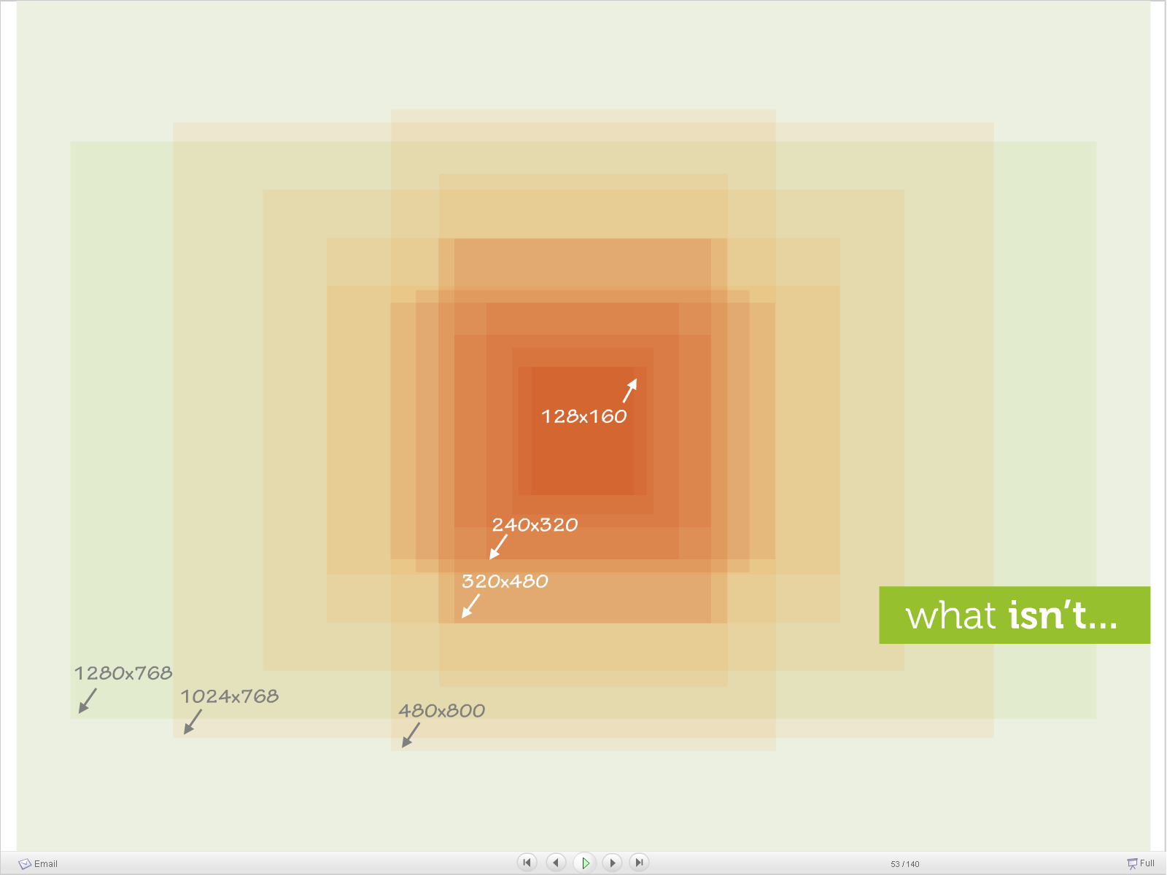
Source: http://www.slideshare.net/bryanrieger/rethinking-the-mobile-web-by-yiibu

Slide 11
Technology Options Reviewed
Device-Specific Applications
Development Kits and Device Emulators:
BlackBerry
iOS
Palm Pre
Etc
Issues:
Device-specific approach is resource-intensive
Required languages not widely used
Cost for iOS and certification process
Mobile-friendly CSS for existing website
“Write the page once, it works everywhere”
Issues:
“media=handheld” tag was not consistently used by mobile browsers
Current website has a lot of content extraneous to mobile users (~11,970 pages)
Current website does not use CSS consistently
Web browsers in varying states of HTML5 and CSS3 readiness (Chrome high, IE<9 terrible)

Slide 12
Technology Options Reviewed
Flash
Explicitly not supported by Apple; not well supported by BlackBerry
HTML5 offers real alternative
Javascript/CSS “Development Frameworks” with separate mobile-friendly web pages
Most commonly-used approach by academic/research libraries; offer app-like experience with the least effort
MIT Framework
iUi (then sponsored by Google)
(Mobi)
(PhoneGap)
University of Montana Libraries
UNC Libraries
Issues:
New options were emerging
Separate pages to maintain from primary website—wouldn’t scale to entire site’s content
Frameworks in varying stages of development, support, and documentation
Each framework had its quirks

Slide 13
What Didn’t Exist Yet
Frameworks:
jQuery mobile
HTML 5 Mobile Boilerplate
Sencha touch
Emerging Best Practices
Responsive Web Design—CSS3 Media Queries and defined breakpoints
See http://nd.edu, http://www.ucsd.edu
University of Connecticut Mobile Branding Standards

Slide 14
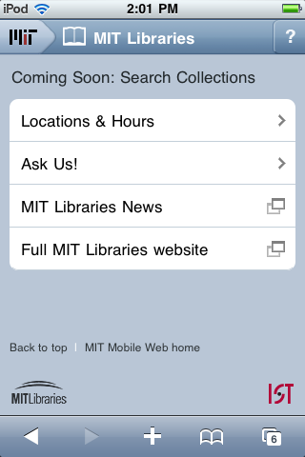
2010 Example—MIT Libraries
“The site currently only works for iPhones. In the future, we plan to create versions optimized for other mobile phones.”

Slide 15
2010 Example—Montana State University Libraries

Slide 16
A Bit About Our Users
Which Library Services They Said They Would Use from Mobile Devices in 2010
Which Mobile Devices They Used to Access www.lib.uconn.edu, in 2010 and now
How Frequently They’ve Been Accessing www.lib.uconn.edu Using These Devices, in 2010 and now

Slide 17
Library Services via Mobile Phone
Percentage of Undergraduates Fairly Likely, Likely, or Extremely Likely to...
Year | 1 | 2 | 3 | 4
Ask a Librarian a Question | 34.80 | 29.30 | 37.40 | 34.60
Send a Call Number from the Catalog | 35.20 | 31.90 | 37.20 | 35.40
Receive Renewal or Overdue Notices | 60.30 | 61.5 | 48.7 | 61
Renew Library Materials | 57.00 | 59.3 | 47.4 | 60.3
Source: 2010 UConn Libraries Undergraduate Technology Survey

Slide 20
Mobile Use as a Percentage of Total Use of UCL Homepage

Slide 21
Mobile Use as a Percentage of Total Use of UCL Homepage

Slide 22
UCL Mobile, October 2010Draft 1

Slide 23
UCL Mobile, April 2012

Slide 24
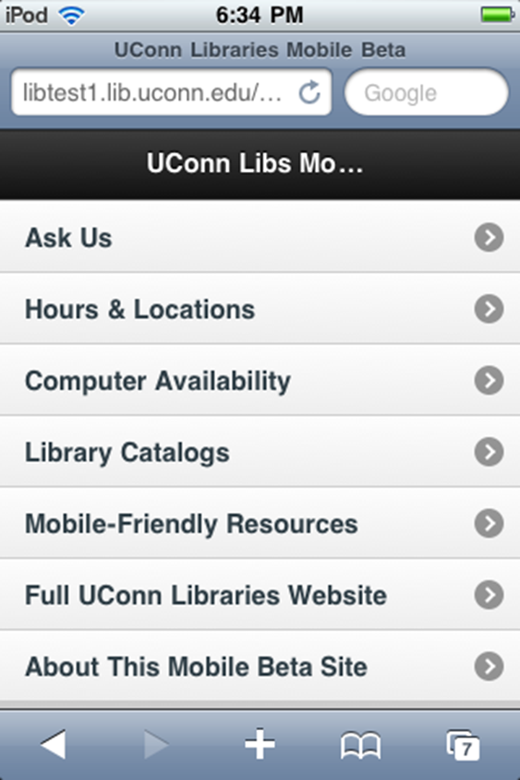
UCL Mobile, October 2010 Draft 2

Slide 25
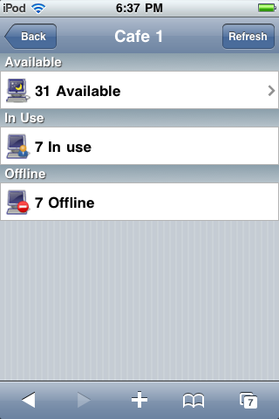
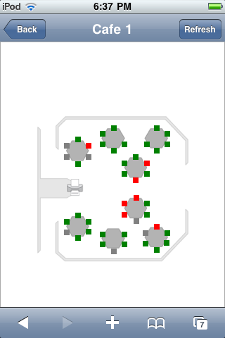
PC Availability v.1

Slide 26
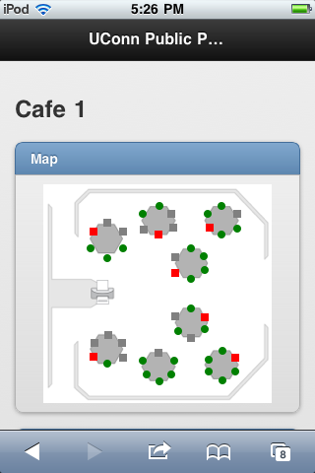
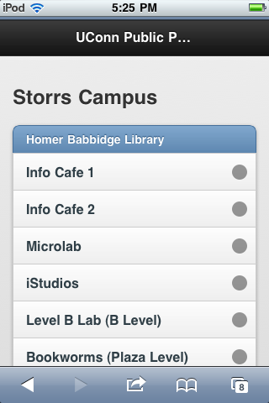
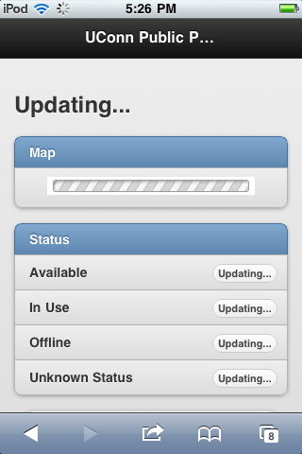
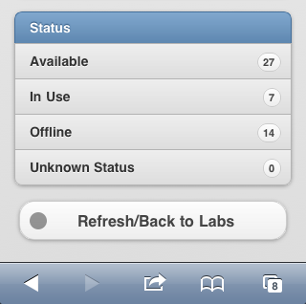
PC Availability v.2

Slide 27
Continuing Steps
November 2010:
Invited University Webmaster/Web Developer community to informal meetings, with goal of sharing experience and unifying direction
Gathered user feedback and staff feedback
After initial jQuery mobile interest, University Communications initial effort used HTML 5 Mobile Template
Late 2011/Early 2012:
Central IT set focus on Mobile Apps after one failed attempt
Current Strategy:
Senta Touch→Website→PhoneGap→Mobile App (not Native, such as Objective C, because of resource constraints)
University Mobile Steering Committee formed
University Mobile Standards Committee formed to extend current branding standard

Slide 28
What Has Changed To Our Site?
Added basic mobile detection/redirection script
PC Availability Application has been rewritten (using jQuery Mobile)
Features/Services Added:
Summon
Libguides
Mobile-Friendly E-Resources

Slide 29
What’s Next?
University Mobile Branding Standard Finalization
Testing Sencha Touch Framework
Library Hours Application
More Google Analytics use
m.lib.uconn.edu?
Content Management System testing, selection, and deployment

Slide 30
Lessons Learned
Use a mobile device yourself
Look at what is being done elsewhere
Mobile Website ≠ Native Mobile App
Web ≠ Desktop
While a tablet can show a desktop website, interaction is by touch, not mouse
Consider your content in “mobile first” context
Minimize keyboard entry
Minimize bandwidth usage with slow cellular connections in mind
Network with other web people in your own college/university

Slide 31
Friendly Suggestions/Advice
Unless you’re a professional developer, focus on Mobile Web first. That content can be consumed/presented by Native Mobile Apps, which will likely be used more
Look for users’ instant needs to satisfy
Leverage your available tools: Springshare (LibGuides), CMS
If mobile isn’t strategic now, it will be, so…
Experiment even if your organization isn’t
Test on as many mobile platforms as you can, but if you only have one, use iOS. Your users probably are
Using Google Analytics to get to know your users

Slide 32
Resources
Framework examples:
http://html5boilerplate.com/mobile
http://jquerymobile.com/
http://phonegap.com/
http://www.iui-js.org/
http://www.sencha.com/
Twitter Sources:
@designmodo
@designshack
@IATV
@mathias
@MsrUsability
@netmag
@nettuts
@paul_irish
@sixrevisions
@smashingmag
@uxmatters

Slide 33
Thank You!
Questions?
dave.bretthauer@uconn.edu

