Slide 1
Lessons Learned: The Evolving Nature of Mobile Websites
Presented for The New England Chapter of ASIS&T (NEASIS&T)
by Edward Iglesias
Systems Librarian, Central Connecticut State University

Slide 2
Assumptions
You already have a mobile website
You have developed it in house
This is part of your overall mission/strategic planning

Slide 3
After you have a mobile website
Who is your long term team?
Do you have written documentation?
What happens when someone leaves?
Can you sustain the service?
How do you cope with change?

Slide 4
Who is your long term team?
This may be different from the group that created the first mobile website.
Will there be an app
iOS
Android
Windows phone?
Who is in charge of evaluation and testing?
Must be retested with users with every new iteration
Must have analytics to show use
Must take in new data constantly (self motivated, autodidacts)
This determines your team

Slide 5
Composition of Team
Should be composed of folks who have authority to make changes to the website.
Should focus on technical expertise primarily and marketing of services secondly.
Should have input from but not be dictated to by the rest of the library.
They know better, trust them!

Slide 6
Documentation
Who is in charge of writing it?
We hired someone
Where is it kept?
Internal wiki?
Who maintains it?

Slide 7
Continuity
Our story
We had a brilliant web developer
Did our mobile site
Wrote an android app
Wrote an iOS app
He got a new job
Hired a new brilliant web developer
She understands his code but changes happen.

Slide 8
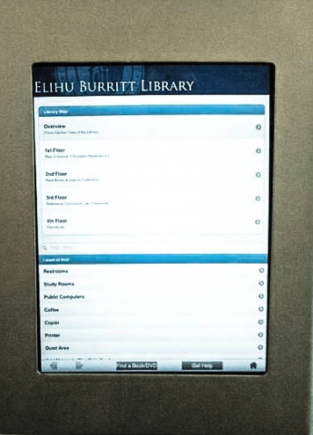
The wrath of the Kiosks
We decided to use iPads as way finder kiosks
Yes, I know it’s crooked.

Slide 9
Our existing mobile website

Slide 10
But, we hired someone smart
Could be optimized differently for iPad using the same source date.
Wayfinders inherently different.
So …

Slide 11
New wayfinder UI
Bigger buttons
Focus on Maps

Slide 12
Which led to

Slide 13
Currently working on
Map overlay issue
Works in iOS
Not in Android
Do we create another site?
How will this affect tracking?

Slide 14
It’s Okay
Downtime and new iterations part of the process.
If you don’t plan on bumps in the road you will be thrown off.

Slide 15
Going Forward
Keep iterating
Keep learning
Keep changing

Slide 16
Remember the rules
From Eric Raymond’s the Cathedral and the Bazar
Treating your users as co-developers is your least-hassle route to rapid code improvement and effective debugging.
Release early. Release often. And listen to your customers.
Given a large enough beta-tester and co-developer base, almost every problem will be characterized quickly and the fix obvious to someone. Or, less formally, ``Given enough eyeballs, all bugs are shallow”.
http://www.catb.org/~esr/writings/homesteading/cathedral-bazaar/

