Slide 1
Shifting Forward in Digital Publishing: EPUB 3
Nettie Lagace
Associate Director for Programs, NISO
nlagace@niso.org / @abugseye
NEASIS&T Spring Event: March 13, 2013

Slide 2
Industry organizations
global trade and standards organization dedicated to the development and promotion of electronic publishing and content consumption.
identifies, develops, maintains, and publishes technical standards to manage information in our changing and ever-more digital environment.
the leading book trade association for standardized best practices, research and education.

Slide 3
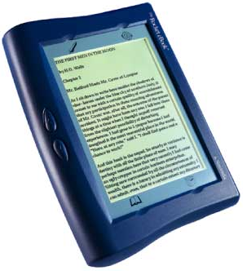
Early e-book packages
1960s and 70s: Experiments on mainframes
1980s: Actual products - CD-ROMs
1990s: The first wave of dedicated eReaders
1999: OEB (Open eBook standard)
2007: EPUB (+ non-EPUB Kindle)
2010: EPUB 2.0.1 (+ EPUB-based iBooks)
… need multimedia, scripting, great typography & layout, and much more…

Slide 4
EPUB 3 Basics
Based on Web standards (HTML 5)
Definitions for representing, packaging and encoding content for distribution in a single-format file
Interoperable between devices
Reflowable text
Intended to be used for wider range of content: magazines, educational materials (textbooks), scientific materials
Support for accessibility

Slide 5
EPUB 3 consists of
EPUB Publications 3.0: publication-level semantics and overarching conformance requirements for EPUB Publications.
EPUB Content Documents 3.0: profiles of XHTML, SVG and CSS for use in the context of EPUB Publications.
EPUB Open Container Format (OCF) 3.0: a file format and processing model for encapsulating a set of related resources into a single-file (ZIP) EPUB Container.
EPUB Media Overlays 3.0 [MediaOverlays30]: format and a processing model for synchronization of text and audio.

Slide 6
EPUB 3 consists of
Packaging: a single Package Document
Specifies constituents and their order; associates metadata and navigation
Reading order: key concept – resources to be consumed in some order
Navigation
Linking
Publication metadata options
Rendering: presentation should adapt to the user
Multimedia
Scripting
Text to speech

Slide 7
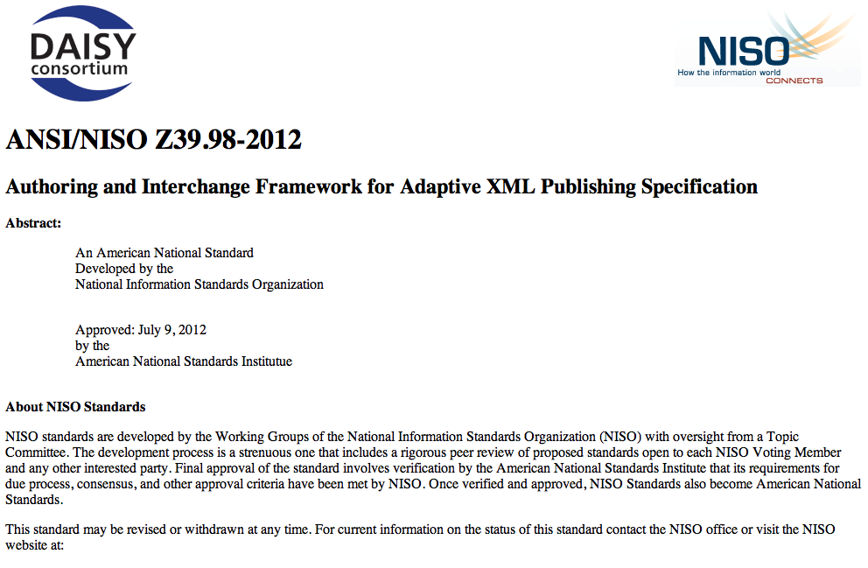
Accessibility
DAISY Consortium requirements for distribution met in EPUB 3
XHTML for processing and rendering
Audio & text synchronization
Integration of text-to-speech markup

Slide 8
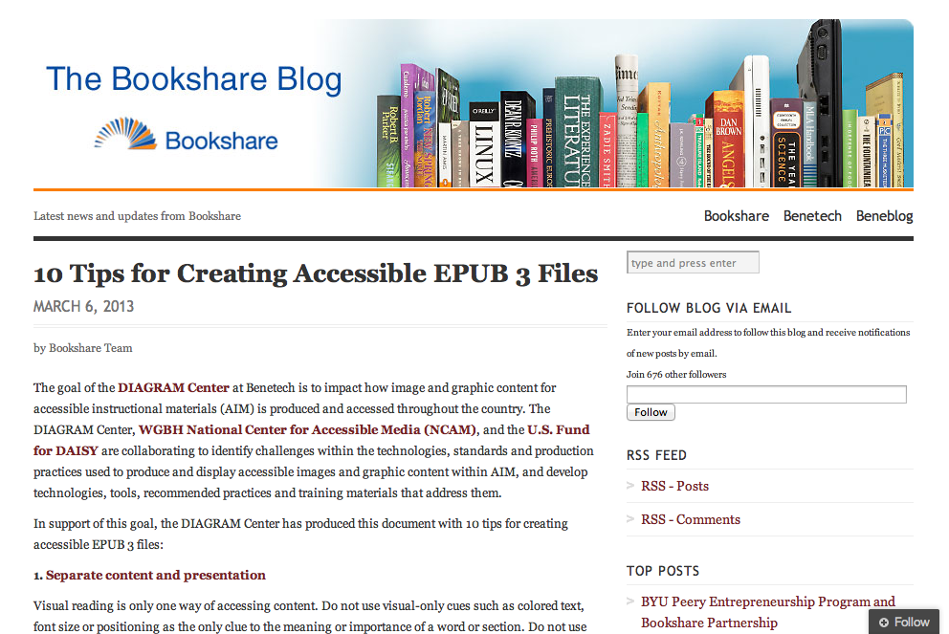
Accessibility
http://blog.bookshare.org/2013/03/06/10-tips-for-creating-accessible-epub-3-files/

Slide 9
BISG EPUB 3 Support Grid

Slide 10
IDPF EPUB 3 Samples

Slide 11
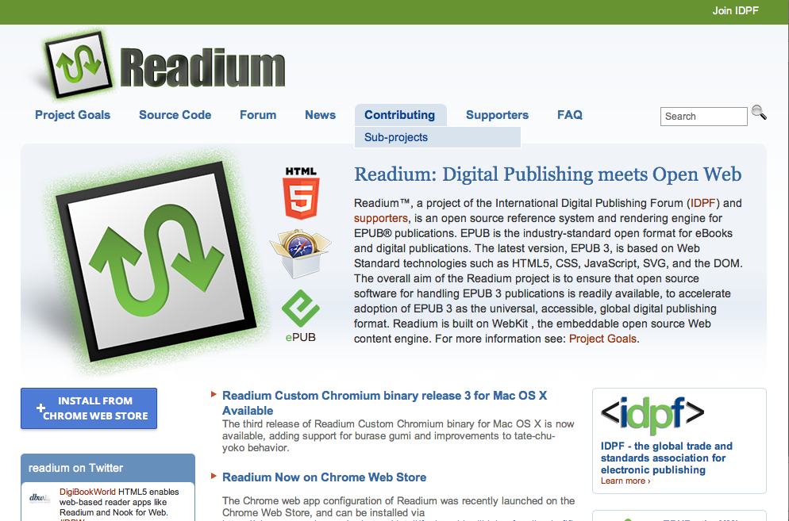
readium.org
Open source collaborative project
Has implemented all EPUB 3 features in Webkit
Can be installed as a Chrome app

Slide 12
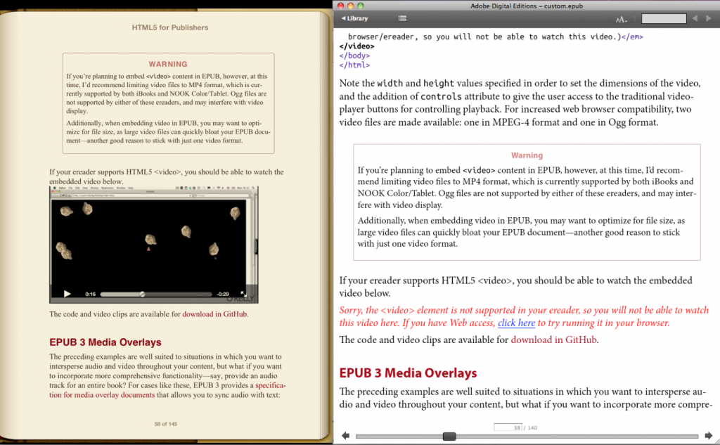
Backward-compatibility
http://toc.oreilly.com/2013/02/oreillys-journey-to-epub-3.html

Slide 13
EPUBs and ISBNs
Digital Books should not be assigned the same ISBN as any Physical Book.
Digital Books of the same title but different file format (i.e., EPUB, PDF, etc.) and/or different usage rights should not be assigned or display the same ISBN.
Assigning and/or displaying the same ISBN can confuse Consumers and/or result in the delivery of an incorrect product. / Assigning and/or displaying the same ISBN can affect the proper cataloging of the title by libraries and registration agencies.
Ideally, identical Digital Books (i.e. an EPUB being sold on various vendor sites) should not carry different ISBNs. There must be a differentiating factor (or factors) in the Digital Book’s content, file format, usage rights or metadata to justify the assignment of a unique ISBN.

Slide 14
designed to be modular and extensible
EPUB 3 Fixed Layout Metadata: specify fixed layout features/behavior
Advanced Adaptive Layout: template-based paginated layouts that adapt and reflow regions based on changes to the viewport, etc. (“liquid layout”)
Childrens’ books, cookbooks, etc.
EPUB 3.0.1 – bug fixes
John V Nicholls [CC-BY-SA-2.0 (http://creativecommons.org/licenses/by-sa/2.0)], via Wikimedia Commons

Slide 15
designed to be modular and extensible
Active working groups:
Dictionaries (dictionaries and glossaries)
Indexes (embedded or standalone)
Advanced hybrid layout (focus on graphics-heavy content like manga, comics)
ISO Standardization
John V Nicholls [CC-BY-SA-2.0 (http://creativecommons.org/licenses/by-sa/2.0)], via Wikimedia Commons

Slide 16
A few additional resources
http://www.digitalbookworld.com
Spring NISO events
April 10: NISO Webinar: Universal Accessibility: Creating E-Books Anyone Can Read (90 minutes)
April 17: NISO Virtual Conference: EPUB3 and the Future of Interoperable E-books: What Libraries Need to Know

Slide 17
Thank You!
nlagace@niso.org
@abugseye

