Slide 1
MIT Libraries & MIT Mobile
Remlee Green
UX Librarian, MIT
remlee@mit.edu
Twitter: @remlee
NEASIST program - April 23, 2012
Going Mobile: Library websites, services, and apps on mobile devices
Notes:
I’m a UX Librarian here at MIT. I’ve also been involved with NEASIST for a few years now. I do user studies and usability testing, and I serve on the User Interface group, where we do a lot of work on the website. I’m a little bit of a techie, but not a super techie, so I know only bits and pieces of how the mobile site works. Some of you may have met Darcy Duke who’s here today – she’s the webmaster for MIT Libraries, so if I miss something, I hope that she’ll jump in, too.

Slide 2
I’ll discuss…
Background of mobile at the MIT Libraries
Best practices that we followed
Lessons learned
Next steps
Notes:
Today, I’ll talk about the MIT Libraries presence on MIT Mobile. I’ll start with by telling you the background of the MIT Libraries mobile presence, best practices that we followed, lessons learned, and next steps

Slide 3
“When I’m on campus and need a book from a library, I almost always look up on-the-go on my phone which library the book is at. But the library website is pretty difficult to navigate on iPhone.”
Before MIT Mobile…
-MIT Postdoc
Notes:
First I’ll talk a little bit about the history of how the libraries became integrated with MIT Mobile. It was a bit of a winding road.
We’ve been interested in providing mobile services for a few years now. And we knew that a lot of MIT students and researchers were on mobile, especially on iOS devices.
In a user study we did last Fall, the topic of mobile came up several times in interviews. Since these students are often on the run, they found their mobile devices handy for txting, email, checking the calendar, browsing the web, and taking notes. They used their smart phones for searching and, in one case, brief research, but only when they needed to, since it’s “not as easy” to do heavy research as with a laptop. One user wrote, "I don’t get to sit down on my computer so I rely heavily on my iPhone: everything from checking email to finding out where the meeting of my group is to the schedule of the on-campus shuttle (I use the MIT iPhone application for that). When I’m on campus and need a book from a library, I almost always look up on-the-go on my phone which library the book is at. But the library website is pretty difficult to navigate on iPhone."

Slide 4
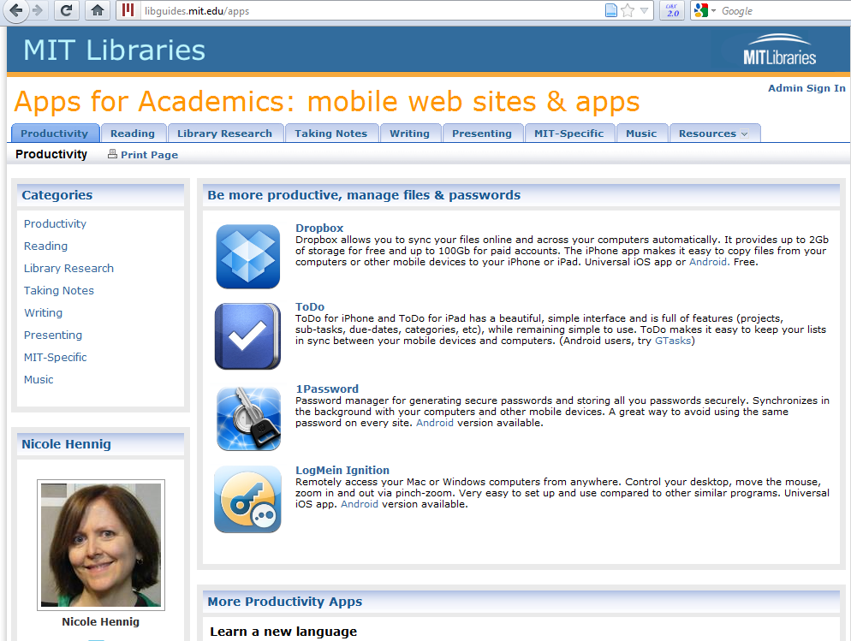
Notes:
We’re lucky to have a UX department head who is extremely passionate about mobile technology, and we had been dabbling in providing our users help with mobile technology by teaching a class called “Apps for Academics.” Originally, we just listed apps for Apple devices, but we’ve since expanded it to include Android devices.
About 2 years ago, the head of UX and I started to look into ways we could create a mobile site or mobile app to provide mobile services. We weren’t quite sure which we wanted: mobile site vs. mobile app. I was leaning toward a mobile site, since anyone with a mobile device could use a mobile site, while apps were limited by device. But there weren’t a lot of great, simple, well-designed options for people like us, who had a decent idea of how to make web sites, but no knowledge of how to code for mobile development.

Slide 5
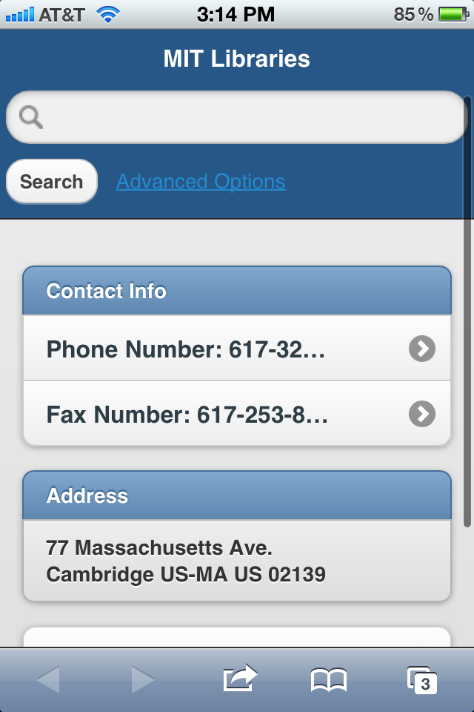
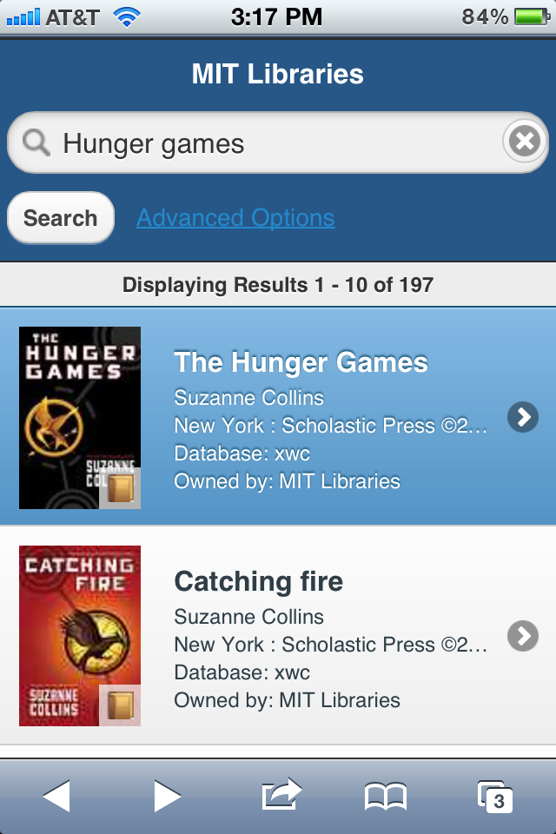
WorldCat Mobile
Notes:
We looked into a variety of services that could help us make mobile apps or sites, but none of them were a great fit. We pursued one promising looking product when OCLC asked us if we’d be interested in being part of a pilot for a free trial through a company called “Boopsie,” since we were using their WorldCat Local interface. But in the middle of the Boopsie trial, we abandoned it, since the design was inelegant.
Thankfully, OCLC has been working on improving their mobile version of WorldCat for a few years, so we had pointed users to the mobile version of MIT’s WorldCat for searching our collections on mobile devices. Searching our web catalog on a mobile device is a miserable experience, since our web pages aren’t optimized for mobile.
We had done some usability testing with our users on MIT’s WorldCat Mobile, so we had the chance to give OCLC our users’ feedback, which OCLC used to improve the interface.

Slide 6
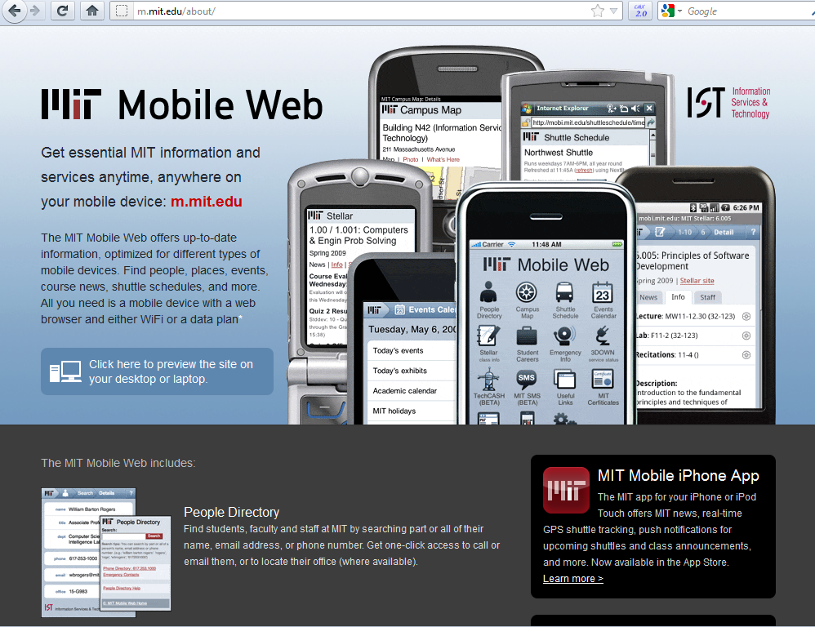
Notes:
Around the same time, we were introduced to the head of the MIT Mobile Team, and decided to included in that project.
MIT is fortunate to have a wonderful team of programmers and designers who create MIT Mobile. There’s an MIT Mobile site, as well as apps for iPhone and Android.
The most popular sections of MIT Mobile, are the Campus Map, Calendar, and shuttle bus schedule. There is no iPad app, since the Mobile Team believes that it makes sense for people to just use the full version of the web on an iPad, since it has a large screen size.
Originally, we thought we’d want to have a standalone mobile site for the MIT Libraries, so that we had control over it, but MIT Mobile presented a great opportunity for us. The majority of the campus population who owned smartphones already used MIT Mobile, so we already had our audience captive. We also knew exactly what we were getting with the design, since it was already a functional mobile presence. It was really well designed, and it was easy to see how we could fit into it.

Slide 7
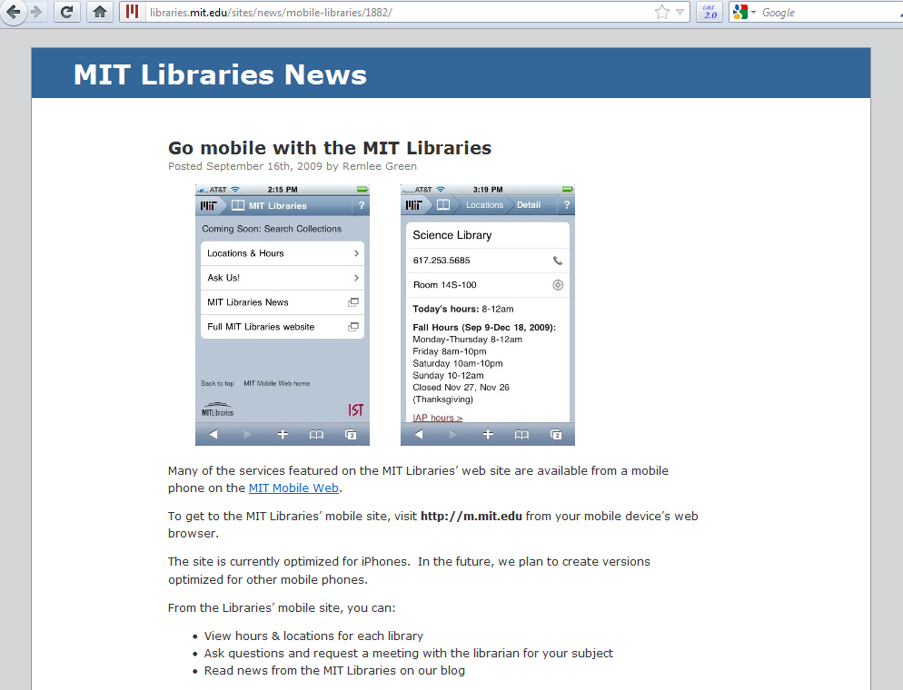
Notes:
We started by offering a few small services on the MIT Mobile web site in September 2009, including Locations & hours, an Ask Us web form, a link to our news blog, and a link to our full web site. Our mobile presence back then was so small that the Libraries icon had a “beta” by it.
Over the last year, we worked with the MIT Mobile team to expand the library’s presence in the MIT Mobile site. Last fall, we were able to increase our presence on the MIT Mobile site by adding an embedded search of MIT’s WorldCat, as well as a way for users to authenticate and log into their library accounts to request and renew books. And a few months ago, the MIT Mobile team released a new version of the iPhone and Android apps, with the same library services added.

Slide 8
MIT Mobile Web stats
80,000 monthly views:
20% Campus Map
20% Calendar
15% Shuttle Schedule
10% MIT News
10% Stellar
5% People Directory
2% Libraries (1-2K a month)
1% 3DOWN
1% How to download native apps
Notes:
The mobile website on m.mit.edu gets around 80k page views a month, with these top ten most popular areas. This is just for the mobile web site; not the apps.
Libraries gets 1 – 2,000 page views a month, with about half of those being requests for hours and locations. And WorldCat searches are not included in that, as those web search go directly to mit.worldcat.org. Loans in Your Account are visited about 60 times per month.

Slide 9
MIT Mobile App stats
40,000 active monthly users:
90% iOS
10% Android
But…
That includes non-MIT users.
Notes:
We have over 40k active users of MIT's native mobile applications. That's 4x our total enrollment of about 10k students. So while our targeted audience is MIT students, we end up reaching a lot of prospective students, alumni, and other people interested in MIT as well. 90% of those users are on iOS devices like the iPhone and iPad. The other 10% is on Android devices. It's hard to tell from our logs which users are at MIT, so we can't say what the iOS/Android breakdown is like for just the MIT community.

Slide 10
Apps vs. web site
Notes:
Over the last two years we've noticed a trend of users preferring the native apps over the mobile website. Web traffic on m.mit.edu has slowly declined while native app use has grown. So there's a benefit to being a part of the overall MIT Mobile setup in itself. Users have a preference for native apps over mobile websites when it comes to frequent tasks. Libraries can take advantage of the native apps' existing user base and outsource development and maintenance costs to MIT’s IT department.
For Libraries content, there's about a 20:1 preference by traffic for native apps.

Slide 11
Apps vs. web site
Notes:
Users check their loans about 60 times per month on the mobile website but close to 1200 times per month in the native apps. And in the last two months we haven't seen any attempts to renew loans on the mobile web, whereas we get around 18 per week through the native apps.

Slide 12
How to choose?
What services would our users want on the run?
Of those, what would work well on mobile devices?
Can we make them look good on mobile devices?
Notes:
So now I’ll talk about why we’ve made the choices we have. We’ve carefully selected what we’ve put into the mobile site.
We’ve carefully selected what we’ve put into the mobile site. We knew we wanted:
Services that the MIT community would want to use on the run
-We didn’t want to just dump all of our services that were on the full site into a mobile interface. Talking to our users led us to believe that they didn’t want to do heavy research on their devices.
-Instead of thinking about what services we already had that we could add to mobile, we started by thinking about what people would want to do on the go. What would people want to do while they waited for the T? What if I were eating lunch or walking around on campus?
-We asked ourselves what we would want to do on the go from our phones. For example, we’d want to find the call number of a book, and when the library closed. We wanted the site to be very simple and useful.
Services that looked good and worked well on mobile.
There are many things we could have just thrown in because they’re on our full web site, but if they aren’t optimized for mobile, people will have a bad experience the first time they use it, and they won’t come back to use the mobile site

Slide 13
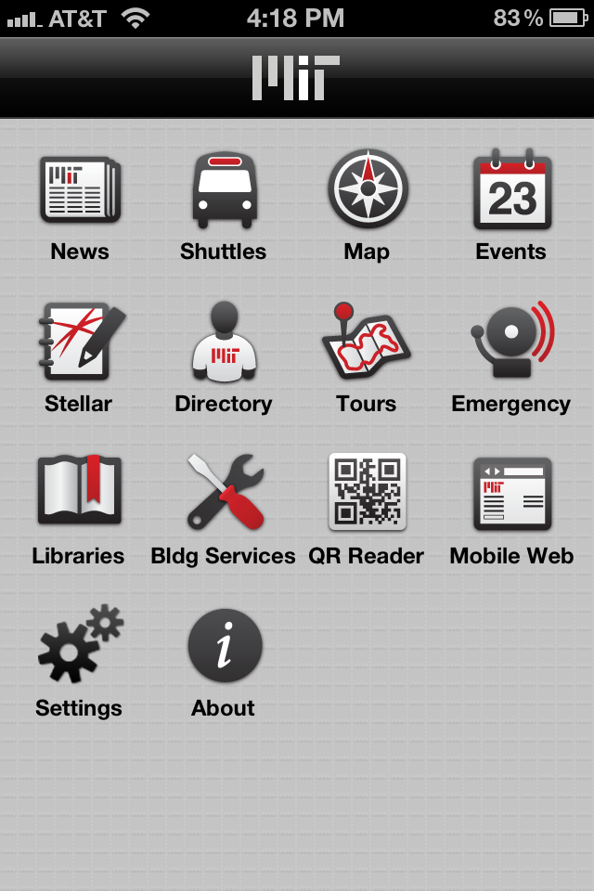
Notes:
Now I’ll do a walkthrough of the library section of the MIT Mobile app for iPhone. I won’t show you the Android app or mobile site, because they have the same functionality and a similar look.

Slide 14
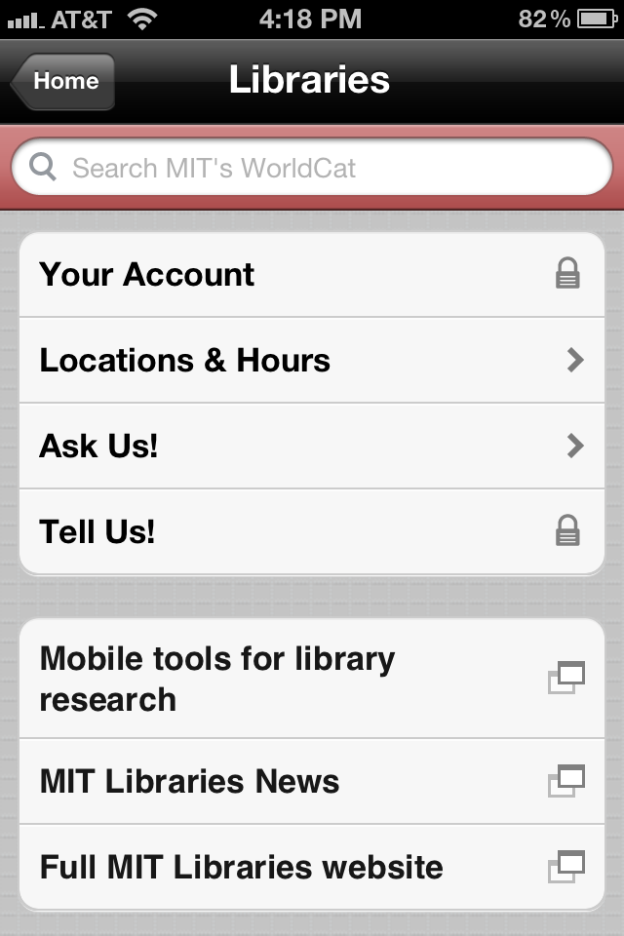

Slide 15
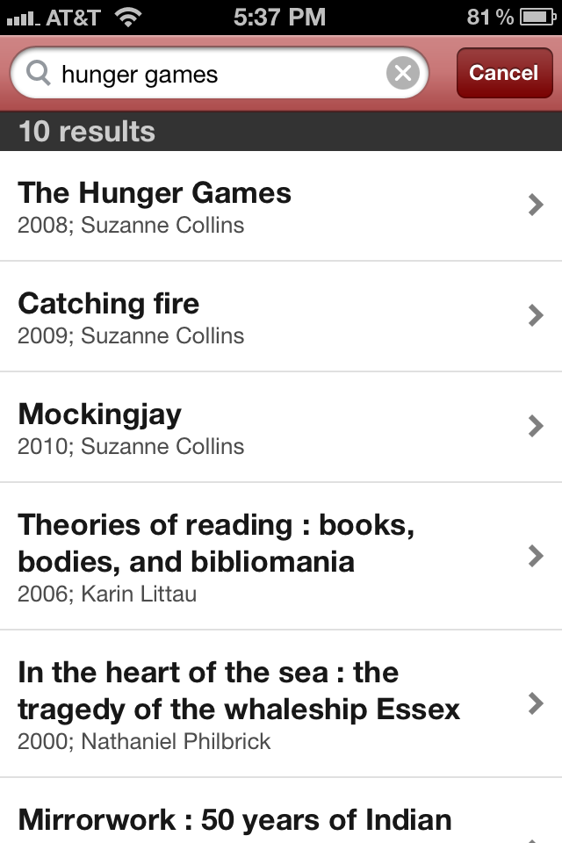

Slide 16
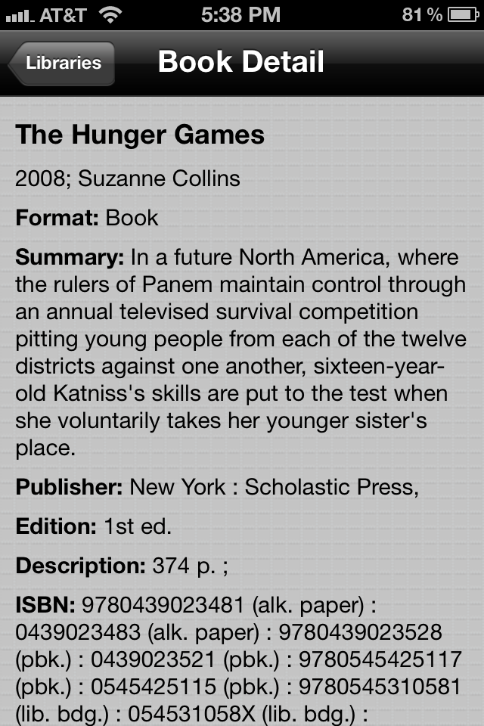

Slide 17
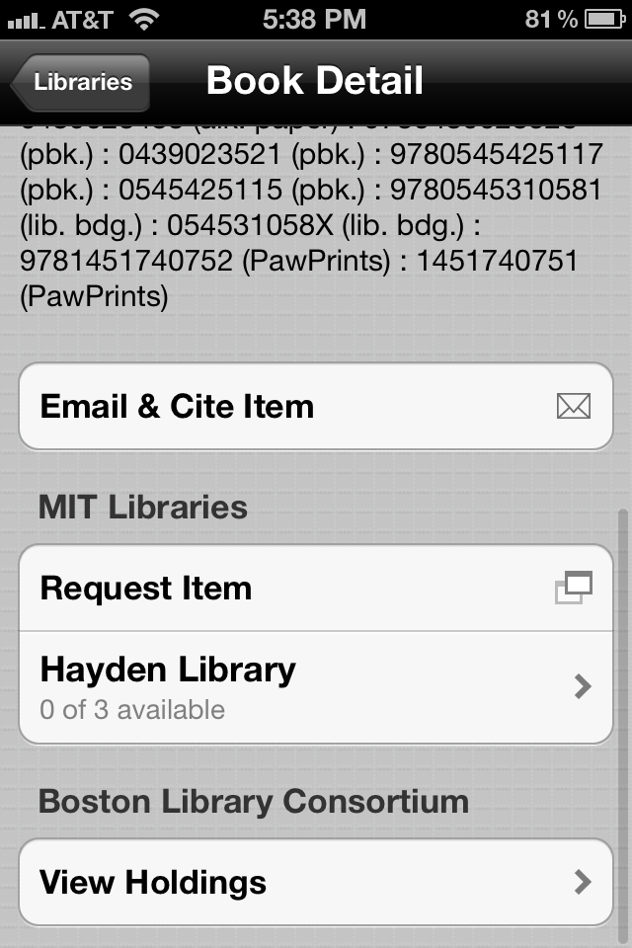

Slide 18
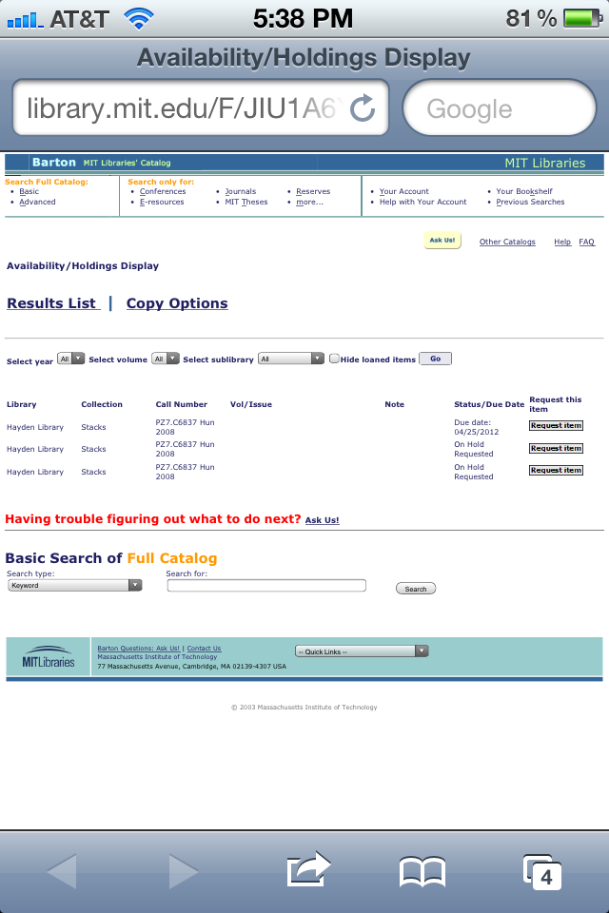

Slide 20
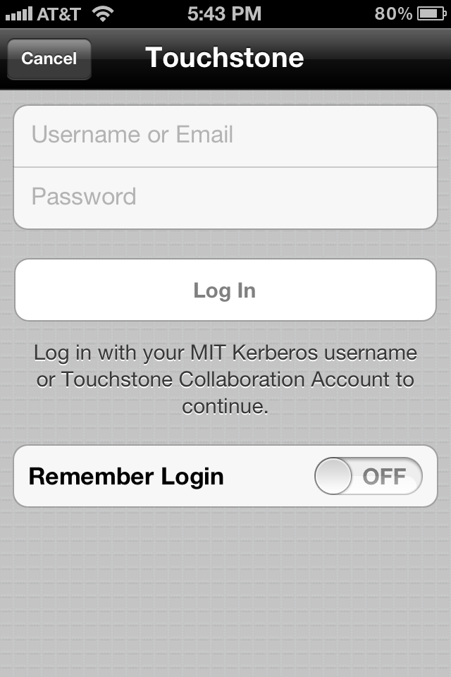

Slide 21
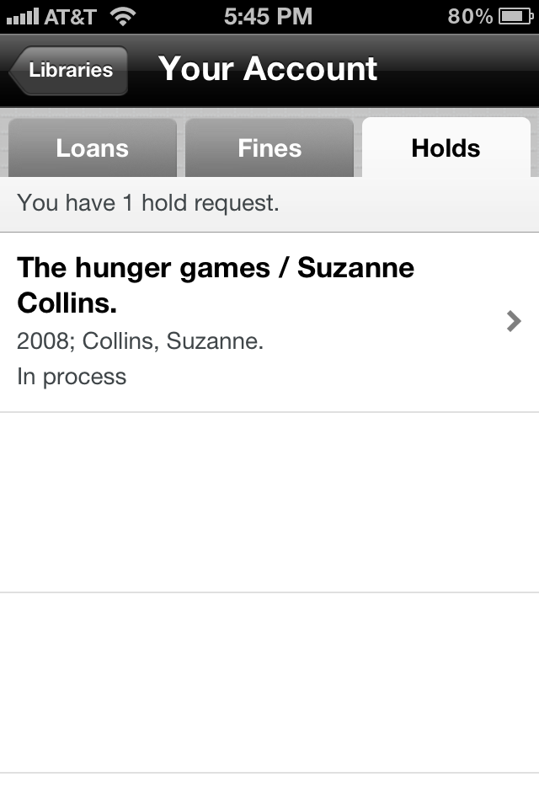

Slide 23
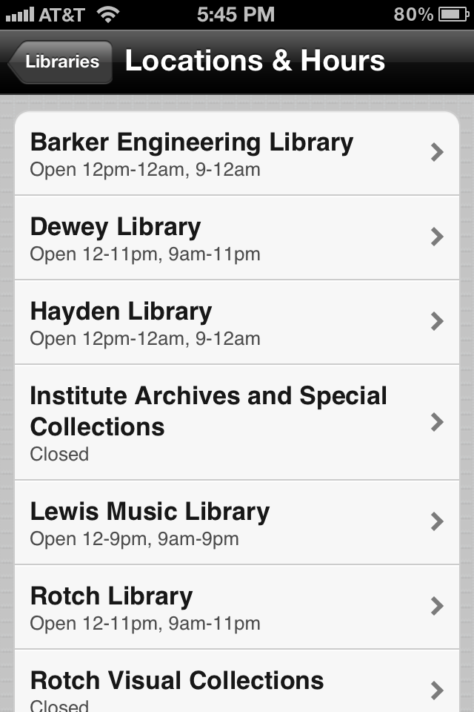
Notes:
Currently works through Google Calendar feeds for each library

Slide 24
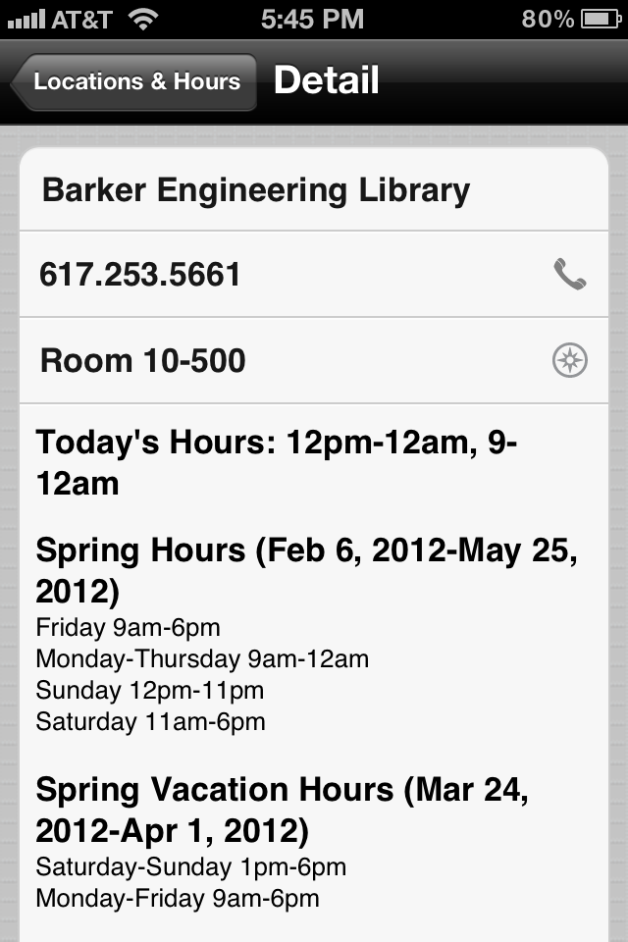

Slide 25
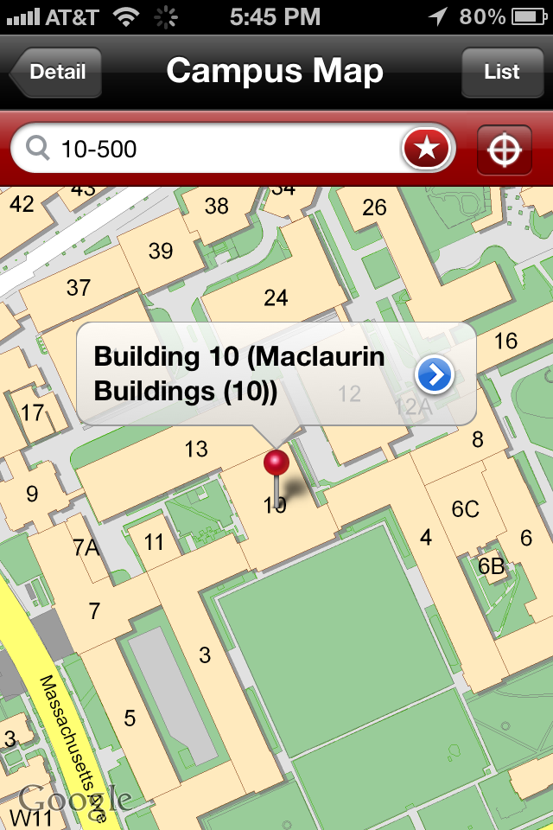

Slide 27
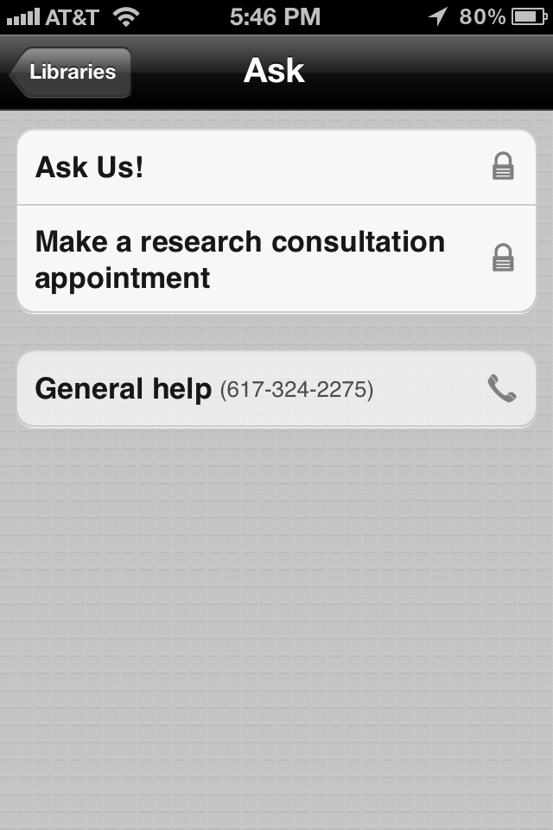

Slide 28
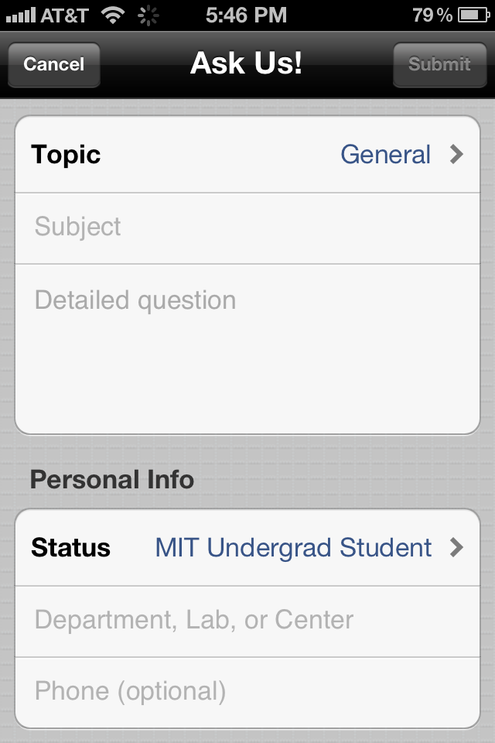

Slide 30
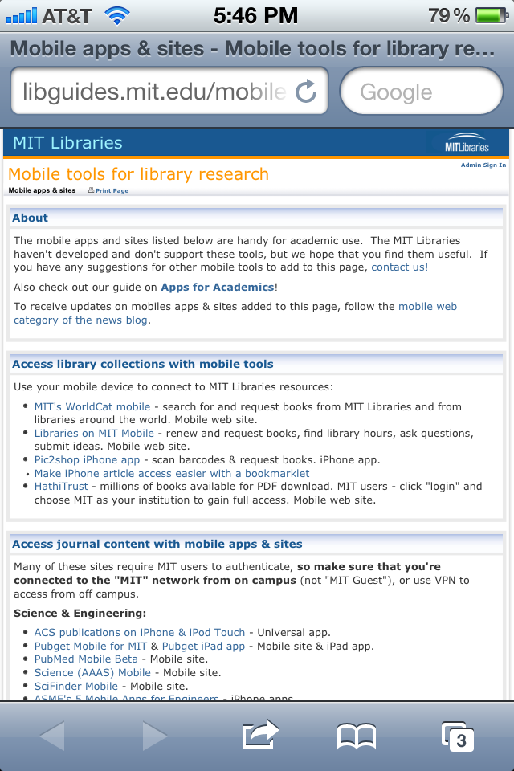
Notes:
Mobile Tools for Research link: Since they’re already on mobile devices, it’s the perfect audience to market tools for mobile. This page is a very simple LibGuide page, so I update the content there. (Side note: originally, we had a few more ideas for using LibGuides with mobile, but LibGuides has really awful mobile implementation, so we turned mobile redirects in LibGuides off)

Slide 32
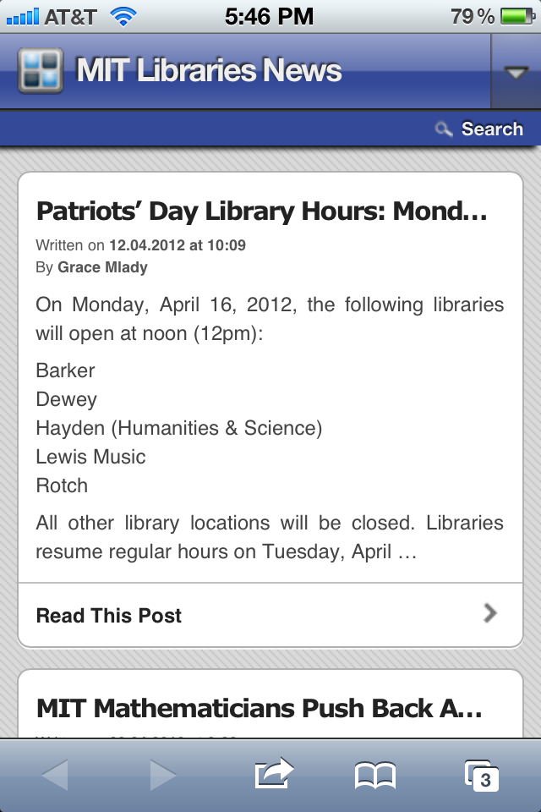

Slide 34
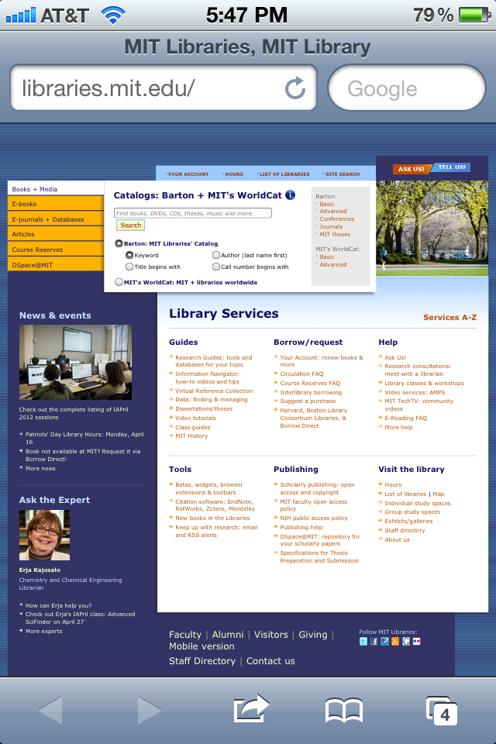

Slide 35
What’s working well?
from http://www.myfacewhen.com/217/
Notes:
What’s working well:
--People are bringing their phones to the desk to ask for items, so we know that they’re using the mobile WorldCat search.
--Being embedded in MIT Mobile. Would have been a lot more difficult to market our mobile site and have so many people downloading a library specific app.

Slide 36
What’s not working?
from http://www.animalsden.com/cat-with-bunny-hat/
Notes:
What’s not working well:
--I’ve heard comments that people aren’t seeing the search box. May need to do usability testing on that, or adapt that screen
--We don’t have automatic redirects to our mobile site from our full site, so if a user goes to libraries.mit.edu on their mobile site, they’re stuck with a bad browsing experience. They’d have to know to get to the library services through MIT Mobile.
--The way that the hours screen is being populated isn’t working as well as we’d hoped, so the MIT Mobile team is creating a new interface for us to add hours. We’ll also be able to embed the hours (through iCal exports??) on our full website, so some day, we may be able to just add the hours in one place.
--The mobile site & apps are entirely edited and controlled by the MIT Mobile Team, so when we want to make a change, we’re at their mercy. They’re phenomenal, but we’re used to having complete control over our full web site, so it’s been hard for us to have to rely on someone else. At the same time, this means that they do the development work for us.

Slide 37
Next steps
Make catalog pages mobile friendly
Make search box more obvious
Add more services
Make regular site more mobile friendly
Notes:
Future:
Make Barton pages mobile friendly
Make search box more obvious
Add services that would be useful (would love to add an ability to reserve study rooms on mobile & maps of stacks)
Make more of our website more mobile friendly. Would LOVE to implement responsive design

Slide 38
Contact
Remlee Green
UX Librarian, MIT
remlee@mit.edu
Twitter: @remlee

