Slide 1
An Introduction to User Experience (UX) Fundamentals
Christopher S. LaRoche
NEASIST
User Experience & You: UX Design & Research
January 6, 2016

Slide 2
Overview
I – Welcome and Introduction
II – What is User Experience (UX)?
III – Methods
IV – Context and “It Depends....“
V – Design – Where does design fit?
VI – Future
VII – Bibliography
VIII - Contact Information

Slide 3
II. Welcome and Introduction
Notes:
Practicioner by Day and worked in the tech field for 20 years – 8 as a full time UX person, formerly a part time UX person and tech writer
Lecturer at night on the topic of UX and related subjects
Unique take on the industry and how to train folks in the field

Slide 4
II. What is User Experience (UX)?

Slide 5
Alphabet Soup of User Experience (UX)
http://www.manyeyes.com/software/analytics/manyeyes/visualizations/new/tag-cloud/the-alphabet-soup-of-user-experien-2/1
Notes:
This is a non complete list and continues to expand
User Experience (UX) is a very fluid term – and actually does encompass all those terms
User Experience and UX is an umbrella term
Usability used to be the umbrella term – now it has become User Experience and is evolving as the most understandable and used term within the field and across many industries
Also the term user experience and UX speaks to a business/business type vocabulary (more than usability)
UPA > UXPA several years ago – more recognizable term.

Slide 6
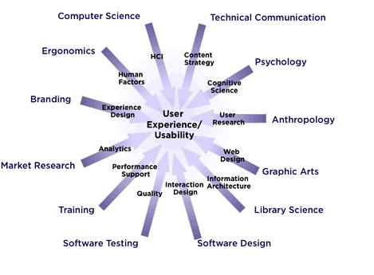
II. What is User Experience (UX)?
http://upassoc.org/usability_resources/about_usability/images/vectors.gif
Notes:
From UPA and Whitney Quesenberry – great high level over view of what encompasses UX and Usability
Further shows how and in what way the UX field is both an umbrella term and incredibly interdisciplinary
Show the expansion and overall interdisciplinary nature of the UX field

Slide 7
Defining this Alphabet Soup!
Most UX professionals use these terms interchangeable – and usability and user experience (UX) often mean the same things
Often these terms have distinct and different definitions between UX professionals
Many people are adding UX to their resume without an solid understanding of the profession as well and understanding the development of one‘s UX skill set is critical

Slide 8
What is User Experience (UX)?
Usability and user experience (UX) are concepts that have been around for generations and evolved from traditional human factors. Over the last few decades, it has become standardized and greatly expanded
World War II – instrumentation, personnel selection, and training
Software and computer hardware industry
Web explosion
Consumer devices
Medical devices
Notes:
Concept is as old as man – a wheel used to move something or someone more efficiently and more quickly from point A to point B
Original rotary dial phone – used in most homes post WWII
Development of the TV remote and its uses – both form and function – was an early example of a user experience in the modern era

Slide 9
What is User Experience (UX)?
Human Factors comes from the field of psychology and focuses on understanding basic biological/human traits and mapping to user’s needs
The fast growth of information technology and the Internet have made UX a critical aspect of product and service design
Notes:
***Usability is on its most basic level trying to understand how users can perform a task in the most efficient and stress-free manner possible for the user***
Brain is efficient and always tries to maximize efficiency as well as minimize use.
Humans are also pattern seekers, so the brain will often “fill in” information when it can; for example, we can often read a word or sentence with portions missing and still understand the word or sentence.
Humans are also change detectors. Humans are rarely satisfied, so we are trying to improve.

Slide 10
What is User Experience (UX)?
As the field of usability matured, it evolved into the field of user experience (UX), which focuses on the full end-to-end experience for a user, not just the user’s interaction with the user interface

Slide 11
User-Centered Design (UCD)
An outgrowth of human factors and early usability work was User-Centered Design (UCD)
Overall, UCD is a framework & method to create products that correctly match a user’s needs and expectations.
Products created produced using UCD principles are more likely to be be successful since user’s needs are considered and (likely) incorporated from the initial planning stages
Notes:
UCD and other frame works increase the odds – but DO NOT GUARANTEE GREAT PRODUGT

Slide 12
User-Centered Design (UCD) - Philosophy
“Know thy user, know thy user, know thy user”
“The key to making things understandable is to understand what it’s like not to understand” (Richard Saul Wurman)
Notes:
Coined the phrase Information Architecture in the 1970s & Founder of the TED talks
Empathy for users is a key component of solid UCD and UX.
EXAMPLE:
Public transportation systems and their cards to access (Boston, DC, London)
Using your TV remote

Slide 13
User-Centered Design (UCD) - Benefits
Ease of learning and relearning (learnability)
Ease of use (efficiency)
Consistency within and between products
First impressions
Error prevention and recovery
Memorability
Satisfaction or likeability
Flexibility and discoverability
Improved collaboration for groups of users

Slide 14
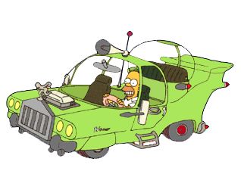
What User-Centered Design (UCD) is NOT
http://simpsons.wikia.com/index.php?title=The_Homer&image=TheHomer-png
Users are not designers and designers are not users!
It is more than common sense!
Notes:
Second season
Homer’s Long Lost Borther finds him and decides “Homer” is the ‘average guy’ so asks him to design a car since he would be represenative of a ‘average user’
Homer busted the budget and the car was super expensive, but the details included:
1 bubble domes – includeing one separate space for the kids to be seperated
Loud Engine
3 horns (La Cucharacha)
Huge Cupholders
Car was a huge bust and bankrupted the company.
This is a popular example of why not to exactly design what the user or one group o users dictate
When is good – good enough….

Slide 15
User Experience (UX) – Clarity?
User Experience (UX) is an open-ended term and profession that continues to grow and expand
User Experience includes three distinct groupings:
RESEARCH – DESIGN - EVALUATION

Slide 16
III. Methods

Slide 17
User Experience (UX) Methods
Within the overall field of User Experience (UX), there are a variety of methods used to obtain information from users
When the profession was emerging in the 1970s and 1980s, the main method was usability testing. Usability testing proved quite successful as a way to understand the user’s perspective on a product – and make our profession visible
The variety of methods expanded as the field evolved from ‘just’ usability testing to looking at the full user experience

Slide 18
UX Methods – By Grouping
Research – Understanding what the users need and their goals and behavior
Design – creating and designing the interface or experience the user expects or needs
Evaluation – once the interface or product is in a working state, users can test and evaluate if the interface or product maps to user’s mental model and needs
Notes:
Design (unlike the others) is a very iterative process and can go through many rounds of expansion/contraction before it is a solution
EXAMPLE – previous job lead a group and we were designing a first experience – and went through 17/18 solid iterations before the final.
Seemed ‘simple’ at the end – but only that could happen after going through the process a multitude of times

Slide 19
Methods – By Grouping
Here are a sampling of the most common methods used in the field today (divided into the grouping mentioned earlier)
Notes:
Usability Testing was the main one – and that is now one of many methods
Usability Testing – formative – earlier in process to understand users needs and expectations
Usability Testing - summative – later in process to understand perfomance and satisfaction
Note in Evaluation – satisfaction surveys

Slide 20
Methods – By Grouping
This listing on the previous slide is only a small sampling of the most common methods
There are many other methods available and used and due to the interdisciplinary nature of the field, we keep expanding the number of methods our field uses

Slide 21
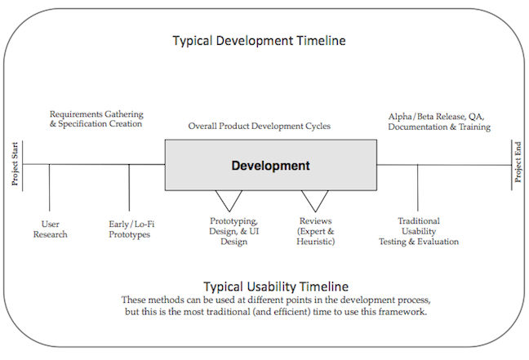
Methods – Timeline of Use
Notes:
Waterfall method
This is optimal an only some methods are used in a ‘real world’ or project – unless the organization is fully UCD
Most methods are flexible enough to be used within any time in the product lifecycle, though this is the optimal time.
TALK ABOUT AGILE

Slide 22
IV. Context and “It Depends“

Slide 23
Context within User Experience (UX)
Part of the overall issue with understanding usability and the user experience is the impact of the context of use of the product or service
This is critical – and needs to be understood when working with a product
This also makes ‘standardizing’ usability & user experience VERY DIFFICULT
Notes:
If a product is not usable but first to market – you put it out to gain market share and improve
If there is little differentiations in products, having a solid user experience is critical.
Do the users have extensive background and knowledge of an older system and have to learn a new system
Is there a particular amount of data they must know before using the site
Consumer products and documentation
Concept is as old as man – a wheel used to move something or someone more efficiently and more quickly from point A to point B

Slide 24
International Organization for Standardization (ISO) – Usability
"[Usability refers to] the extent to which a product can be used by specified users to achieve specified goals with effectiveness, efficiency and satisfaction in a specified context of use." - ISO 9241-11
Notes:
There are newer ISO Standards that mention usability, but this is the most usability centric one around

Slide 25
“It Depends...“
The term ‘it depends’ is often used when asked if a product is ‘usable’ or a ‘good user experience’
Again, all experiences are contextual, so often the same product can be ‘usable’ for one person and ‘not usable’ for another. This is one of the more difficult aspects of user experience is to understand
User research helps determine what aspects of context are most important for a good user experience
Notes:
Mention Research contradictions
Steve Jobs – user research good for something if no one knows it exists or does not envision it?
TESTING AFTER RELEASE USER RESEARCH ANYTIME
Concept is as old as man – a wheel used to move something or someone more efficiently and more quickly from point A to point B

Slide 26
V. Design – Where does Design fit?

Slide 27
User Experience (UX) and Design
As the field has matured and gained acceptance within organizations, the importance of design has also become crucial to the user experience profession
As the user experience field has evolved, design’s influence expanded as important to the user experience. Now design is rightly seen as a critical component of the user experience field

Slide 28
User Experience (UX) and Design
Using the three main groupings of research, design, and evaluation allows the user experience professional involvement with the product development through the entire product or service life cycle
This is a recent development and a testimony to the importance & growth of the field, as only a decade or two ago, the best we could hope was a part in product evaluation (mostly usability testing)

Slide 29
User Experience (UX) and Design
The idea of ‘Design Patterns’ has emerged within the user experience field.
Design Patterns are online style guides and/or sets of widgets and interaction patterns/standards to use in particular interactions (sometimes coded parts too)
Notes:
British government reference http:/webarchive.nationalarchives.gov.uk/20100428141142/usability.coi.gov.uk

Slide 30
Usability Body of Knowledge (BOK)
http://www.usabilitybok.org/
The Usability Body of Knowledge (BOK) is resource and repository for information about UX methods and design Content is updated and changed over time and is a tremendous way to review resources about UX methods and design information

Slide 31
VI. Future

Slide 32
So, How Bright‘s the Future?
VERY BRIGHT!
The user experience is now an important concept in many products. Products need to deliver more than just a ‘good interface’
With the increasing visibility and importance of user experience, the idea of being strategic and the emergence of ‘UX strategy’ is continuing
Notes:
Process/Workflow vs. user interface

Slide 33
So, How Bright‘s the Future?
User Experience is now expanding into industries that traditionally were not viewed as concerned with ‘usability’ – and that shows how much this field has evolved
As design becomes more a part of the overall user experience, our field itself becomes bigger and more valuable
The future for our field and job prospects are quite solid and bright – for the near future
Notes:
Cadillac ad as the ‘Customer Experience’ TV ad….
Design has helped further make UX bigger and burst much more!

Slide 34
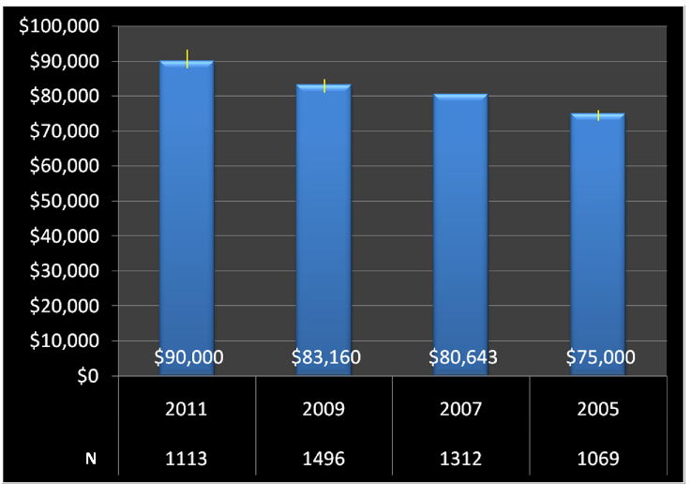
Median Salary, by Year (UXPA Salary Survey)
Notes:
https://uxpa.org/system/files/members-only/2011_Salary_Survey_FULL.pdf

Slide 35
Most Recent Salary Survey (2014 UXPA Salary Survey)
2014 UXPA Salary Survey https://uxpa.org/system/files/public/UXPASalarySurvey2014_Final.pdf
Jeff Sauro’s Analysis of the 2014 UXPA Salary Survey http://www.measuringu.com/blog/salary-survey2014.php
Notes:
https://uxpa.org/system/files/members-only/2011_Salary_Survey_FULL.pdf

Slide 36
VII. Bibliography

Slide 37
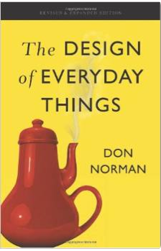
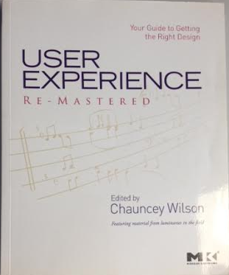
Good UX Books
Design of Everyday Things User Experience Remastered Revised & Expanded Edition Chauncey Wilson Donald Norman

Slide 38
Good UX Web Sites
User Experience Magazine (A UXPA publication) http://uxpamagazine.org/
Boxes and Arrows http://boxesandarrows.com/
UX Matters http://www.uxmatters.com/
Journal of Usability Studies [JUS] (A UXPA publication) http://uxpajournal.org/

Slide 39
VIII. Contact Information

Slide 40
Let‘s have a conversation about this topic! Questions?
Thank you for your time!
c.laroche@neu.edu
@silvaire

Slide 41
Chris LaRoche
Biography
Presenter
Chris has worked as a technical writer, information designer, user researcher, and usability consultant in the technology field for over eighteen years. He has worked most frequently as a ‘UX generalist’ with a severe interest in user research. He is also a lecturer at the College of Professional Studies (CPS) at Northeastern University, where he has taught for over a dozen years. He teaches graduate courses in usability and user experience, content strategy, user research, and prototyping. He also teaches undergraduate survey courses in modern Irish history. UXPA geek too!
Email: c.laroche@neu.edu
Twitter: @silvaire

