Slide 1
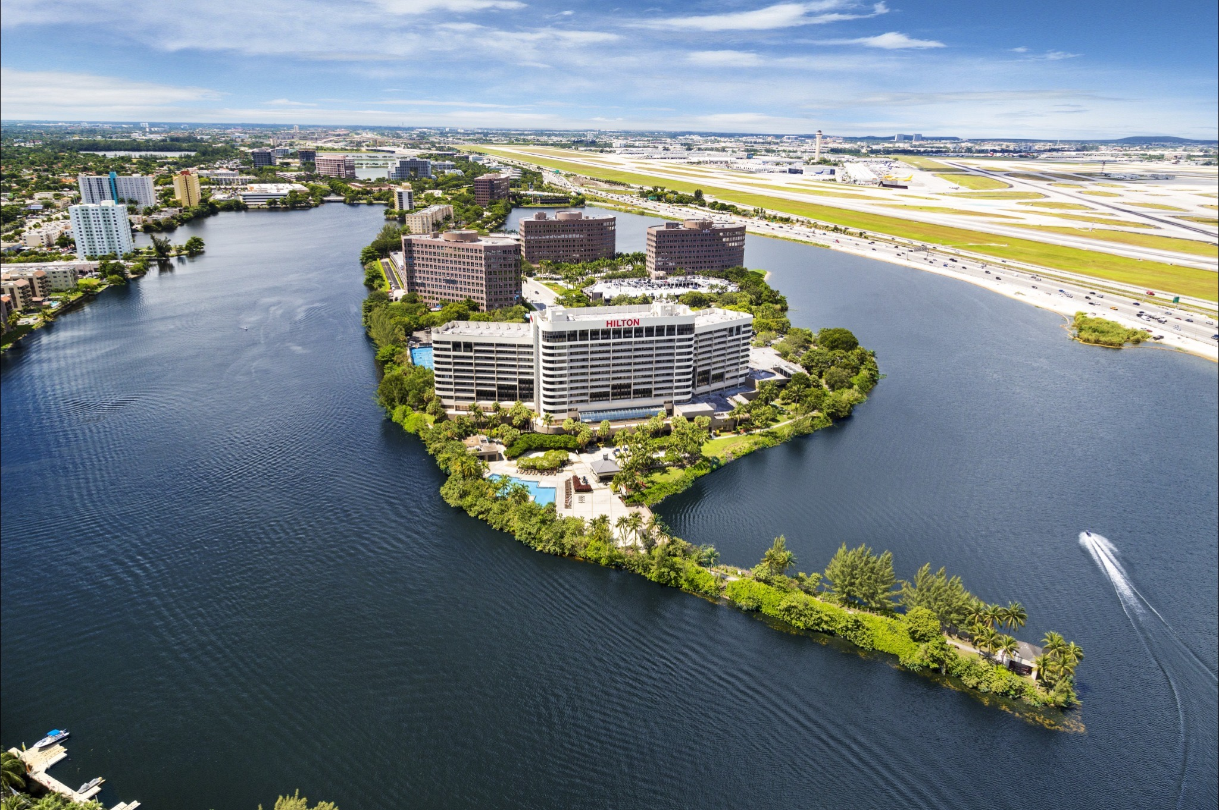
EXPLORE
MIAMI
Hilton Miami Airport
Blue Lagoon
“Miami’s Airport Resort ”

Slide 2
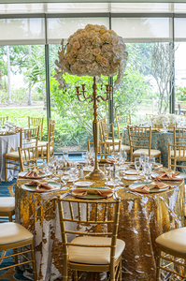
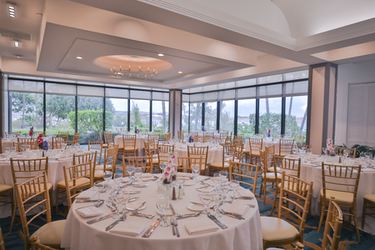
Fresh Look
Hilton Miami Airport Blue Lagoon
Newly renovated 5k sq. ft Cove Ballroom
Floor to ceiling windows overlooking Blue Lagoon and our tropical grounds
Attractive space for social functions or fundraisers

Slide 3
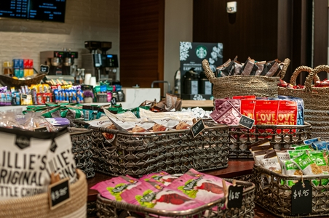
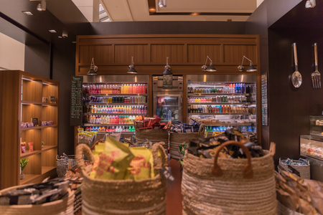
Cool Bites
Herb N‘ Kitchen
Freshly made sandwiches and salads
Freshly baked pizza and pastries
Starbucks Coffee
Snacks, wine and beer , soft drinks
Open 5 a.m. – 11 p.m.

Slide 4
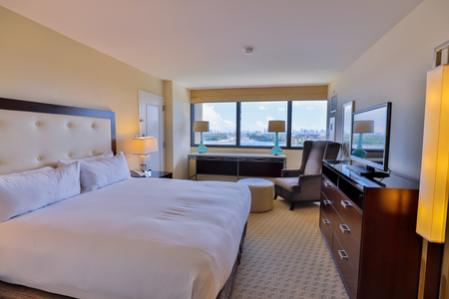
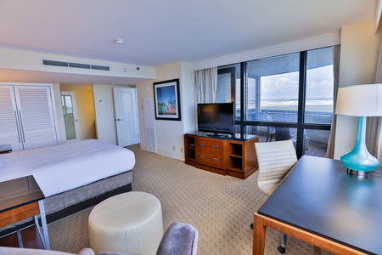
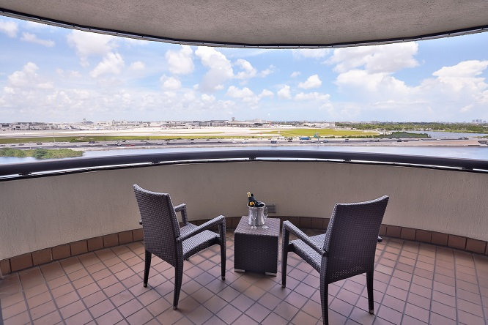
Guestrooms
Hilton Miami Airport Blue Lagoon
Minutes away from Miami International Airport.
508 rooms, including 83 suites with water views, balconies and Miami Skyline views
Located on a Private Peninsula.
Short drive away from Wynwood, Downtown, Little Havana, Coral Gables or Dolphin Mall.

Slide 5
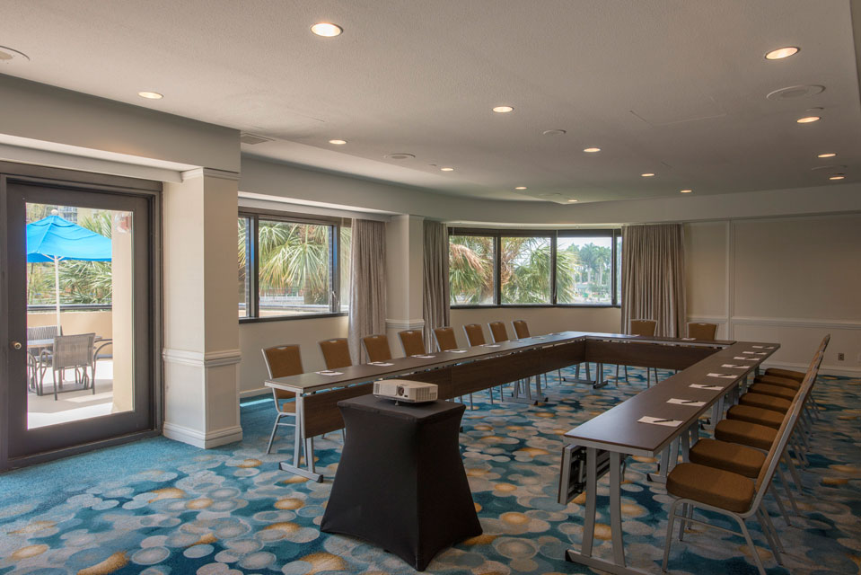
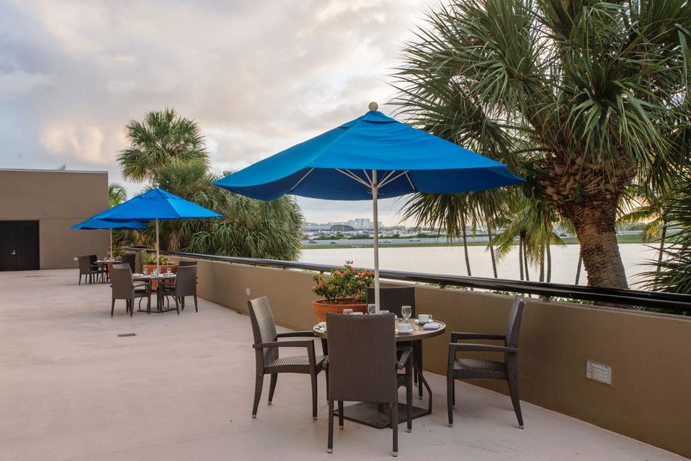
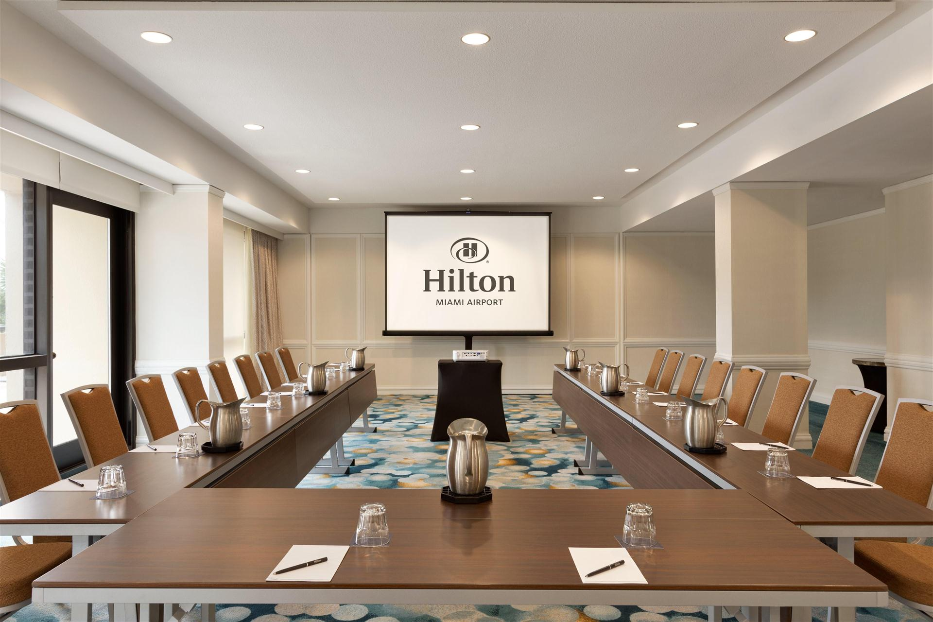
Meeting Spaces
Hilton Miami Airport Blue Lagoon
Over 30,000 sq. ft. of versatile event space
9,700 Sqft. International Ballroom
16 airy meeting rooms, each with individual lighting and temperature controls and many with natural daylight.

Slide 6
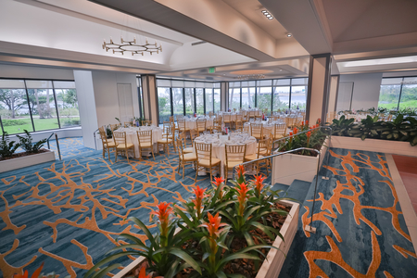
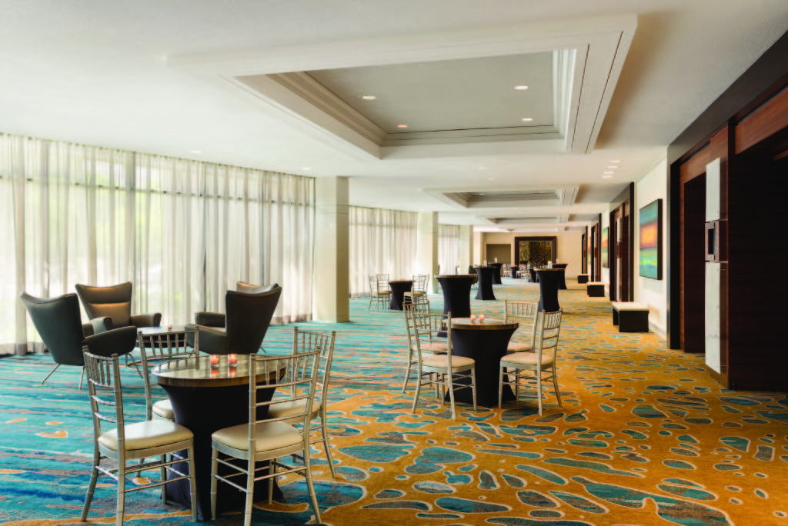
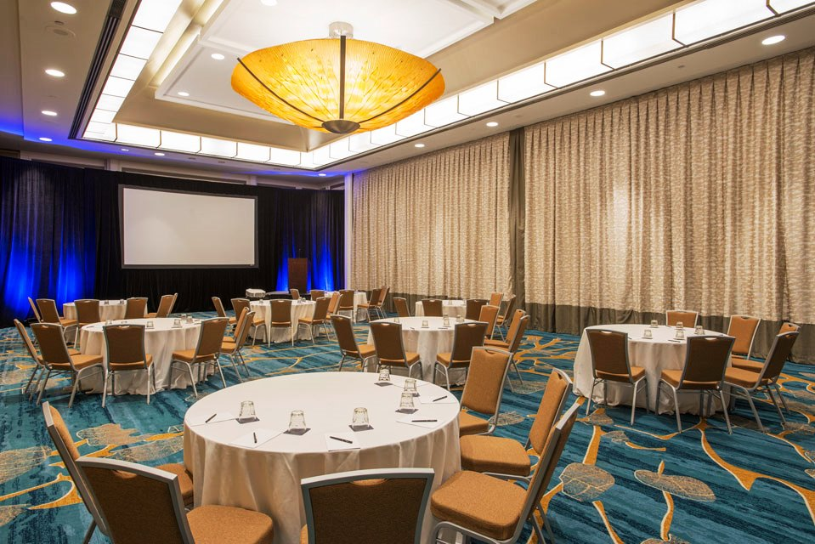
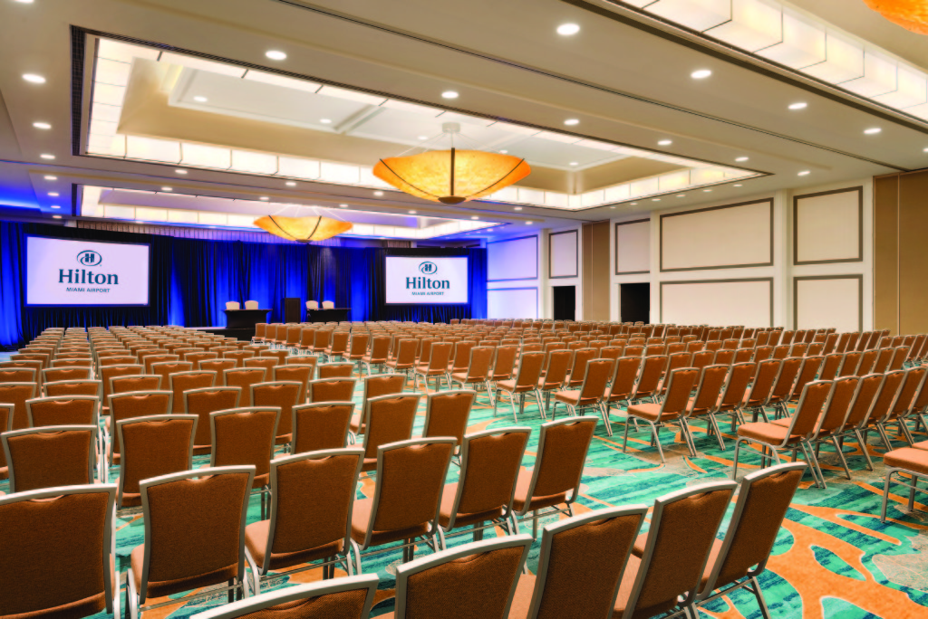
Cove Ballroom
Foyer
Salon
International Ballroom

Slide 7
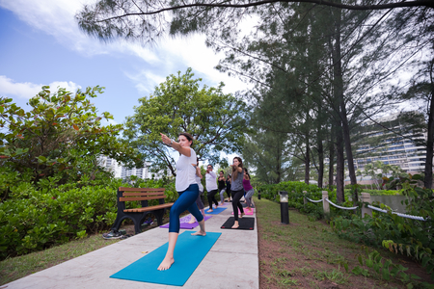
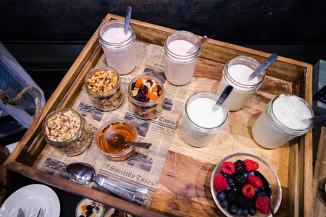
Yoga and Yogurt
Hilton Miami Airport Blue Lagoon
Relaxing tropical grounds perfect for Meet with Purpose, Yoga and Yogurt breaks, fitness options, meditation or breathing sessions and more

Slide 8
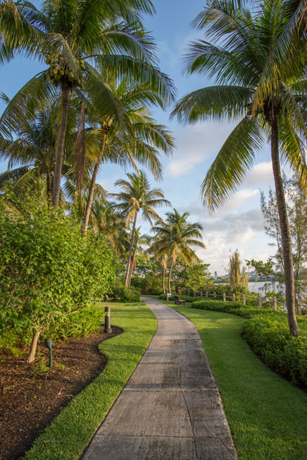
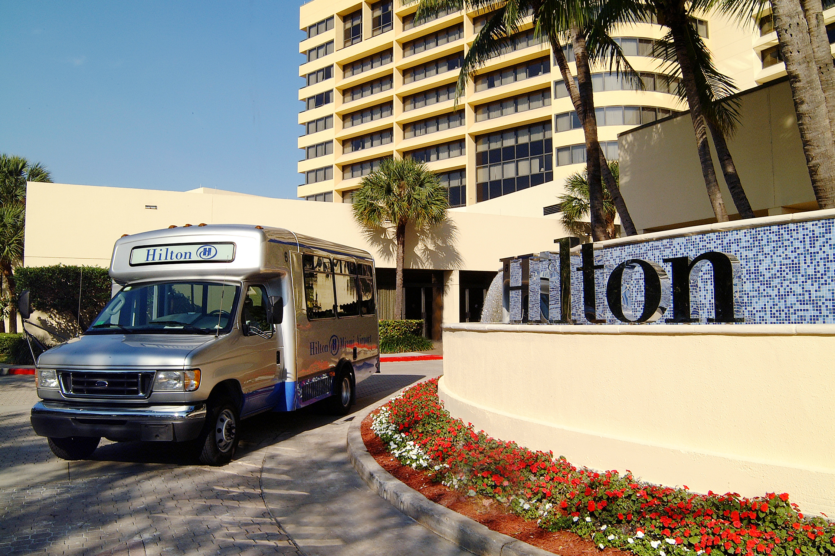
Amenities
Hilton Miami Airport Blue Lagoon
24 hour computer stations with printer
State of the art Fitness Center
Outdoor recreation facilities; Pool, Jacuzzi, Tennis Courts, Basketball court, and jogging path.
1 restaurant, 2 bars, Grab n Go, and room service options.
Complimentary Airport shuttle.
THE PERFECT WAY TO RELAX THE HILTON WAY.
DISTANCE FROM AIRPORT
Approx. 3 mi.

